Slide 1
Enhanced active power control through dynamic estimation of effective wind speed
WindEurope Summit 2016, Power conversion session, 27th September 2016
Salvador E. Boleko-Ribas

Slide 2
Outline
Active power control and primary frequency control and the role of the available active power
Estimation of the available active power by means of the rotor effective wind speed
Application of the rotor effective wind speed estimates to enhance the active power control
Summary and conclusions

Slide 3
Active power control and the role of the available active power
Most modern grid codes demand active power and primary frequency control (APC-PFC)
It is usually realised at two different control levels
At the wind farm control level the available active power plays a relevant role, particularly regarding dispatch
Available active power: Maximum generated active power by a wind turbine given wind kinetic energy and control settings
It depends on air density, nacelle-wind alignment, free-stream wind speed and control settings

Slide 4
How can we assess the kinetic energy in the wind ?
To evaluate the free stream wind speed one met mast (or LIDAR) per wind turbine would be needed
Mostly it is not feasible
We try to estimate its value online by means of a virtual sensor
Rotor effective wind speed estimate
Estimation relies on very simple aerodynamic and electromechanical models

Slide 5
Use of aero-servo-elastic simulation as an oracle
By means of aero-servo-elastic simulation codes we can integrate at will:
Complex and realistic aerodynamics and electromechanical models of the wind turbine;
The actual control algorithms and controller settings;
Wind time series featuring given:
Air density, turbulence and wind speed;
And use it to reliably estimate the available active power lookup tables in a wide range of conditions

Slide 6
Outcome of the aero-servo-elastic simulation
Evaluation of the available active power as a function of the free stream wind speed for various environmental conditions and control settings
Environmental conditions and control settings can make a big difference
A correction to the rotor effective wind speed estimate is needed at wind speeds higher than rated wind speed

Slide 7
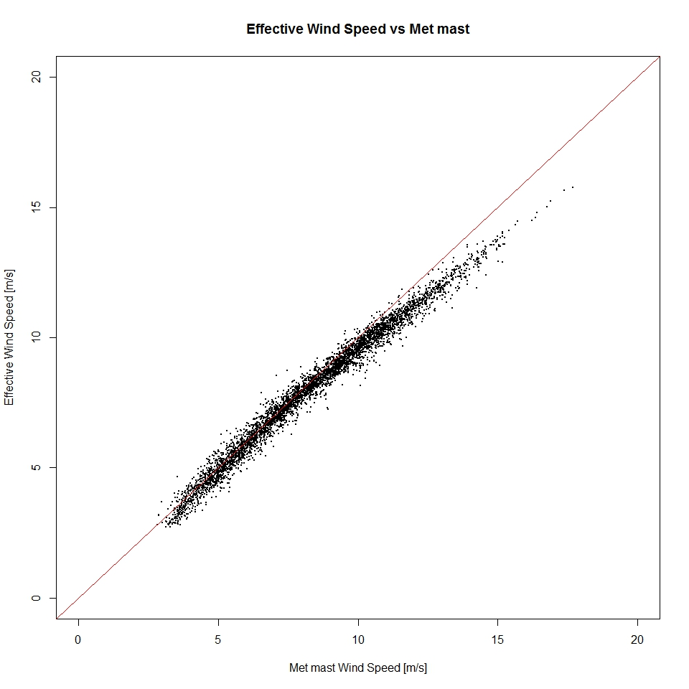
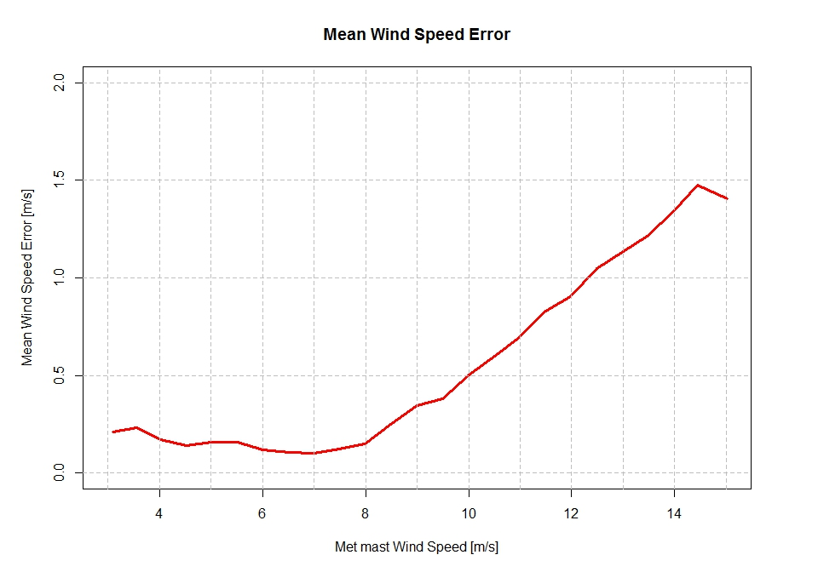
Experimental validation of the rotor effective wind speed estimation
The comparison of rotor effective wind speed estimates with experimental data from calibrated met mast confirms the aero-servo-elastic outcome:
Very good correlation at low and moderate wind speeds
Need for a correcting transformation beyond rated wind speed

Slide 8
Enhanced APC at wind turbine control level (I)
We use an open-loop lookup table to determine the control actions required to track the APC set-point
On the whole it works very well
However, the open-loop approach performance at very low power (e.g. close to cut-in wind speed) is not good enough
Power reserve demand: 50%
Achieved power reserve: 84.5%

Slide 9
Enhanced APC at wind turbine control level (II)
We use the outcome of the rotor effective wind speed estimation to implement a closed-loop solution instead
Feedback control yields:
Improved tracking of the power reserve demand
E.g. from 84.5% to 45.6% for a 50% demand
Improved regulation of the generator angular speed
Reduced downtime of the wind turbine

Slide 10
Enhanced APC at wind turbine control level (III)
Feedback control yields:
Improved tracking of the power reserve demand
E.g. from 84.5% to 45.6% for a 50% demand
Improved regulation of the generator angular speed
Reduced downtime of the wind turbine

Slide 11
Lessons learned
Available active power estimates play a relevant role in the realisation of the APC at wind farm control level
Particularly, they determine the share resulting from the active power dispatch
The devised procedure provides a reliable estimate of the available active power relying on:
Online estimation of the free-stream wind speed through the rotor effective wind speed
Experimentally validated, it requires a correction at high wind speeds
Realistic aero-servo-elastic simulation of different scenarios defined by environmental conditions and control configuration settings
The procedure allows for characterisation and harmonisation of any control strategies concurrent with the APC
E.g.: Aerodynamic noise reduction, de-rating, etcetera
APC performance can be enhanced at the wind turbine control level by means of feedback control at the wind control
Using by-products of the said online estimation
E.g. power coefficient or achieved spinning reserve estimates

