Slide 1
CFD simulations of a wind turbine for analysis of tip vortex breakdown
WINDEUROPE SUMMIT
27 – 29 September 2016, Hamburg, Germany
The University of Tokyo
○Keita Kimura, Makoto Iida, and Chuichi Arakawa
Japan Aerospace Exploration Agency
Yasutada Tanabe, Aoyama Takashi, and Yuichi Matsuo

Slide 2
Outline
0. Todays topic
Background / Objectives
Approach
Results
Conclusions
WindEurope

Slide 3
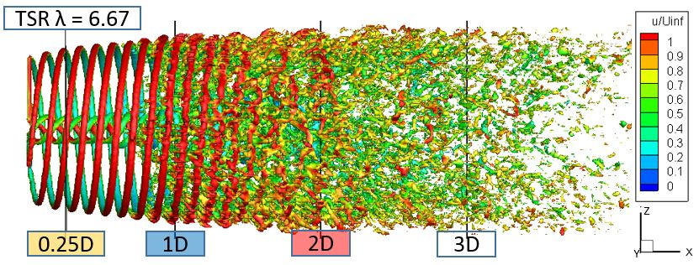
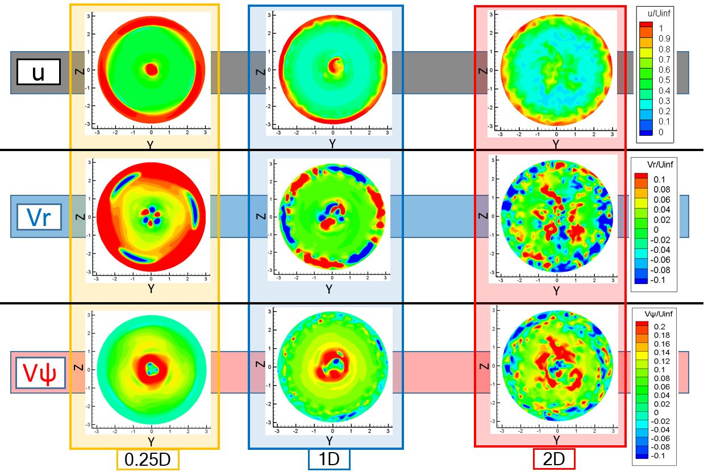
0. Today’s Topic
CFD analysis for WT wake
Tip vortex breakdown process
・helical to minute structure
Near-wake structure
・Radial flow : Vr
・Rotational flow : Vψ
disappearance of Vr and Vψ
corresponding vortex breakdown
D: rotor diameter
Contours of each velocities (λ=6.67)
WindEurope

Slide 4
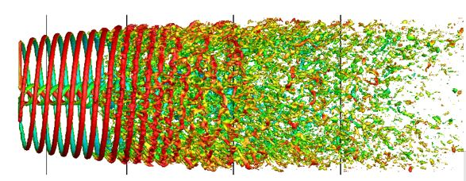
1. Background / Objectives
Wake recovery process
= taking outer flow into wake region
Generated power by a WT of wake region ?
⇒ velocity profile is necesary
Outer flow cannot be taken in
Outer flow
Tip vortex is important for wake analysis
= Obstacle for momentum exchange between outer flow and wake[1]
Wind turbine wake in wind farm [2]
WindEurope

Slide 5
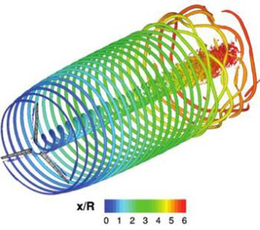
1. Background / Objectives
wake analysis
Difficult to capture by LiDAR or SODAR
Tip vortex analysis
・Unsteady and complex phenomenon
・small scale (∝ chord length@tip )
CFD (Computational Fluid Dynamics) wake analysis
・can get 3D information of wake region
・visualize velocity or/and tip vortex
⇒ useful to understand physical phenomema
Study of the effects of various simulation models[3]
CFD can capture tip vortex clearly[4]
Tip vortex of WT [4]

Slide 6
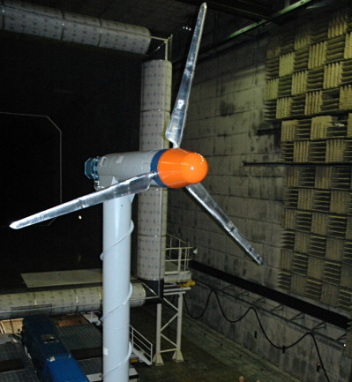
2. Approach
Analysis objective
MEXICO rotor[5-7]
The model rotor has 3 blades and 4.5 m in diameter
PIV(Particle Image Velocimetry) measurement on wake region
Specifications of MEXICO exp. [7]
Rotor diameter [m] | 4.5
Blade length [m] | 2.05
Number of blade | 3
Speed of main flow [m/s] | 10 | 15 | 24
Tip speed ratio [-] | 10 | 6.67 | 4.17
Rated number of revolution [rpm] | 424.5
Chord length [m] | 0.113 ( at 82% span-wise position)
Reynolds number | 8×10⁵
MEXICO rotor[7]
WindEurope

Slide 7
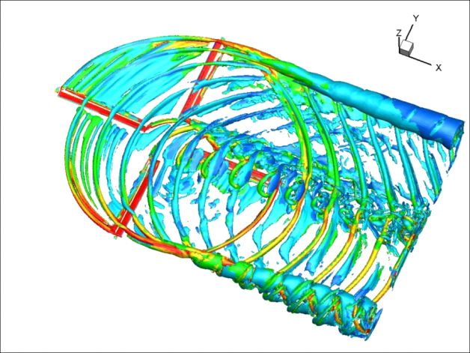
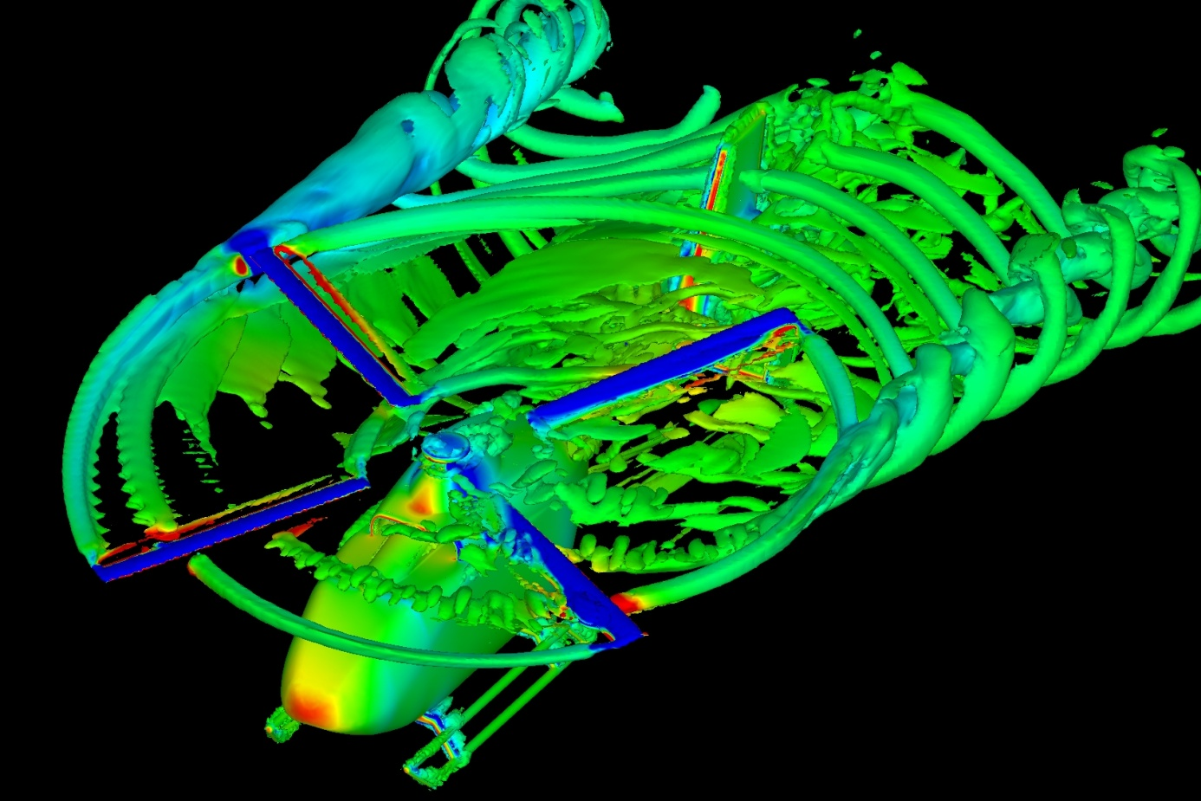
2. Approach
Numerical analysis condition
Using rFlow3D[8]
Developed by JAXA for analyzing rotorcrafts
Moving overlapping grid allowing motions of the rotor blades
Capturing the tip vortices by all-speed numerical scheme SLAU[8] and a fourth order reconstruction FCMT[8]
Numerical Condition(rFlow3D)
Governing equations | Reynolds-averaged Navier-Stokes equations / Navier-Stokes equations
Space discretization | Cell-vertex FVM (Background grid) Cell-centered FVM (blade grid)
Inviscid flux | SLAU[9]
Reconstruction | 4th order Compact MUSCL TVD interpolation [8]
Turbulence model | Spalart-Allmaras[10]
Rotation of wind turbine | Moving Overlapped Structured Grids
Time integration | 4th order Runge-Kutta (Background grid) LU-SGS/LU-DUR implicit method (Blade grid)
Tip vortices of helicopter captured by rFlow3D[7]
WindEurope

Slide 8
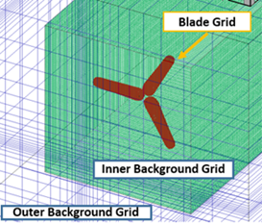
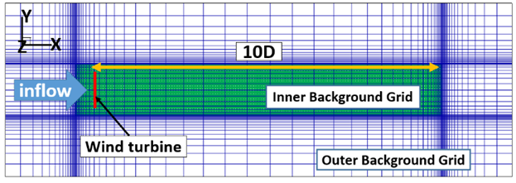
2. Approach
Computational grid
※diameter of the rotor D = 4.5 [m]
※chord length at 82% span c = 0.113 [m]
Grid around blade region
Grid around wake region
Computational grid information
The set of grid is composed of
・Blade Grid
⇒ moving grid
・Inner Background Grid
⇒high resolusion (0.32c) for
capturing tip vortices
・Outer Background Grid
⇒ determines the analysis domain
 | Blade Grid | Inner Grid | Outer Grid
partition (I×J×K) | 121×121×61 | 1307×187×187 | 151×101×101
domain | - | 10.5D×1.3D×1.3D | 14.5D×5D×5D
Minimum space | $$y^{+}≈1$$ | 0.32 c ( c = 0.113 m) | 0.32 c
number of Cell | 900K | 46M | 1.5M
WindEurope

Slide 9
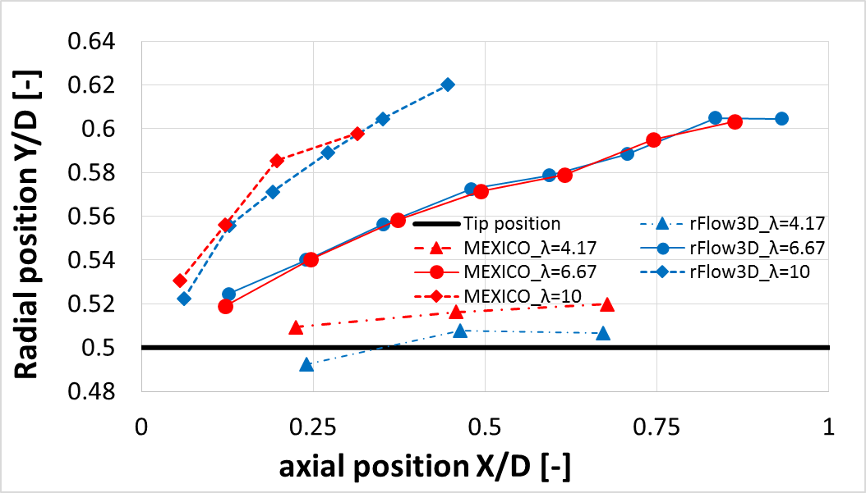
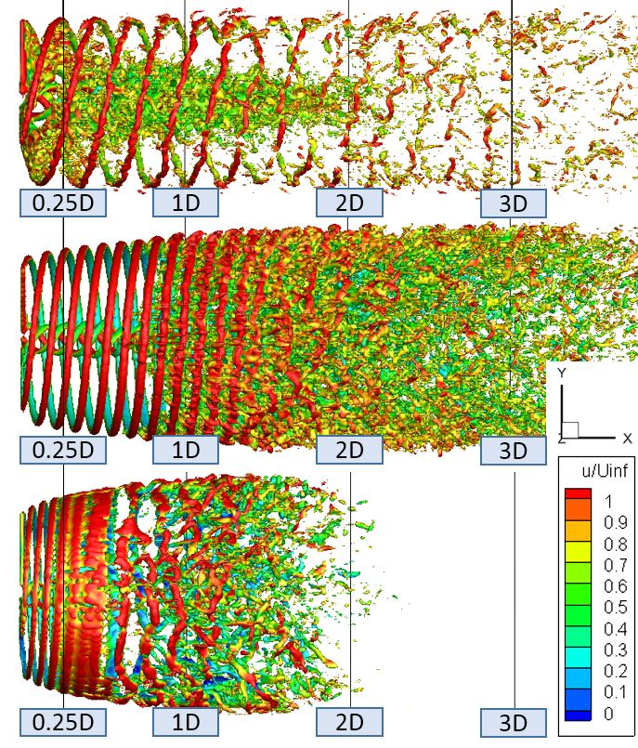
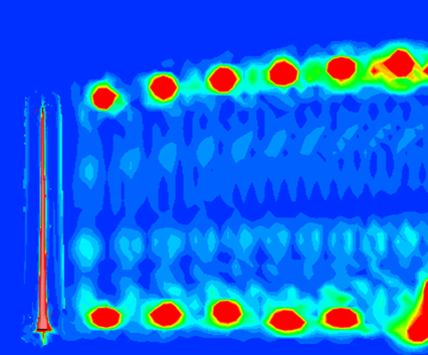
3. Results – wake analysis -
Vortex breakdown process
λ = 4.17
Increase of TSR
Dynamic separation
tip vortex
λ = 6.67
Hecilacal
structure
Y axis
Positions of tip vortex core
Minute instabilities
λ = 10
X axis
When TSR increases, distance between vortices get close and encourage vortex interactions
Wake expansion rate increases with high-TSR
Iso-surface of normalized vorticity = 0.5
(top: λ=4.17, middle: λ=6.67, bottom: λ=10)
WindEurope

Slide 10
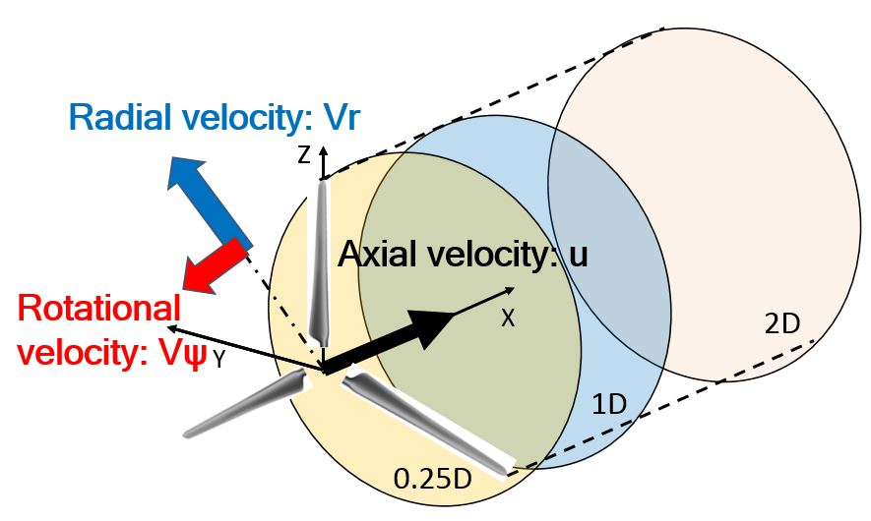
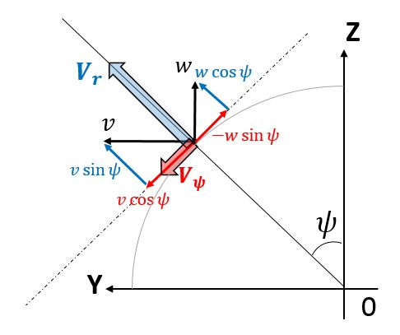
3. Results – wake analysis -
Velocity distributions
Convert into cylindrical frame of reference
・(u,v,w) ⇒ (u, Vr, Vψ)
Visualise each velocities
・visualize contours of (u, Vr, Vψ)
at 3 positions (0.25D, 1D, 2D)
$$V_{r}=v\sin{ψ}+w\cos{ψ}$$
$$V_{ψ}=v\cos{ψ}−w\sin{ψ}$$
⇒ Radial flow
⇒ Rotational flow
Decomposition velocities of Cartesian coordinate system into radial and azimuthal velocities
Positions of visualization
WindEurope

Slide 11
3. Results – Design point -
Velocity contours (λ = 6.67)
D: rotor diameter
Radial flow : Vr
・ corresponds to wake expansion
・ disturb momentum exchange
between outer flow
Rotational flow: Vψ
・ exists inside wake region
Disappear with vortex breakdown
(note that Vr disappears faster than Vψ)
Contours of each velocities (λ=6.67)
WindEurope

Slide 12
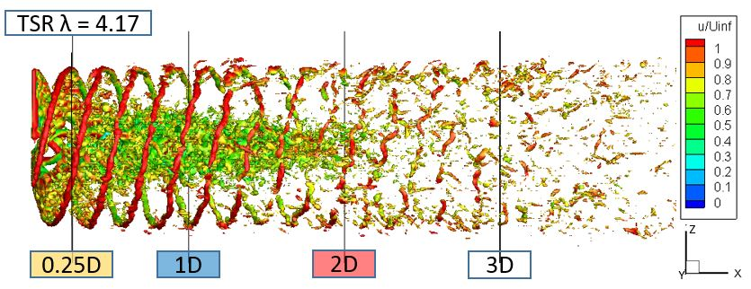
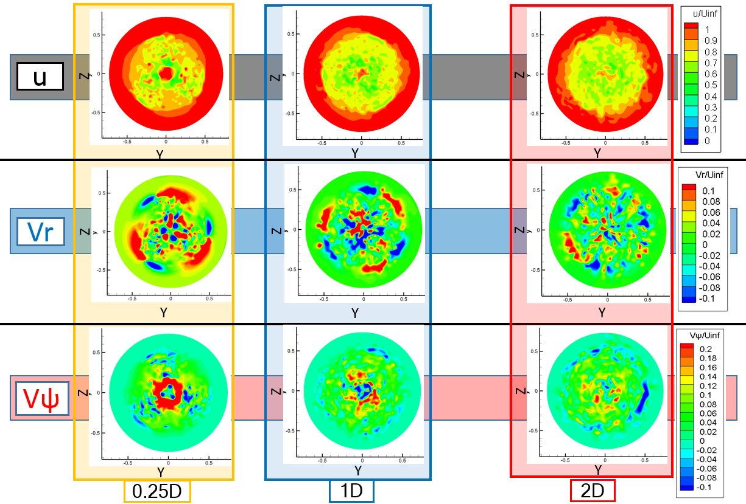
3. Results – Low TSR case -
Velocity contours (λ = 4.17)
D: rotor diameter
AOA : angle of attack
Low TSR (High AOA)
⇒ separated flow with vortices
Wake region is not expanded
( rotational effect is weak)
Vr and Vψ are relatively weak because of dynamic separation
Contours of each velocities (λ=4.17)
WindEurope

Slide 13
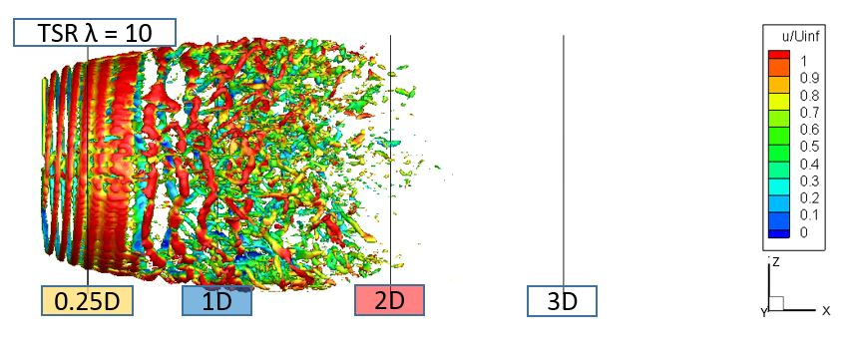
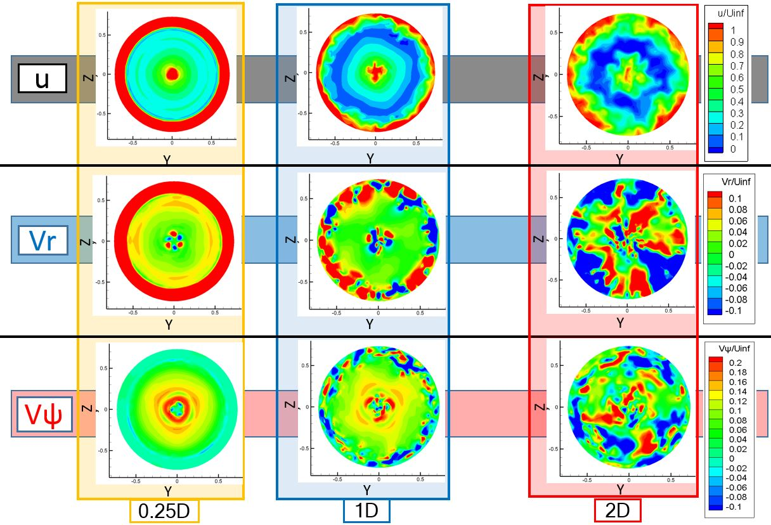
3. Results – High TSR case -
Velocity contours (λ = 10)
D: rotor diameter
High TSR
⇒ rotational effect increases
Momentum exchange between outer flow
Vr and Vψ are similar tendency of λ = 6.67
Disappearance of Vr and Vψ becomes faster than λ = 6.67
Contours of each velocities (λ=10)
WindEurope

Slide 14
4. Conclusions
Conclusion
Tip vortex breakdown:
・helical structure and vortex instability are captured clearly
・When TSR increases, wake expands greatly and vortex interactions
are encouraged
Relation between each velocities
・Vortex breakdown correspond momentum exchange between
outer flow
・WT wake has radial and rotational flow and they disappear
with vortex breakdown
WindEurope

Slide 15
Thank you for your kind attention.
WindEurope

Slide 17
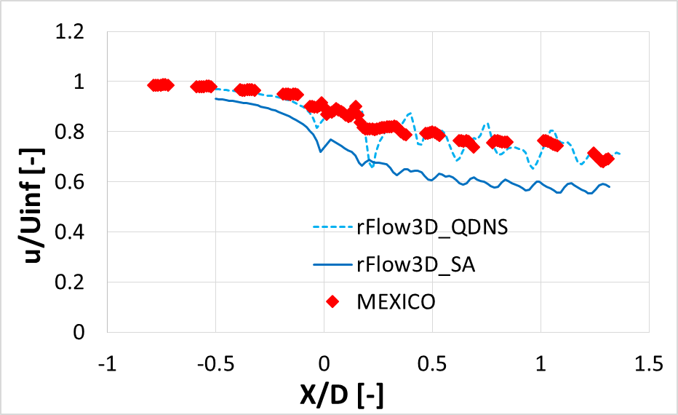
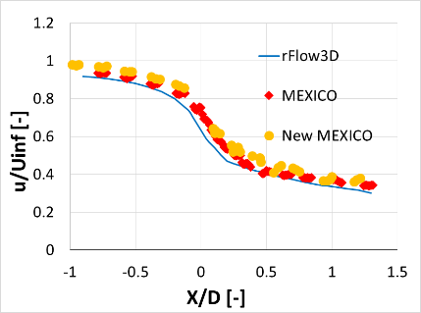
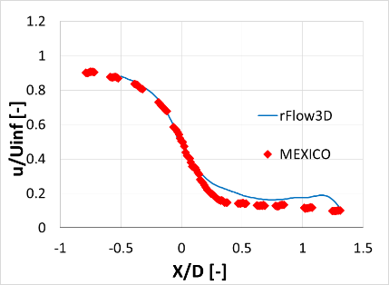
3. Results – validation -
rFlow3D vs MEXICO exp.[4]
24 m/s λ = 4.17
15 m/s λ = 6.67
10 m/s λ = 10
15 m/s λ = 6.67
Axial traverse of axial velocity at r = 1.8 m [4,10]
Comparison of axial velocity deficits
・X(axial position) and U(axial velocity) is normalized by Diameter and speed of main flow
・good agreement with MEXICO exp.
・Overestimate in λ = 4.17 b/c delayed separation with SA model[11]
WindEurope

Slide 18
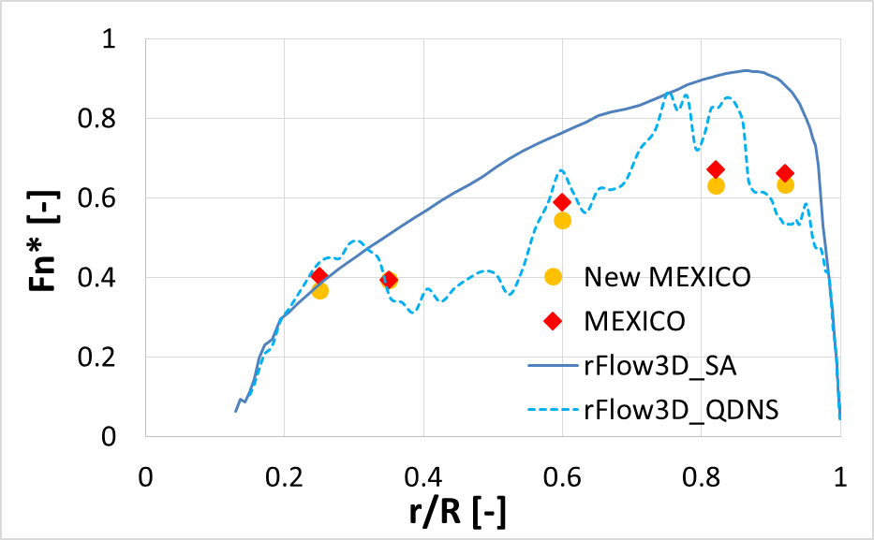
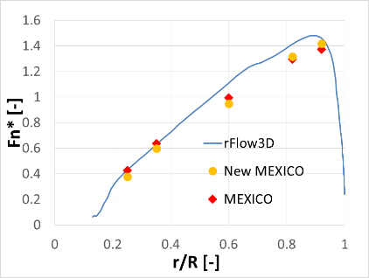
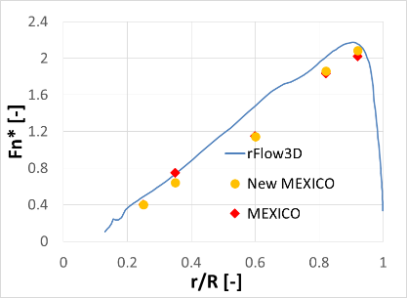
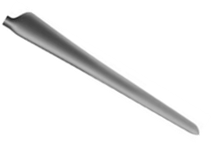
3. Results – validation -
●Axial force
24 m/s λ = 4.17
15 m/s λ = 6.67
10 m/s λ = 10
Radial distribution of axial force
Axial force
r/R = 0
r/R = 1
・Axial force (＝Thrust) also has good agreement with MEXICO
・QDNS shows the effect of separation
inflow
WindEurope

