Slide 1
EU Grid Code Compliance
& equipment certification (EC) according to Network Codes

Slide 2
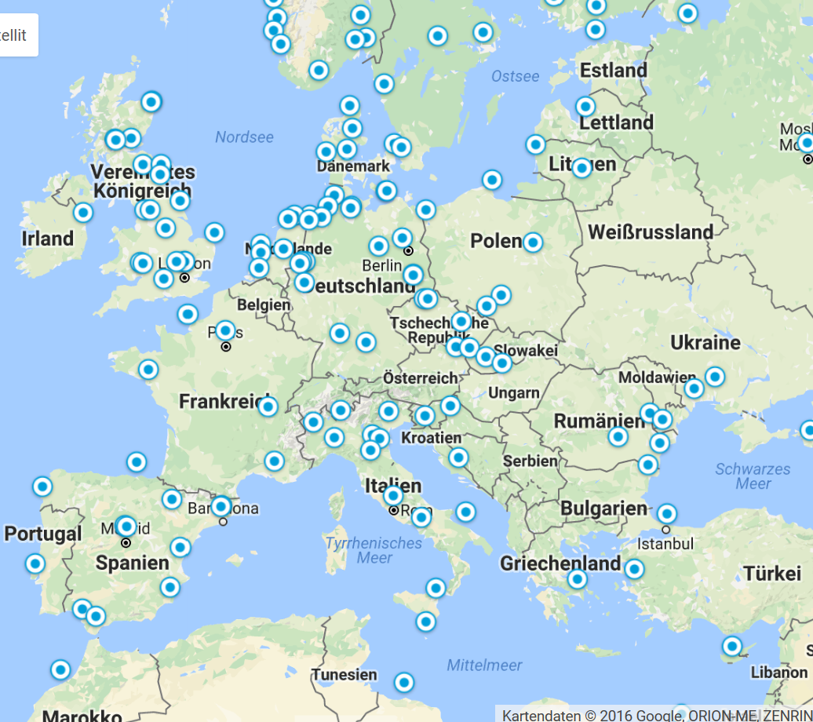
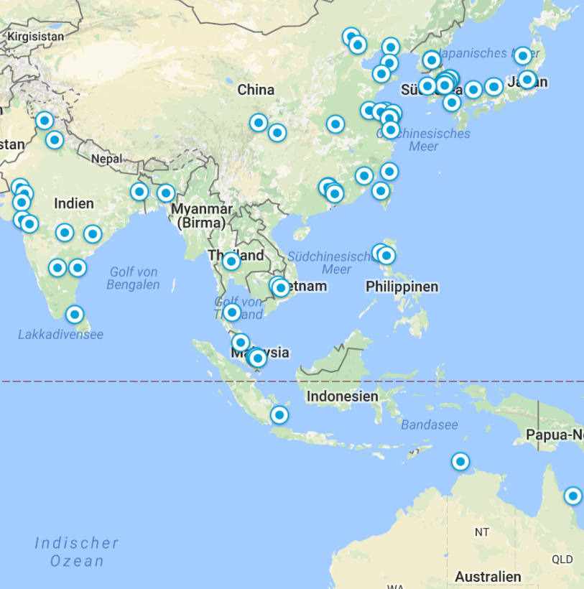
Authors and international offices in EU and Asia Pacific

Slide 3
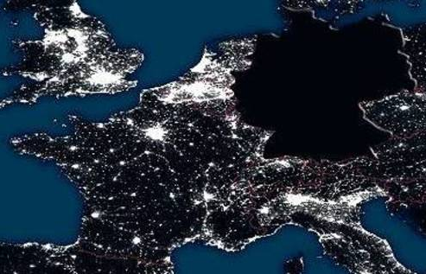
Scope within this presentation: Grid Code Compliance only
Grid Code Compliance only
“Type Certificate” used for different subjects
Clarification brings checking the evaluation criteria (usually a standard etc.)
Type Certificate
Structural Integrity means avoiding this:
IEC 61400
GL 2010
DNV GL
Danish
BSH
Etc.
Type Certificate
Grid Code Compliance means avoiding Black-Outs:
ENTSO-E
NC RfG
AEE
FNN
BDEW
FGW
In combination with DNV GL Service Specification GCC as certification procedure

Slide 4
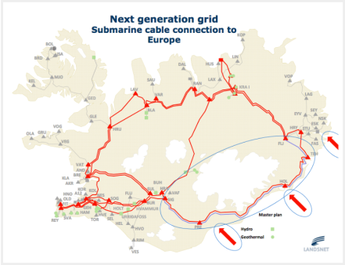
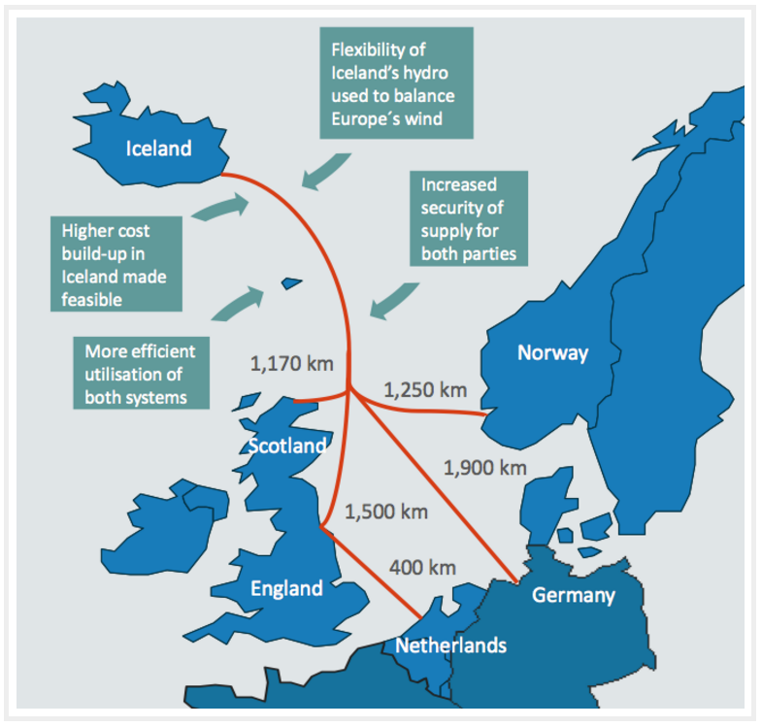
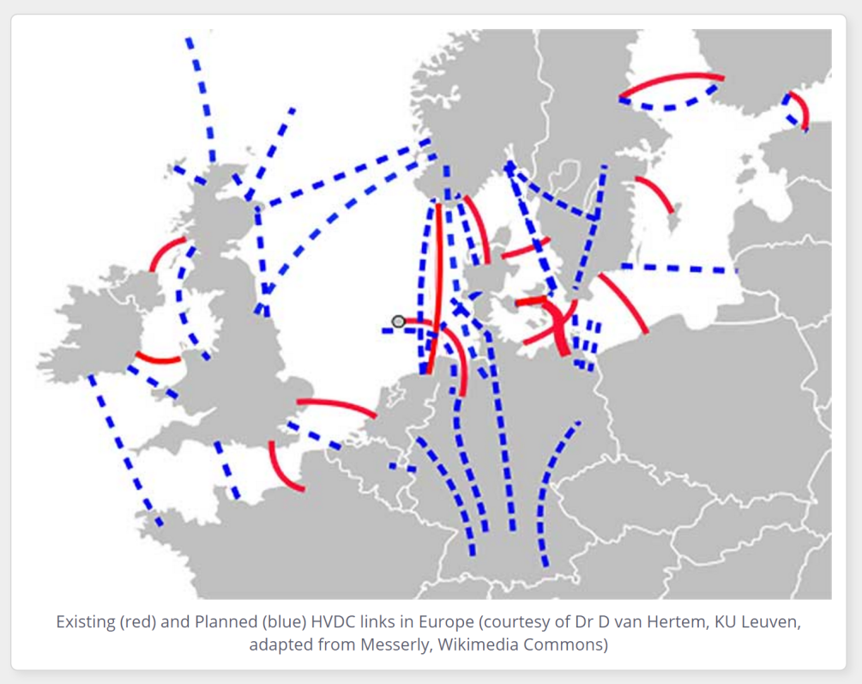
EU Grid
Source: http://images.google.de/imgres?imgurl=http://www.eee.manchester.ac.uk/media/eps/schoolofelectricalandelectronicengineering/research/pc/images/HVDC_Europe700x495.jpg&imgrefurl=http://www.eee.manchester.ac.uk/our-research/research-groups/pc/researchareas/powerelectronics/vsc/&h=495&w=700&tbnid=mOYT6xmp0dBCdM:&tbnh=90&tbnw=127&docid=xMAOkS6YDNnpEM&usg=__F6dpa2IrtuHfG0AhwyEjvYx3-F8=&sa=X&sqi=2&ved=0ahUKEwi51fmez6zPAhUEChoKHes_DH4Q9QEILTAB
Source: http://www.amprion.net/ucte-verbund-verbundnetz-regelzonen
http://images.google.de/imgres?imgurl=https://askjaenergydotcom.files.wordpress.com/2011/11/landsnet-iceland-tso-next-generation-grid-hvdc-cable-to-europe.png&imgrefurl=https://askjaenergy.com/transmission/hvdc-subsea-link/&h=637&w=837&tbnid=4deoJwaoHgtQUM:&tbnh=90&tbnw=118&docid=HQowpOb8rKFm8M&usg=__Gq3UoE9DmA_l8sgraEKt4v5epY8=&sa=X&sqi=2&ved=0ahUKEwi51fmez6zPAhUEChoKHes_DH4Q9QEIOTAH

Slide 5
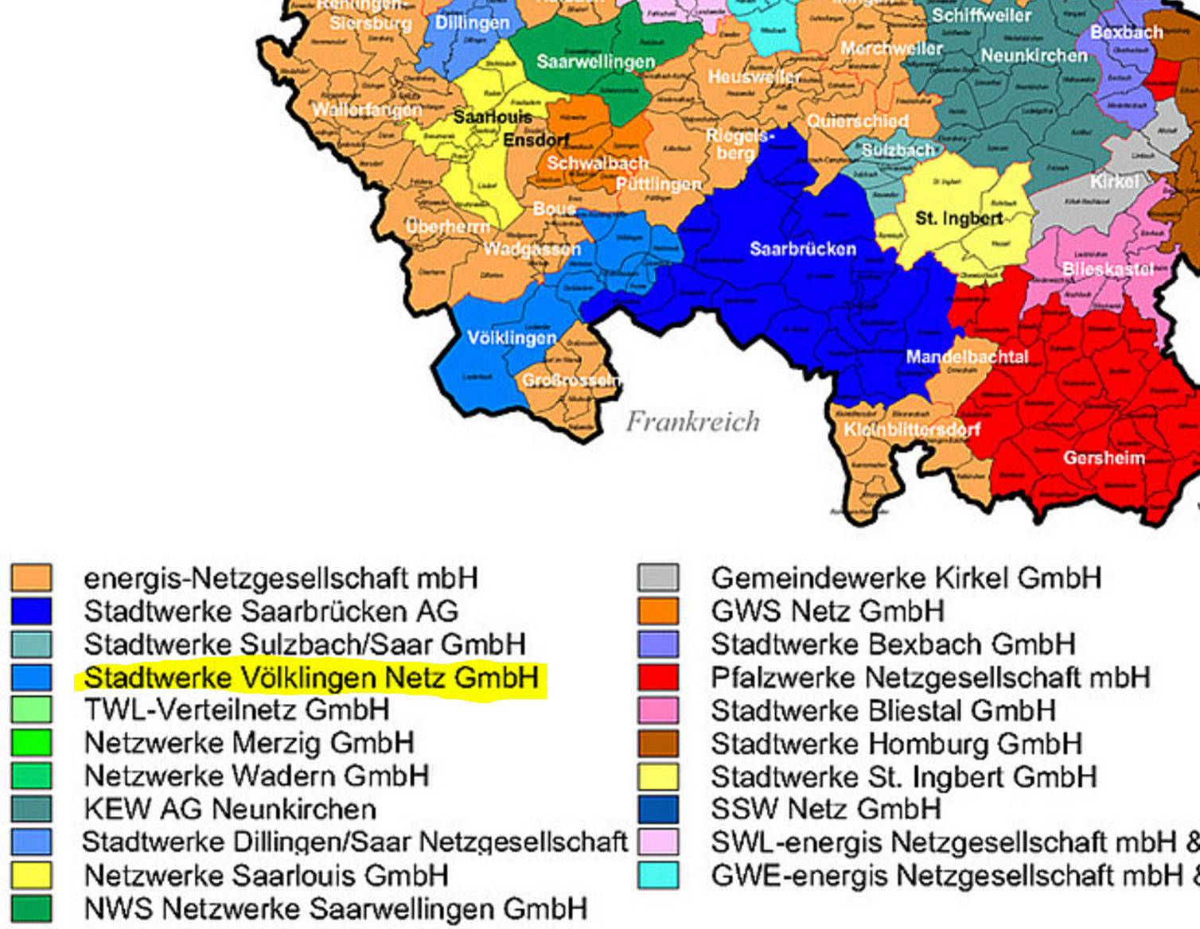
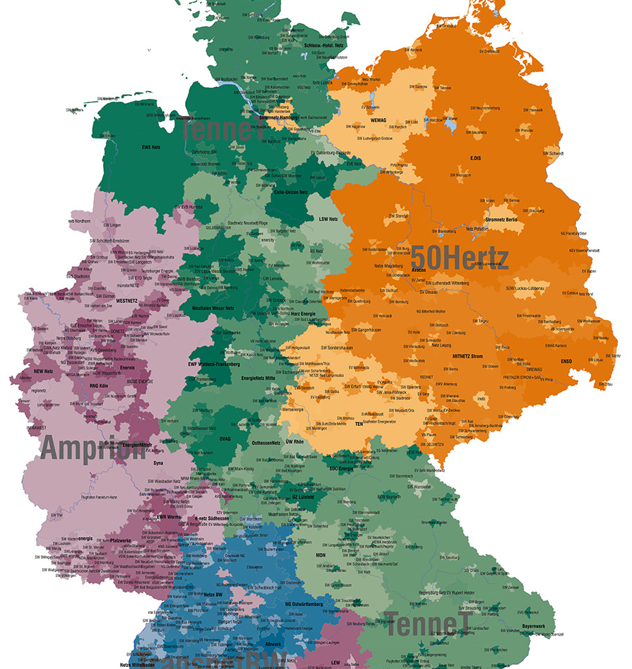
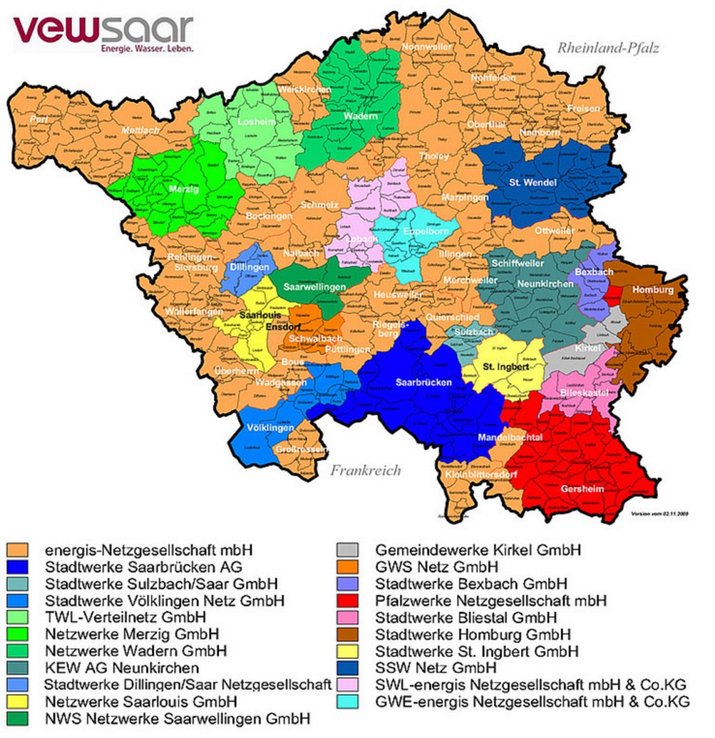
System operator, EU wording: Relevant Network Operator (RNO)
Assume a wind farm in Germany close to France
Who is RNO?
Is it a TSO?
Connection to medium voltage: DSO
Here it is, marked in yellow
https://www.stadtwerke-bliestal.de/fileadmin/_processed_/csm_strom-netz-saar_0855c37839.jpg

Slide 6
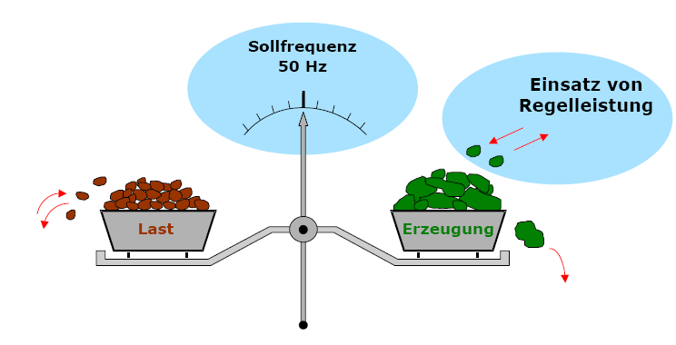
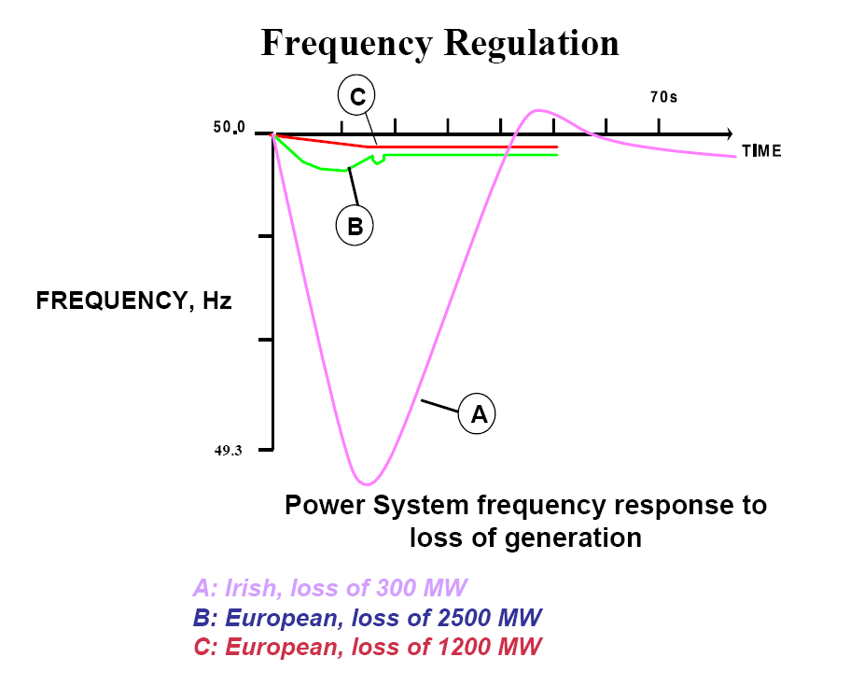
Two examples why grid codes must exist: Frequency Control and fault current injection
Consumption and generation need to be balanced continuously.
To date monitored by: Frequency
Future: unclear
Balancing power
Balancing Power
consumption
Generation
Behaviour during faults (means during voltage dips)

Slide 7
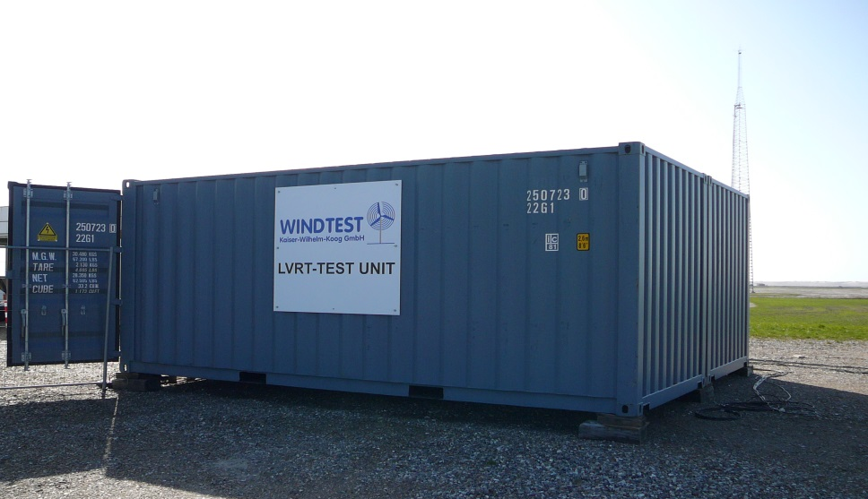
UVRT field dipping (fault ride-through)
2
Spannung
1
Fault

Slide 8
Two examples why grid codes must exist: Frequency Control and fault current injection
Consumption and generation need to be balanced continuously.
To date monitored by: Frequency
Future: unclear
Balancing power
Balancing Power
consumption
Generation
1.
2.
x...
Grid Code
For Country
A,
B,
C,
….
Behaviour during faults (means during voltage dips) could be required differently:
active current injection
Reactive current injection
Specific characteristic

Slide 9
Certification
Basically means comparing and stating conformity (if subject complies with the evaluation criteria)
In our case (Grid Code Compliance) this needs:
Grid Code
For Country
A,
B,
C
Test Standard & Test Results
Certificate
According to Certification Procedure in combination with Grid Code A,
B,
C
Other validation
Certification Procedure
Assessment
Product or Project

Slide 10
Objectives: Ways to proof that wind farms conform with grid code
Multitude of Grid Codes challenging. (see: www.dnvgl.com/GridCodeListing.pdf )
Certification helps by summarizing requirements and re-use existing tests.
EU has put into force Network Codes (NC), valid for all 27 countries.
Here: NC RfG (Requirements for Generators).
Implementation timelines:
2018 for system operators.
2019 for plant operators and wind turbine manufacturers.
Conformity shall be proofed. System operators (RNO) have to decide.
Part of this proof of evidence are certificates, so called equipment certificates.
Equipment certificates might be required by law, up to national decisions.
Scope not generally defined, resulting in confusion.
The work to be presented here is a complete system for grid code compliance (GCC) including equipment certificates, flexible enough to cover all needs and requirements. It is called Service Specification covering all kind of GCC Services

Slide 11
Objectives: Why and how – Methodology of developing the Service Specification GCC
Public hearing led by DNV GL with:
Supporting the grid is required
publicly available description was missing saying “how to proof” (& test)
DNV GL issued the first description how to proof and certify in 2005
Various national service specifications followed
Spain: AEE
Germany: BDEW, FGW, SDLWindV, FNN
DNV GL decided to further develop its unique world wide applicable International Service Specification GCC (formerly called “Technical Note”) in 2015

Slide 12
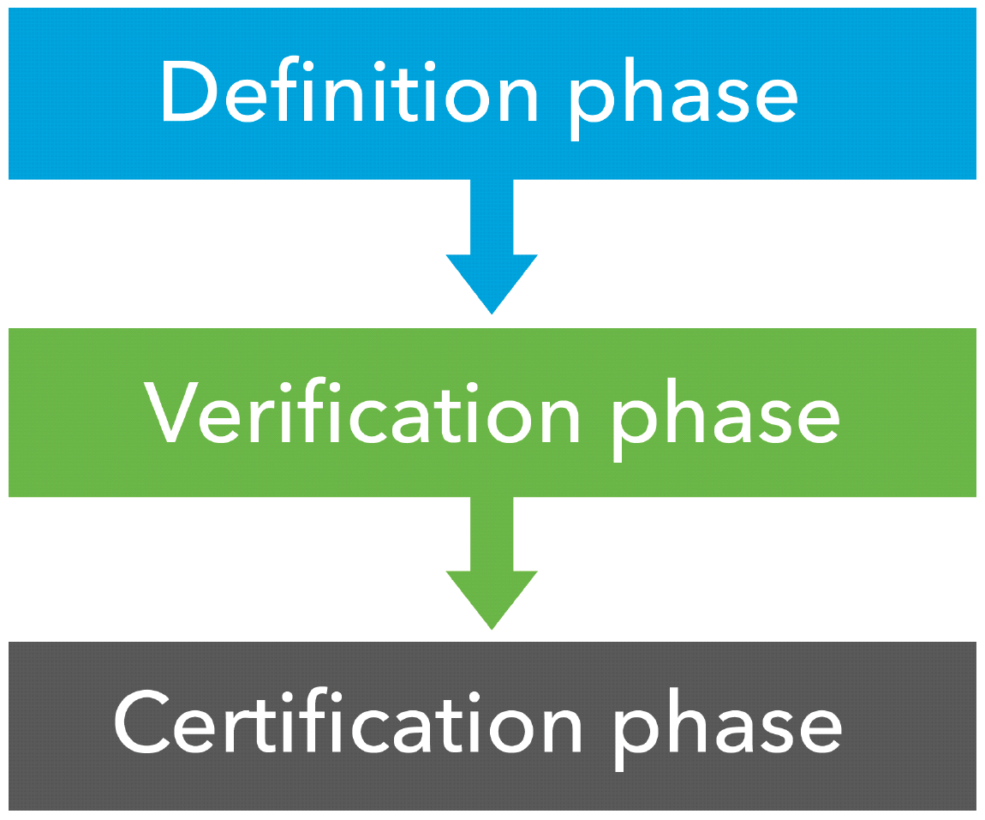
Descriptions: Structure of the Services GCC (Grid Code Compliance)
Requirements: taken from Grid Codes or defined according definitions
What to test: a tailor-made test plan will cover the needs, principles of test plan preparation is already standardized by DNV GL
Scope: depending on the application
Component
Equipment
Type
Project
Acceptance: depending on customers wish, 3 options available:
Full acceptance by system operator (GCC-Class I)
Fulfilling defined rules and grid codes completely (GCC-Class II)
Fulfil well-defined features only (list of feature definition available)

Slide 13
Descriptions: Definition of Equipment Certificate in the NC RfG: one para only.

Slide 14
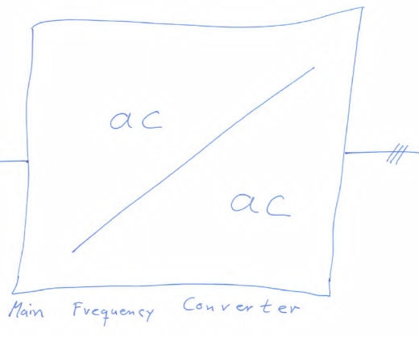
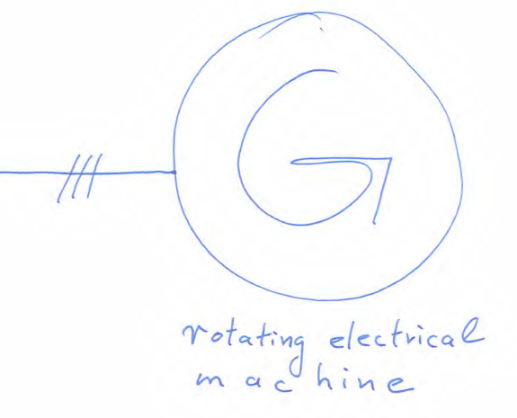
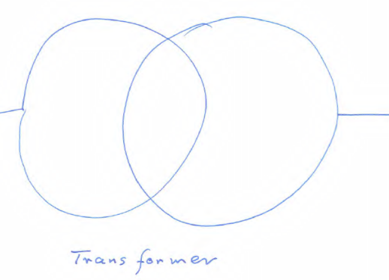
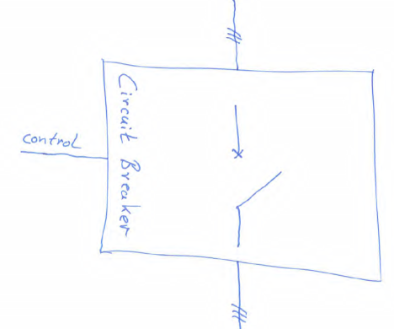
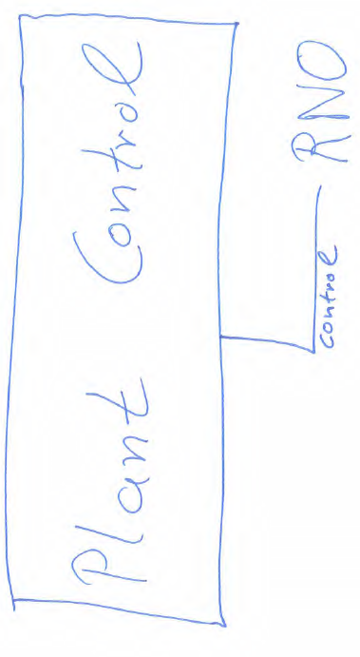
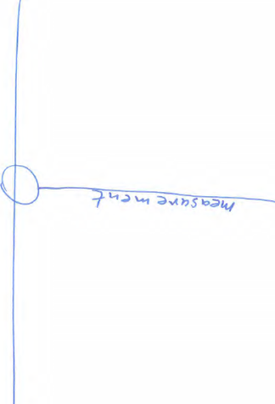
Equipment

Slide 15
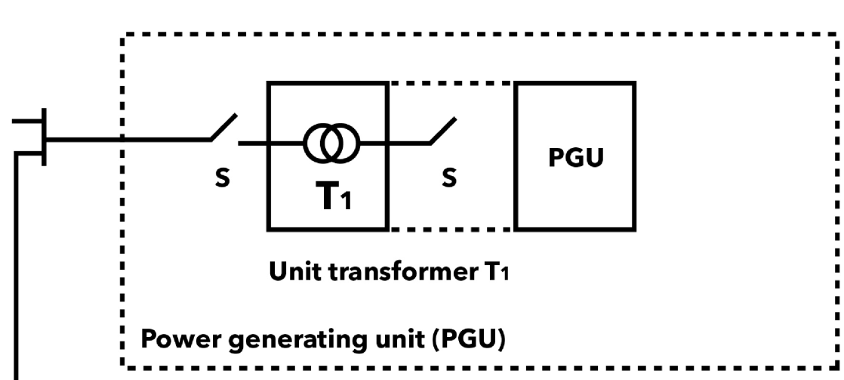
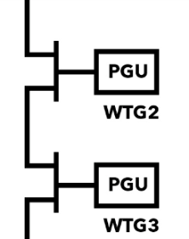
Units

Slide 16
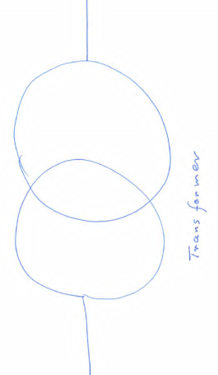
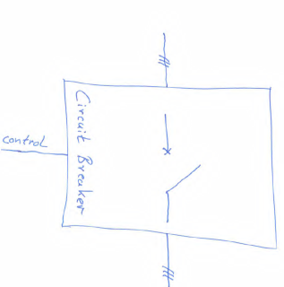
Wind plant can be a power generating module
Wind Plant

Slide 17
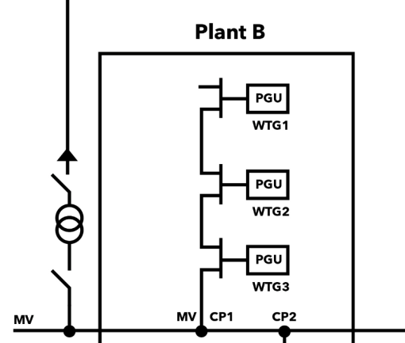
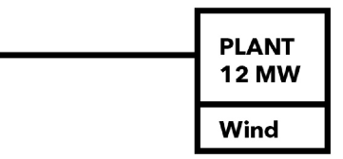
Descriptions: Even puzzles are depending on the observer’s perspective
Plant B
Windsor Wind Plant
Windsor Wind Plant

Slide 18
Module and facility
Power generating facility
Power park module
Windsor Wind Plant
RNO: medium voltage DSO

Slide 19
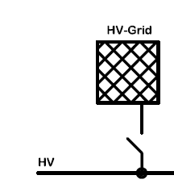
Module and facility
RNO: High Voltage Transmission System Operator (TSO)
Power generating facility
Power park module
Windsor Wind Plant

Slide 20
Solution EU Grid Code Compliance
Project Certificate for the site
(Equipment Certificate for module)
Type Certificate for EU
(Equipment Certificate units)
Annex to
Type Certificate for Country
A
Component Certificate for Plant Control
(Equipment Certificate)
B
C

Slide 21
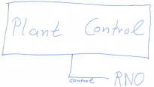
Solutions: The full picture regarding different parties involved
Acting Party | Equipment | Thread | Approving Party | Solutions
Manufacturers: Turbines Electr. Machines Switchgear Protection Converters | transducers Relays etc. | Design might not fit the market | (Building) Authority Bank Unknown RNO | Equipment Certificates Cover all countries of relevant market: Pre-Screening Reports
Developer | Site suitability, planning a plant | Grid connection requirements | None, RNO only after site is clear | Pre-Screening Report per country, getting site specific requirements
Engineering (plant) | See Manufacturer | To forget about one important grid code requirement | RNO | Preliminary Project Certificate (Planning Certificate)
Procurement | See Manufacturer | Buying the wrong turbine | RNO | Buying equipment having certificates acceptable for the site specific requirements
Construction | Cable | Not as planned | RNO | Engineering should be checked via certification
Commissioning | Settings, functions | Not as planned | RNO | Certification should cover it
Operation | Plant | System change | RNO | Compliance monitoring

Slide 22
Various perspectives why this is a solution
Put verification cost to other parties (as long as synergies exist)
Expensive Testing need only to be done once
EU-wide requirements (exhaustive) can be verified for all EU
Validation of simulation models can be done once per turbine type
No time delay, no cost increase during EPC of Wind Plants
Use only turbines with EU Type Certificate (Equipment Certificate)
Use only turbines with national Annex for the proper country
Plant engineering stays local, only little additions for local requirements
RNO have different possibilities within the coming 2 Years
Maximum in-house-know-how: Do all by themselves
Reduced effort: Demand Equipment Certificates for modules
Keep full control with least effort: Demand Equipment Certificates for facility
Increase quality with little effort: Demand GCC-Class I and define extras

Slide 23
Thanks for listening.
Looking forward to designing your Equipment Certificate!
How can we support you?
Tobias Gehhaar
Tobias.Gehlhaar@dnvgl.com
+49 (0) 40 36149 7577

