Slide 1
Storm Britta
Xiaoli Guo Larsén (xgal@dtu.dk)
Jianting Du (jitd@dtu.dk)

Slide 2
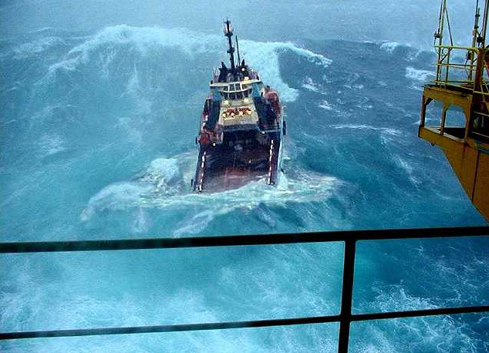
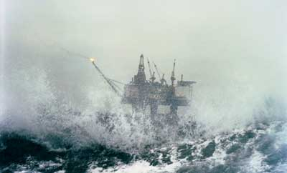
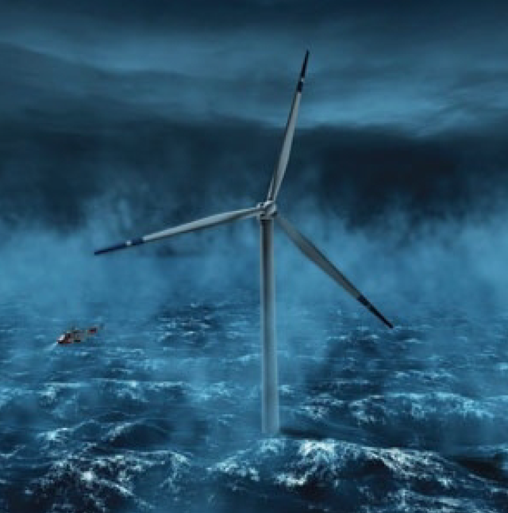
Storm Britta: context
The X-WiWa Project: EXtreme Winds and Waves for Offshore Turbines – Coupling atmospheric and wave modelling for design and operation in coastal zones
Key deliverables of X-WiWa:
A modelling system
Extreme wind map
Extreme wave map

Slide 3
Storm Britta: context
Challenges in modeling storm winds and waves
Storm postion, path, size, intensity and spatial distribution of wind field
Accurate wind input important for wave modeling
Wave modeling is missing the peak

Slide 4
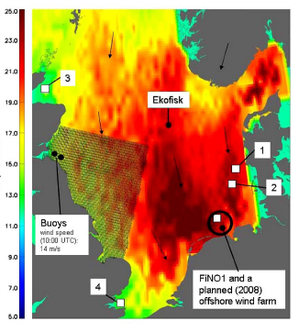
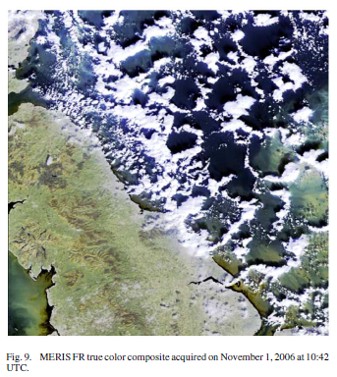
Storm Britta: context |Characteristics
Facts from the literatures:
Brusch et al. 2008
Hs about 10 m at FINO 1 (20-year value)
Max wave height 18 m at FINO 1
Strong winds in Quikscat data
Presence of open cells
HIRHAM modeling (7 km) did not reproduce open cells

Slide 5
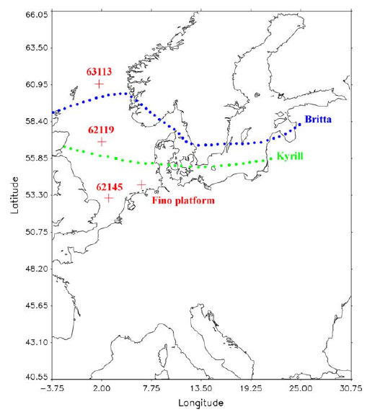
Storm Britta: context |Characteristics
Facts from the literatures:
Brusch et al. 2008
Behens and Günther 2009
Britta
Kyrill
DWD and WAM captured Hs quite well at FINO 1
Britta and Kyrill: different paths, different strength
Open cells not modeled, not mentioned

Slide 6
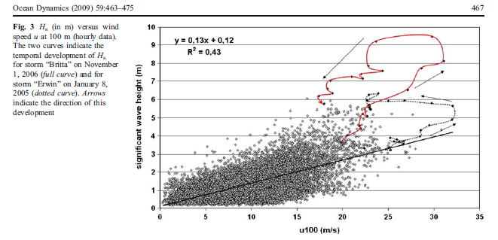
Storm Britta: context |Characteristics
Facts from the literatures:
Britta
Brusch et al. 2008
Behens and Günther 2009
Emeis and Türk 2009
Erwin
Measurements at FINO 1
Britta and Erwin:
Unstable and stable
Similar wind strength, much larger Hs at Britta

Slide 7
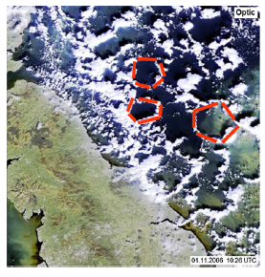
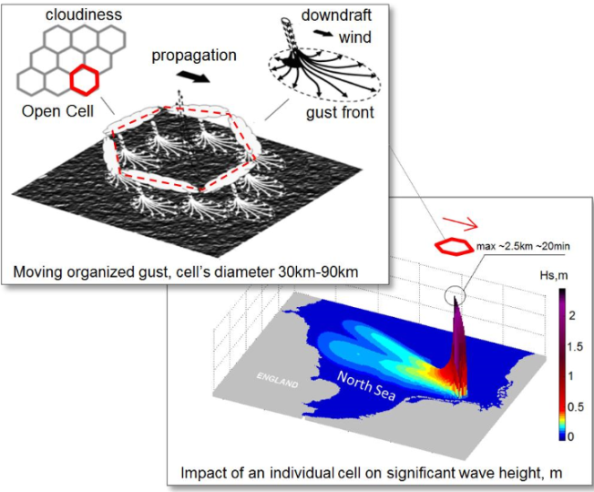
Storm Britta: context |Characteristics
Facts from the literatures:
Brusch et al. 2008
Behens and Günther 2009
Emeis and Türk 2009
Pleskachevsky et al. 2012
Storm-in-storm structure updated in wind field
Spectral wave modeling, 1 km
”open cell wind” leads to increase of 6 m in Hs

Slide 8
Storm Britta: context |Research Topic
*Is stability the cause to the extreme wave at FINO 1?
*Is open-cell the cause to the extreme wave at FINO 1?
*What is the mechanism behind that caused the extreme wave at FINO 1?

Slide 9
Findings
Not stability directly…
Not open cells…
It is the intensive cold front with a special path…

Slide 10
Method
Combination of various types of measurements, reanalysis data and mesoscale numerical modeling
Use COAWST modeling system (WRF+SWAN)
Analysis of groups of storms of different conditions (stability, open cells, storm path, storm intensity)

Slide 11
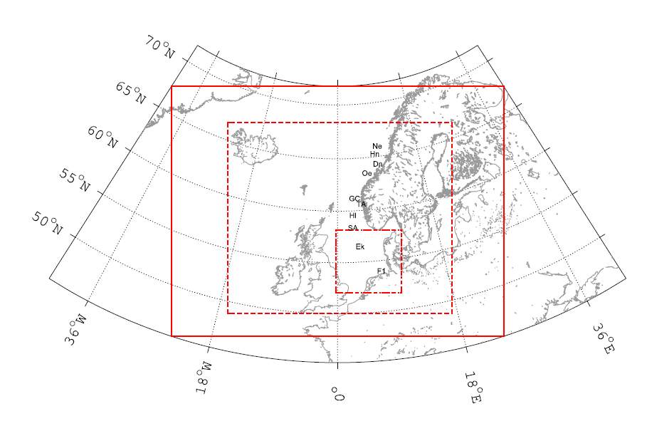
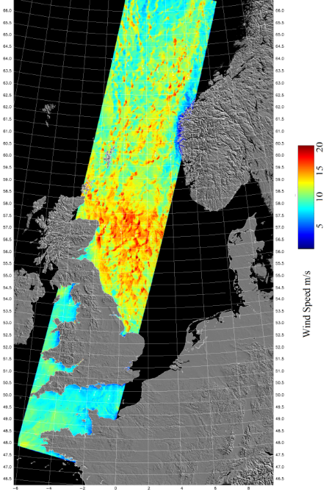
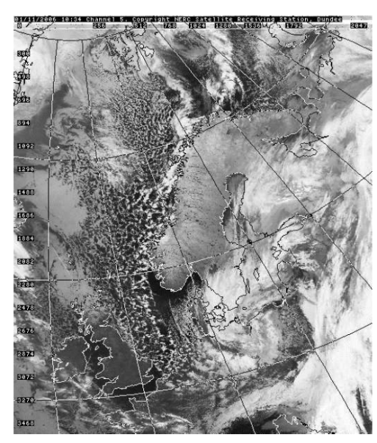
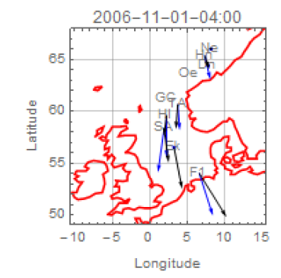
Measurements

Slide 12
Modeling system
2-way online
Nested: 18 – 6 – 2 km
2006-10-30 to 2006-11-02
36 hours for each run
WRF:
CFSR + SST
46 vertical sigma levels
MYNN 3.0 PBL scheme
Thompson microphysics scheme
RRTM long and short wave radiation
Kain-Fritsch cumulus scheme (I, not II & III)
Corine land use
WRF
U₁₀ ,V₁₀
I
II
SWAN:
1/8 arc-minute bathymetry data
Initiated with JONSWAP spectrum
Outer domain open boundaries with JONSWAP spectrum with Hs = 0.5 m, Tp=1 s
36 directional bins, resolution of 0.1 f and 0.03 Hz < f < 1.02 Hz.
Komen input and dissipation source func.
III
SWAN
z₀ (T_{p})

Slide 13
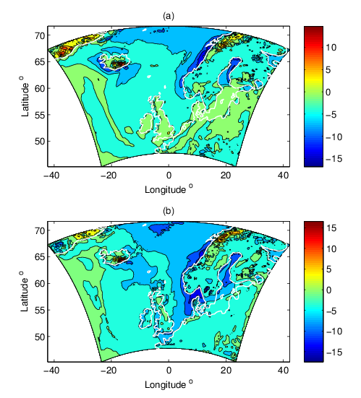
Results
T2m – SST (K)
2006-10-31 16:00
Temperatures at FINO 1
2006-11-01 04:00

Slide 14
Results
U at 10 m (m/s)
4:00 1st Nov
10:00
U at 100 m at FINO 1
13:00
22:00

Slide 15
Results
Hs (m)
4:00 1st Nov
10:00
Hs at FINO 1
13:00
22:00

Slide 16
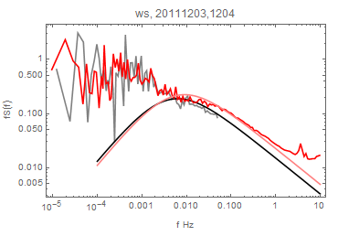
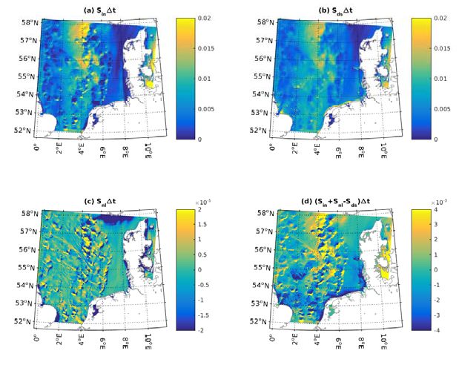
Results
Open cell
obs
Høvsøre, 80 m
Open cell issues
Horns Rev II, 107 m
Hs (m)
Kaimal
4:00
10:00
4:00 S_{in}
10:00 S_{ds}
0.02
0.02
13:00
22:00
13:00 S_{nl}
22:00 S_{tot=}S_{in}-S_{ds}+S_{nl}
2*10⁻⁵
4*10⁻⁵
Notes:
S_tot ~change of the spectrum -> change in Hs

Slide 17
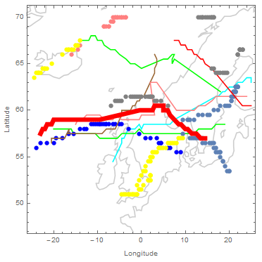
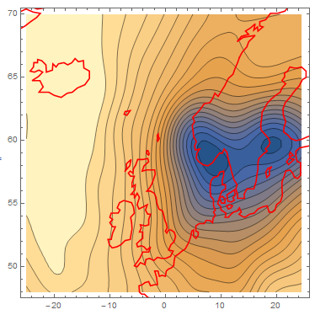
Results
Storms examined
Behrens and Günther’s list
10 storms from 2006 to 2013 identified at FINO 1 (U33 > 10 m/s, Hs>6 m): 2006 to 2013
Conditions examined
Spatial distribution of wind and wave vectors during the storm
Atmospheric stability
Presence or absence of cells
Presence or absence of extreme waves
Britta
MSLP 20061031 16:00
Longitude

Slide 18
Summary and applications
COAWST is capable of capturing main characteristics of storms like Britta for open seas
The development of extreme wave at FINO 1 benefits from the persistent strong wind field with a long undisturbed fetch over a long period.
Unstable stratification and open cells are two phenomena that alone are not responsible for the generation of extreme waves
Hundreds of storms, responsible for extreme wind and wave climate for water areas around Denmark, have been identified and will be modelled using COAWST, for further calculation of the 50-year return values.

Slide 19
Acknowledgements:
Supported by Danish ForskEL PSO 12020 XWiWa project.
Thanks to our colleagues from DTU Wind Eenergy and DHI.
Thanks to FINO 1, DONG Energy and Vattenfall for Horns Rev data, European Space Agency for the SAR data, NERC Satellite Recieving Station, Dundee University for the cloud pictures, UCAR for CFSR data.
Thank you for your attention!

