Slide 1
Ice actions on offshore wind turbine foundations – mitigating ice loads and ice-induced vibrations
Dipl.-Ing. Gesa Ziemer
Project Manager Hamburgische Schiffbau-Versuchsanstalt GmbH (HSVA)
WindEurope Summit 2016, Hamburg, 28.09.2016

Slide 2
Ice loads as design case for offshore wind turbines
Ice loads have to be taken into account even in mild climate areas where ice forms in extremely strong winters only (e.g. Southern Baltic Sea)
Design ice loads usually exceed all other design loads
Ice loads are still hard to predict
http://www.erantiengineering.fi/pilot-wind-turbine.htm

Slide 3
Prediction of ice loads
Design formulas (analytical / (semi-)empirical)
Numerical methods
Model tests
Usually very conservative. Hardly applicable for complex geometries. Often calibrated for cold climate (e.g. Northern Baltic Sea)
Not yet fully reliable. Calculations need calibration, which requires full scale measurements -> not available for OWT in ice
Expensive, suffer from scale effects.
Combination of numerical and physical modelling can improve understanding of ice loads on OWT and lead to more realistic design formulas

Slide 4
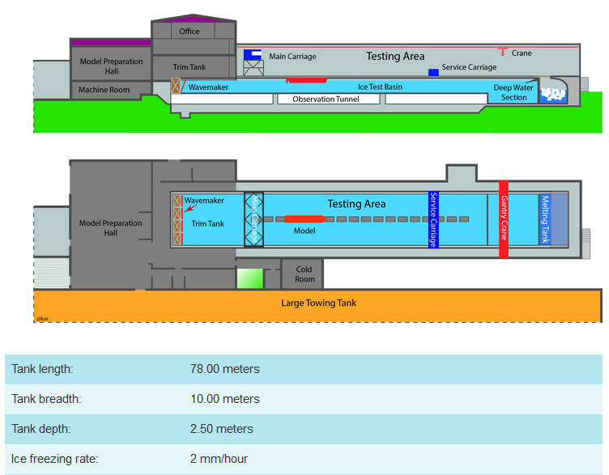
Ice model tests at HSVA

Slide 5
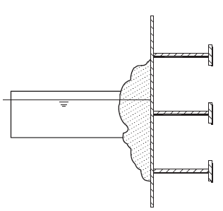
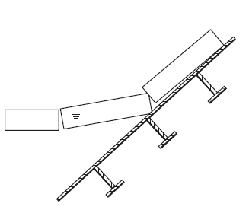
Basics of ice failure
Crushing failure
Bending failure
Occurs primarily on vertical structures
Creates highest ice loads
Poses a risk of ice-induced resonant vibrations („lock-in“)
Vertical structures are relatively cheap and easy to build
Occurs primarily on sloping structures
Ice loads are reduced compared to crushing failure
Ice-induced vibrations are easy to assess by slope angle and ice drift speed
Sloping structure increase costs and building effort
ISO 19906-3. (2010)

Slide 6
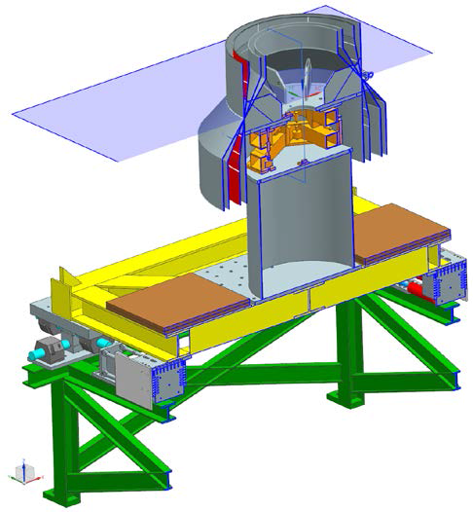
Model Tests: BRICE project
Collaboration with Fraunhofer IWES and VTT
Objectives:
Improve existing numerical models by calibration with scale model tests
Assess influence of slope angle on load and vibrations to optimize construction / building costs
Tests in 8 ice sheets using 4 models: 90° cone (cylinder), 80° cone, 60° cone, 50° cone

Slide 7
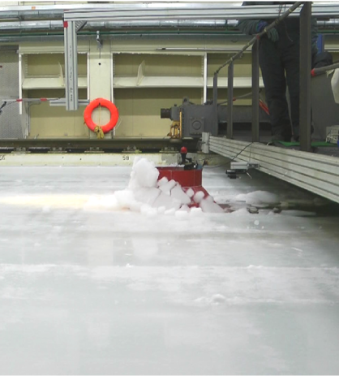
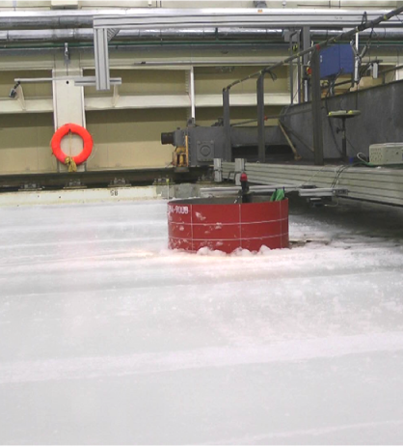

Slide 8
Results – ice loads
Bending drastically reduces ice loads
Ice loads on vertical and flat sloping structures almost independent of ice drift velocity
Effect of 80° cone highly depends on conditions at site
$$F_{n}=\frac{v}{\sqrt{gh}}$$

Slide 9
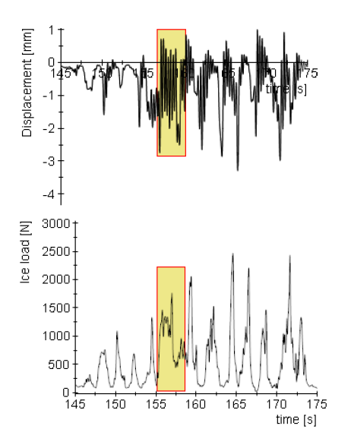
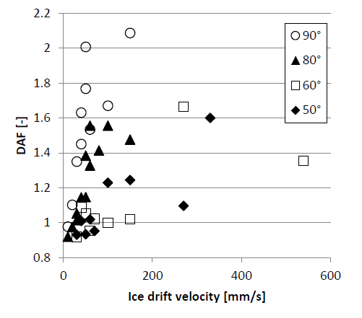
Results – vibrations
High dynamic amplification on cylinder and 80° cone due to locked-in crushing
60° and 50° cones show strong vibrations at high drift velocities

Slide 10
Summary
Ice loads are critical for design of OWT. Realistic and not over-conservative prediction of ice loads and vibrations is inevitable for cost-efficient design
Model tests are suitable to support design calculations and numerical methods
Sloping structures are recommended and often used for OWT in ice. Most reasonable slope angles depend on the site of OWT

Slide 11
Thank you.

Slide 12
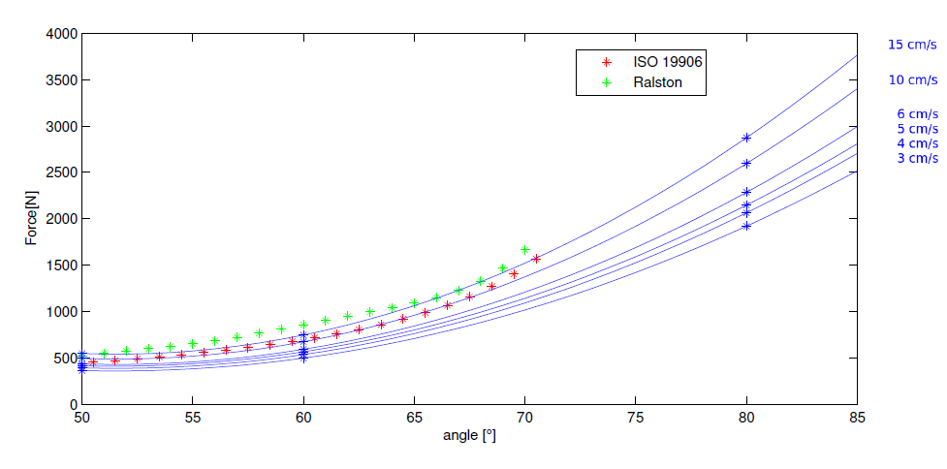
Results – Ice Loads

Slide 13
Ice model tests at HSVA
Towed Propulsion Test
Fixed mode testing
Towing and Oblique Towing
Free Running Propulsion
Ahead and Astern
Maneuvering
Turning Circle
Breaking out of Channel
Dynamic Positioning
Level Ice
Floe Ice
Brash Ice Channel
First Year Ridges
Pressure and Rubble Fields
Marginal Ice Zone Wave and Ice

