Slide 1
What digitization will mean for the industry in a few years time
Peter Thorsted
September 2016
Head of Global Windfarm COE
Notes:
Present my self, bagground and Envision COE purpose and scope
I will try to give some thoughts of where the end of digitization will take us

Slide 2
Agenda
Where we come from
Smart Wind Farm
Design and planning
Supply & Installation
Grid integration
Operation & maintenance
Lifetime data
Beyond turbines
Toward an energy internet and smart energy
Notes:
Where can we go – what is the ultimal end goal by using Digital solutions.
To answer that I would like to start with describing the journey that we have had and where we stand currently.

Slide 3
Where we come from
Up to today
Construction and operation has mainly been about different business strategy and thereby fully depending on various of different processes, standards and norms.
Optimization in design, construction, operation and maintenance was primarily achieved through Engineering studies, lessons learned and best practices.
Digitization has only played a subordinate role.
Notes:
The wind industry has been a very Entrepreneurial Industri, where we have matured and standardised a lot over time trying to achieve optimal solutions in a case by case manually handled way.
up to today windfarm design, construction and operations has mainly been about different business strategy and thereby fully depending on various of different processes, standards and norms. Where digitalisations has only been supporting tools. The Industry is at a turning point where currently digitalisation and processes goes hand I hand but already now companies like Envision is introducing a digitalised approach where processes is built into smart digital solutions like Greenwich, WindOS and other tools.
The business is to day a streamlined business with no room for errors. The margins does not allow that.

Slide 4
Smart Wind Farm
Design and planning
Using global weather data for windfarm layouts, turbine choice and optimization
Supply & Installation
Modualised BOM to optimise logistic cost with integrated BOP
Grid integration
Adjusting smart turbines to specific grid requirements
Operation & maintenance
Using smart turbines and weather forecast data to optimize yield
Notes:
Today we use digital solutions in the whole valuechain from design & planning and all the way to end of lifecycle in operations and back
From what I have experienced Envision is a frontier when it comes to windfarms in a digitalised world. Already today Envision uses digitalised solutions for designing a windfarm. By using Greenwich Envision can do windfarm layouts, turbine choice and optimisation. Soon the whole BOP can be designed automatically without any manual processes with possibility of mistakes and errors meaning that the BOM is coming out of a digital solution. Which means that manufacturing, supply, and constructions is controlled digitally.
I just want to highligt a couple of examples:
Designing a windfarm including wind assesment, turbine choise, layout and whole BOM for the BOP together with AEP calculation is all done digital
By the use of cloud data like weather forecasting for the specific site the scheduled maintenance is determined by a self-detecting turbine that instead of unplanned downtime orders a new spare part and technician for a specific day so not only to avoid that the turbine all of a sudden is broken down and spare parts first needs to be order at that time. But everything including detecting that a technical part needs to be replaced before next scheduled service but at the same time the software order the spare part and technician to arrive at a specific day where the turbine is not producing electricity due to low wind.

Slide 5
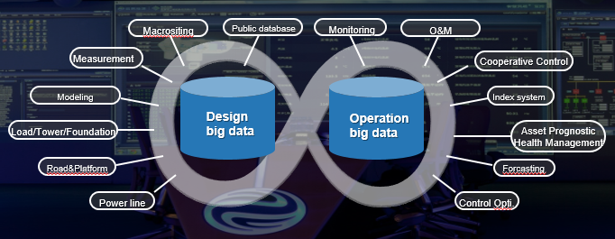
Smart Wind Farm
The Industry is at a turning point with lifetime data playing the most vital role
Notes:
What is important though is that data and software talk together and thereby open up for completely other opportunities for optimization and it is not only software that is smart and digital but also the turbine and whole windfarm.

Slide 6
Validation system based on assets index big data
Macrositing
Feasibility study
Investment Financing
Bidding
Construction
Operation
Meteorology data
Environment data
Mast
data
Design
data
Operation
data
Account
data
Forecasting
data
Operation data
Plan phase
Construction phase
Operation phase
Forecasting phase
Mast
Index
Resource
Index
Cost
Index
Availability
Index
Maintenance
Index
Performance
Index
AEP
Index
Turbine
Substation
Feeder
Engineering capability
Develop capability
Risk recognition and quantization
Investment business
Purchase business
Assets optimization
Turbine purchase optimization
O&M service
Design optimization
Macrositing optimization
Design capability
Notes:
Putting Big data into a more business structured approach
Everyone is having a stage gate model with different steps, processes and deliverables.
We in Envision have made our Smart Windfarm as a product that is not only depending on a Project Model but a 3 layer solution where digital products control and support different areas from cradle to grave.
Which enables us to utilize data stored in cloud based systems to optimise solutions upstream.

Slide 7
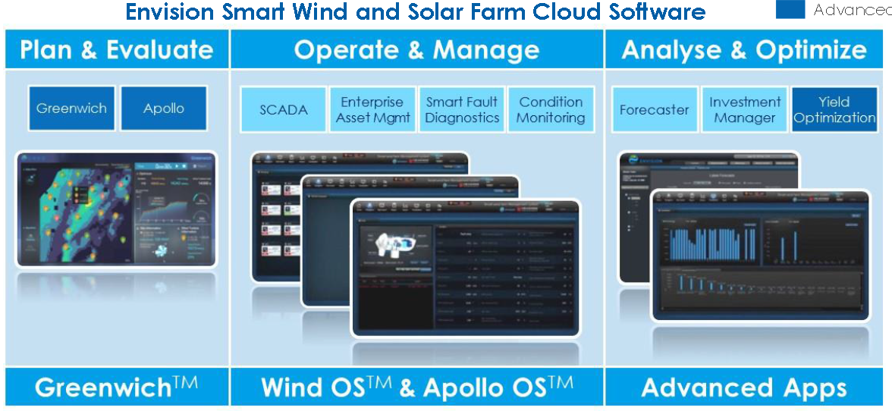
Smart Wind Farm
Lifetime data
Optimising wind farm and turbine design, operations and maintenance for the purpose of optimised AEP
Notes:
By using data throughout the whole value chain from cradle to grave, valuable learnings can be implemented both in turbine design but also in logistics and operations. Here it is essential that data is available across the business.
Advanced software solutions that is using realtime data

Slide 8
Overview of Digital Architecture
Validation
Supply
Data
SRM
PLM
Design
Finance
EPCM
O&M
.
SQM
.
.
.
Period Maintenance
.
EN Execution
Quality Mgmt.
SCM
.
.
Archiving Mgmt.
Spare Parts Mgmt.
Logistic
Optimization
Tracking in Transit
.
Case Mgmt.
Lesson Learned
Quality
Work Flow and Approval Workflow
Notes:
Therefore we need by the use of digitialisation to not only reduce risks but also to optimise solutions and reduce costs to be competetive and sustainable towards other competetive renewable energy solutions

Slide 9
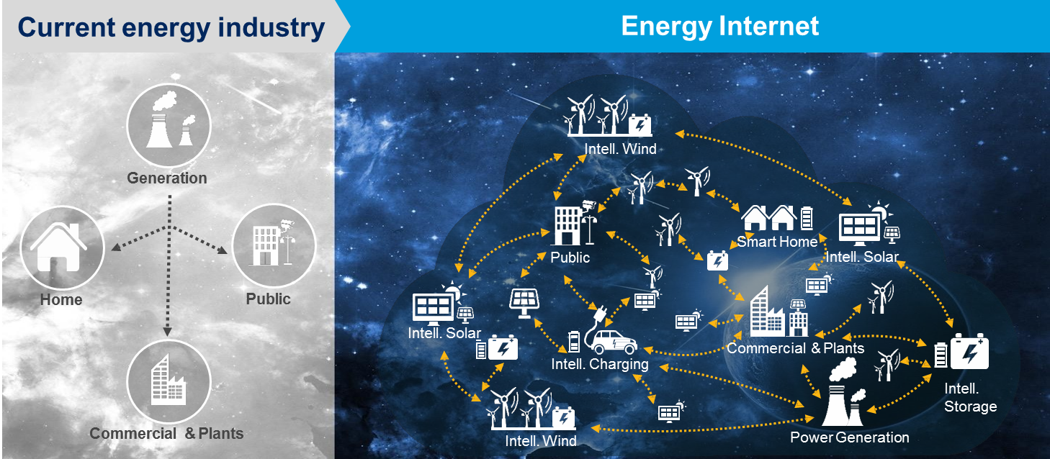
Energy Internet
What is it?
Energy internet is the operating mechanism of renewable energy centric energy system
It is a flexible energy system
We need a software nerve system which can optimize the production, distribution, storage and demand
Notes:
But where is the current bottleneck in making this happen?
How can we create this nervesystem?
How can we make an Energy Internet where data and dataflow is not interrupted by other interest then for the benefit of an affordable, reliable, sustainable and renewable energy?

Slide 10
So how far can we go by the use of digitialisation?
Notes:
Can digitialisation be used for other purpose than to reduce risk and cost?
I have tried to give you some examples already where we in Envision uses digital solution for complete windfarm design and operation
But what else can we benefit from digital solution – can it be used to revolutionaise the wind sector from a technology perspective?

