Slide 1
Model Based Diagnostics 2016
siemens.com/weh
© Siemens AG 2016

Slide 2
Siemens Diagnostic Center – Diagnostic Intelligence – Model Based Diagnostics (MBD)
MBD drives the two most important levers for shifting reactive service into proactive and prescriptive service
Scheduled
service visit
Failure
Scheduled
service visit
Scheduled
service visit
Failure
Fault
Fault
Fault
1. Year
2. Year
3. Year
Avoid failures by clearing the faults during scheduled service
1
Remove unscheduled activities by detecting faults before they become failures
Removing up to 20% of check items performed during scheduled service
2
Reduce scheduled activities by remote verification of systems’ operational state
Longer Mean Time between Failures
Reduce the cost of scheduled services
Avoiding downtime and lost production
Improving availability and product integrity
Turbine service is scheduled once per year
Hidden faults appear
Turbine failure and repair

Slide 3
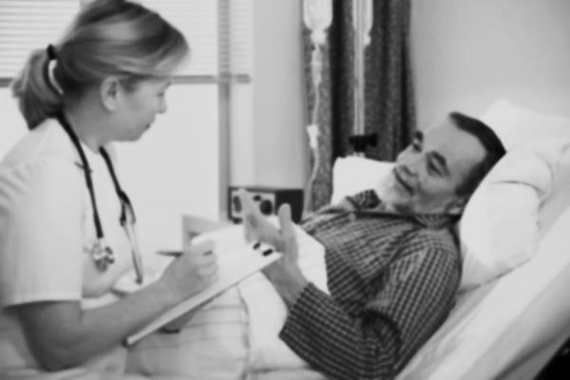
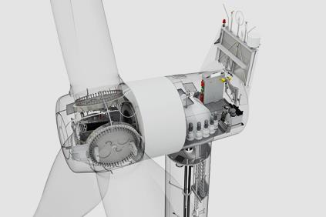
Siemens Diagnostic Center – Diagnostic Intelligence – Model Based Diagnostics (MBD)
How does Siemens Wind MBD compare to diagnostics in other complex systems?
Siemens Wind Turbine
Formula 1 car
Person (Only when sick)
Case handling
Person (Only when sick)
200 sensors
Hours of measuring
Remote data acquisition
10 experts standing by
Dynamic limits
Average lifetime = one race
1-5 sensors
Single check and some monitoring
Entire Hospital standing by
Only fixed limits – what is normal heart-rate?
Average lifetime 78 years
Total of 4,000,000 sensors; ~400 each
Total 60,000 years of measuring (10,000 turbines x 6 year average)
Remote access to all systems
10,000 turbines covered the MBD systems
Dynamic limits in multiple dimensions
Average lifetime 25 years
21 trillion (21,000,000,000,000) stored values per week
2-5,000 system alerts per week
80-120 diagnostic recommendations issued and executed per week
Auto discovery of new turbines connected

Slide 4
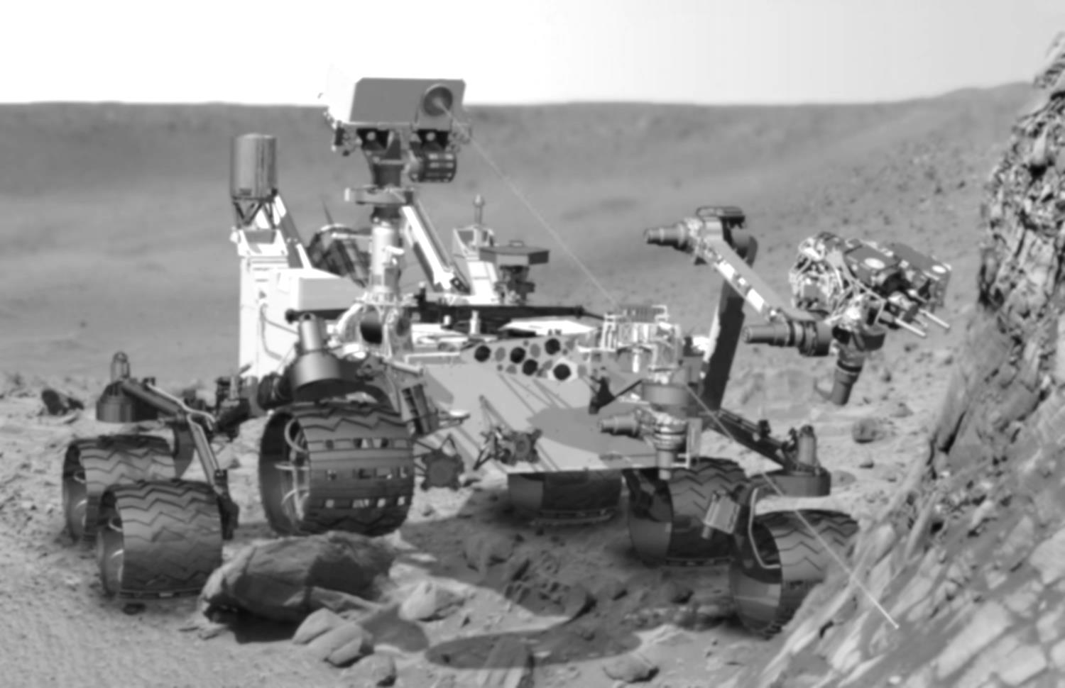
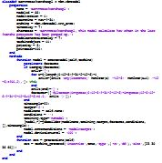
Siemens Diagnostic Center – Diagnostic Intelligence – Model Based Diagnostics (MBD)
Inside the model
What does a diagnostic model look like?
Not just a simple magnifying glass that allows BIG DATA to provide the answer by itself
More like the Mars rover, with dedicated sensors designed from expert knowledge, knowing what to look for and how
Actually hundreds of lines of code in high performance computers, constantly evaluating new data as they arrive
Autonomous Learning
Math and Analytics
Expert Knowledge and Experience

Slide 5
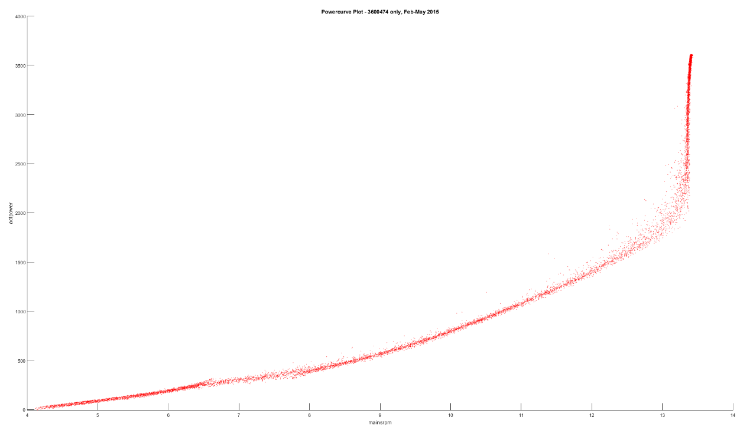
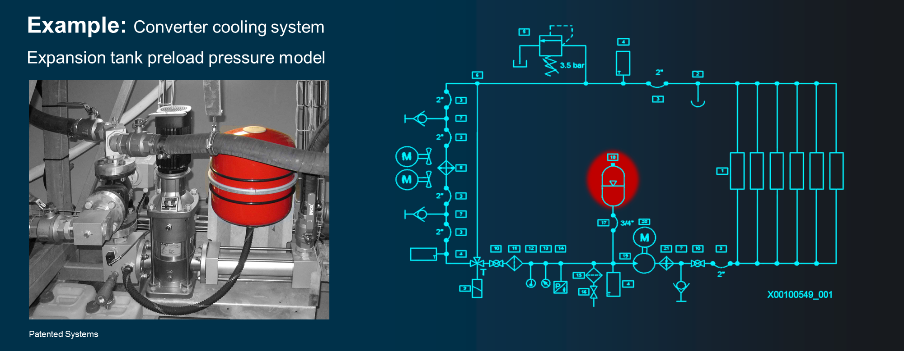
Siemens Diagnostic Center – Diagnostic Intelligence – Model Based Diagnostics (MBD)
Generic performance monitoring system
The turbines are monitored from the outside
Deviations typically displayed on dash- board solutions
The powercurve
One model
Performed causation analysis
Investigate the cause of degrations case by case
Needs additional data from the turbine
Needs expert evaluation
Manual escalation
Action plan needs to be created manually based on the outcome of manually and individual case analysis
Implemented tool
Analytic approach
Case handling
Remediation
Siemens Model Based Diagnostic
Intelligent models systematically evaluate systems inside the turbines.
Deviations are detected and evaluated automatically
Model Based Diagnostics
523 individual models
1,432,448 analysis weekly
Technical advice
The model reveals the cause of deviation
Expert knowledge is integrated into the model
All relevant data channels are considered by the model
Automated escalation
Precise technical advice can be issued automatically to the escalation systems, and assigned to a service planner for immediate remediation

Slide 6
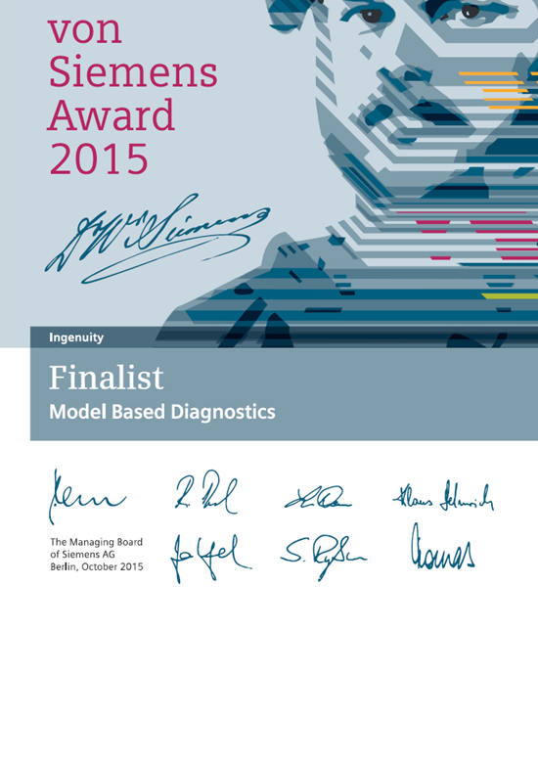
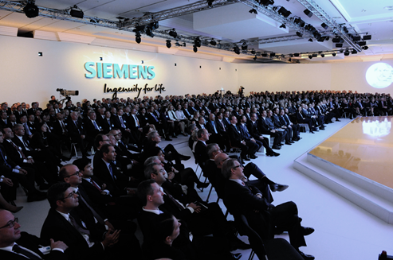
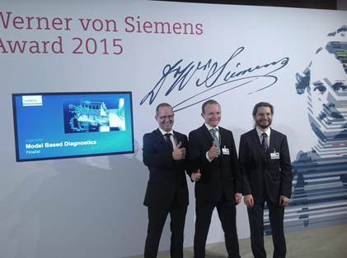
Siemens Diagnostic Center – Diagnostic Intelligence – Model Based Diagnostics (MBD)
Werner von Siemens award Finalists

Slide 7
Model Based Diagnostics 2016 Thank you for your attention
siemens.com/weh
© Siemens AG 2016

