Slide 1
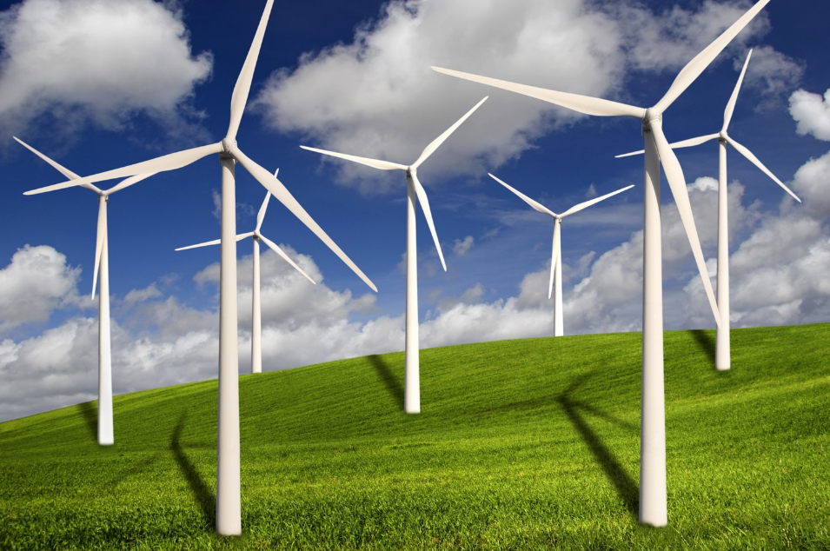
Overview of existing funding opportunities in Europe
Matthijs Soede
Hamburg
27 September 2016
Research Policy Officer European Commission

Slide 2
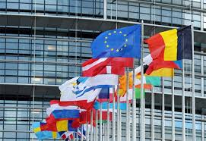
Feb 2015: Energy Union
Energy Union: 5 Pillars
1. Energy security, solidarity and trust
2. A fully integrated European energy market
3. Energy efficiency contributing to moderation of demand
4. Decarbonising the economy
5. Research, Innovation and Competitiveness
⇒ the Strategic Energy Technology Plan (SET Plan) as a key implementing pillar
2

Slide 3
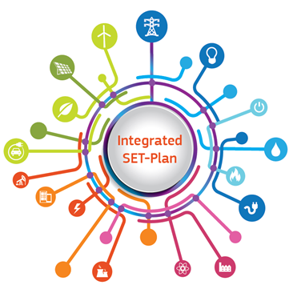
SET Plan – Sept 2015
Energy Union Priorities
SET Plan Ten Key Actions
4 Core priorities
No1 in Renewables
1. Performant renewable technologies integrated in the system
2. Reduce costs of technologies
Smart EU energy system, with consumer at the centre
3. New technologies & services for consumers
4. Resilience & security of energy system
Efficient energy systems
5. New materials & technologies for buildings
6. Energy efficiency for industry
Sustainable transport
7. Competitive in global battery sector (e-mobility)
8. Renewable fuels
3

Slide 4
SET Plan
prioritisation
For each of the 10 Key Actions
A few targets proposed by the EC using the Integrated Roadmap
Large consultation among the stakeholders and 32 SET-Plan countries
A meeting between all to decide on the final targets
➔ 'Declaration of Intent'

Slide 5
Declaration of Intent
For Global leadership in offshore wind
Reduce the levelised cost of energy* (LCoE) at final investment decision for fixed offshore wind by improvement of the performances of the entire value chain to
Less than 10 ct€/kWh by 2020 and to
Less than 7ct€/kWh by 2030
Develop cost competitive integrated wind energy systems including substructures which can be used in deeper waters (›50m) at a maximum distance of 50 km from shore with LCoE* of
Less than 12 ct€/kWh by 2025 and to
Less than 9 ct€/kWh by 2030
*the costs for delivering the electricity to onshore substations are taken into account within the LCoE

Slide 6
Common backbone of ETIPs
ETIPs
Overview
Key governance structures to implement the SET Plan
Independent and self-financing stakeholder fora
Industry-led and innovation driven covering the whole innovation chain
Role
Develop and implement R&I Agendas
Provide strategic insights into market opportunities and needs
Support the selection and monitoring of priority SET Plan R&I Activities
Cover technological and non-technological aspects
Address the need for system integration
Systematically identify pathways to exploit research results
Identify and communicate the SET Plan results and success stories
Mobilize stakeholders to implement the R&I Activities
Cooperation with countries and the EC
Confined to precise tasks and goals

Slide 7
Implementation Plans
SET Plan
Next Step
Selection of R&I Activities to reach the targets
Identify and agree on Joint Actions between countries
Temporary Working Groups
Identify Flagship Activities
Mainly at national level
On occasion at EU level
Off-Shore wind is already an example: MoU signed by European countries around the North Sea

Slide 8
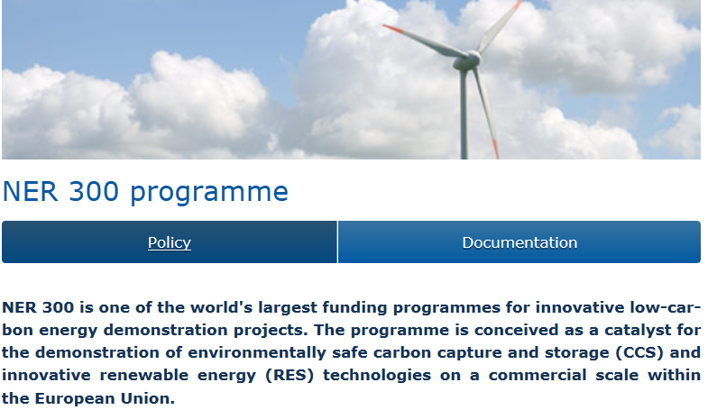
EU funds for wind energy
EU Support
Horizon 2020 (focus on  cost,  performance of off-shore wind)
NER300/400
http://ec.europa.eu/clima/policies/lowcarbon/ner300/index_en.htm
EFSI – European Fund for Strategic Investment EUR 315 billion
http://ec.europa.eu/priorities/jobs-growth-and-investment/investment-plan_en
ESIF – European Structural and Investment Fund
EUR 46 billion Research & Innovation
EUR 45 billion low cost economy
http://ec.europa.eu/contracts_grants/funds_en.htm

Slide 9
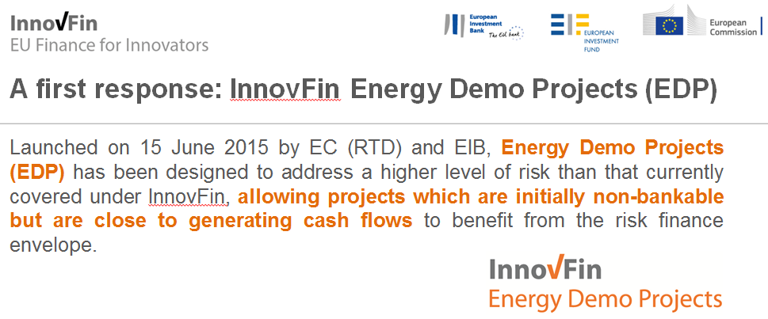
EU funds for wind energy
EU Support
Innovative Financial Instrument for First-of-A-Kind Energy Project
➔ "Valley of Death" from demonstration to comercialisation
http://www.eib.org/products/blending/innovfin/products/energy-demo-projects.htm?lang=en

Slide 10
Risk finance for demonstration projects
InnovFin Energy Demo Projects Pilot Facility (EDP)
(Other Action#28)
First-of-a kind commercial-scale industrial demonstration projects (TRL 7-8) for unproven pre-commercial technologies in the field of innovative renewable energy, fuel cells and hydrogen in support of the SET-Plan
Loan amount: min EUR 7.5 M€, max EUR 75 M€
Loan maturity: max 15 years
Application & inquiries: directly with the EIB - New Products & Special Transactions, EIB, Luxembourg Tel: +352 4379 85002, E-mail: innovfinFDP@eib.org http://www.eib.org/products/blending/innovfin/products/index.htm

Slide 11
European countries: DE, DK, FR, IT, NO, SE, UK 2 June: European Commission joined
COP21
30 Nov. 2015
Double Governmental Investment in Clean Energy R&D over 5 years ~ $ 30 billion per year by 2021
Link with Breakthrough Energy Coalition, i.e. Private investors

Slide 12
THE EU FRAMEWORK PROGRAMME FOR RESEARCH AND INNOVATION
HORIZON 2020
H2020 - Energy Calls 2016-2017
European Commission

Slide 13
H2020 - The 2016-2017 calls of the Energy Challenge Secure, Clean and Efficient Energy
Energy Efficiency (EE)
Heating and Cooling
Engaging consumers
Buildings
Industry, services and Products
Innovative financing
Competitive low-carbon energy Technologies (LCE)
Energy system (grids, storage)
Renewable energies
Decarbonising fossil fuels
Socio-economic research
European Research Area in energy
Smart Cities and Communities (SCC)
Light-house demonstration projects
SME instrument (SIE)
Call budgets (in Mio €)
Call | 2016 | 2017
EE | 93 | 101
LCE | 352,66 | 367,62
SCC | 60 | 71,50
SME | 46 | 50

Slide 14
H2020 Wind energy topics
Rationale:
European industries are still world leaders but the competition is growing;
Cost reductions for all components essential, in particular for offshore;
Offshore considered as the future market - large turbines to be demonstrated
Issues remain on environmental and social impact, and on public acceptance
Basic research
OPEN: Improved understanding of the physics of wind as primary energy source and wind energy technology - LCE-6-2017 – 2 stage – deadline 29/11/2016
Advanced research
CLOSED: Advanced control of large-scale wind turbines and farms – LCE-7-2016
OPEN: Reduction of environmental impact – LCE-7-2017 – 2 stage – deadline 29/11/2016
Demonstration
CLOSED: Solutions for reduced maintenance, increased reliability and extended life-time of off-shore wind turbines/farms – LCE-13-2016 (EUR 10 million)
Large >10 MW wind turbines – LCE-14-2017 (EUR 25 million) – deadline 7/9/2017
Market-uptake
OPEN :Increase market share of wind energy – LCE-21-2017 – deadline 05/01/2017

Slide 15
Cross-thematic priorities
LEITs (Leadership in Enabling and Industrial Technologies)
Nanotechnologies, Advanced materials, Advanced manufacturing and processing, Biotechnology
Energy-efficient Buildings
(EEB-01 - EEB-8)
Sustainable Process Industry
(SPIRE-04, SPIRE-05, SPIRE-08)
Materials for Energy
(NMBP-2, NMBP-3, NMBP-17 - NMBP-20)
LEITs (Leadership in Enabling and Industrial Technologies)
Information and communication technologies
Low energy computing
(ICT-5)
Photonics
(ICT-29)
Internet of Things
(EUB-2)
Power electronics
Big Data
(ICT-15)

Slide 16
The SME Instrument
Seamless business innovation support
Completely bottom-up – all areas of the Energy Challenge covered
Only open to SMEs – also single-beneficiaries possible
3 phases of support (no need to start with phase 1)
Business innovation grants (feasibility studies, lump sum of EUR 50,000 per project);
Business innovation grants for innovation development & demonstration purposes (between EUR 0.5 – 2.5 million / project)
Free-of-charge business coaching, access to a wide range of innovation support services and facilitated access to risk finance to facilitate the commercial exploitation of the innovation.
4 submission deadlines per year for phase 1 and 2
Budget for the Energy SME topic (SMEInst-09-2016-2017):
46 M€ in 2016
50 M€ in 2017

Slide 17
Fast-track to Innovation Pilot
Innovation from the demonstration stage through to market uptake (starting as of TRL 6)
Completely bottom-up – covers all areas addressed by H2020
Small consortia with strong participation from industry
Business plans mandatory
3 submission deadlines in 2016 (15/3, 1/6, 25/10/2016)
Budget 100 M€ (no earmarking for areas)

Slide 18
H2020 – projects
Wind turbine
Ecoswing – Energy Cost Optimization using Superconducting Wind Generators - World’s First Demonstration of a 3.6 MW Low-Cost Lightweight DD Superconducting Generator on a Wind Turbine (<TRL7, IA, 10.591.734 €, 1/3/2015 – 28/2/2019, Envision Energy (DK))
Rotary wing CLFC - Closed-Loop Flow Control to Enhance Aerodynamic and Aeroacoustic Performance of Wind-Turbine Blades (MSCA-IF-2014-EF, 171.460 €, 24 months, 1/5/2015 – 30/4/2017, TU Berlin (DE))
Riblet4wind – Riblet-surfaces for improvement of Efficiency of Wind Turbines (<TRL7, IA, 3.307.172 €, 42 months, 1/5/2015 – 30/11/2018, Fraunhofer (DE))

Slide 19
H2020 – projects
Substructures
TELWIND – Integrated telescopic tower and evolved spar floating substructure for low-cost deep offshore wind and next generation of 10MW+ turbines (<TRL5, RIA, 3.498.530 €, 30 months, 1/12/2015 – 31/5/2018, ESTEYCO SAP)
LIFES50+ - Qualification of innovative floating substructures for 10 MW wind turbines and water depths greater than 50 m (<TRL5, RIA, 7.274.838 €, 40 months, 1/6/2015 – 30/9/2018, Marintek (NO))
ELISA/ELICAN – Self-bouyant precast concrete foundation for the craneless installation of complete offshore wind turbines: full scale offshore protype (SME -2, IA , 13.679.850 €, 24 months, 1/6/2015 – 31/5/2017, ESTEYCO SAP)
DEMOGRAVI3, innovative gravity based foundation for offshore wind turbines (TRL7, IA, 19.243.042 €, 48 months, 1/1/2016 – 31/12/2019, EDP (PT))

Slide 20
H2020 – projects
Cost reduction in offshore wind
DEMOWIND (Eranet Cofund, IA, max 10.441,788 € funding, 60 months, 1/1/2015 – 31/12/2019, DECC (UK)) combined with national funding of UK, DK, NL, ES, PT and BE total: 31.000.000 €
DEMOWIND 2 (Eranet Cofund, IA, max 8.557.865 € funding, 60 months, 1/1/2016 – 31/12/2020, DECC (UK)) combined with national funding of UK, DK, NL, ES, BE and NO total: 25.932.924 €

Slide 21
H2020 – projects
Small wind
Briareo – Implementation of a vertical axis micro-wind turbine capable of working at high efficiency even at a low wind speed (SME-1, 50.000 € funding, 6 months, 2015, Arken SPA)
IRWES Integrated Roof Wind Energy System (SME-2, 1.696.381 € funding, 24 months, 2015 – 2017, IBIS Power BV)
Omniflow – Next-generation hybrid wind and solar power technology (SME-1, 50.000 €, 6 months, 2015, Omniflow SA (PT))
ECIWIND - Cost effective wind turbine of 40 kW of rated capacity (SME-2, 1.307.305 € funding, 24 months, 1/5/2015 – 30/4/2017, ENAIR ENERGY SL)

Slide 22
H2020 – projects
Airborne Wind
AMPYXAP3 – Commercial introduction of the first Airborne Wind Energy system: renewable eneryg at costs below fully depreciated coal fired power plants (SME-2, 2.500.000€ funding, 23 months, 2015, Ampyx Power BV)
REACH – Resource Efficient Automatic Conversion of High Altitude Wind (FTIPilot -1, 2.675.132€ funding, 36 months, 2015, ENEVATE BV) Kite Power

Slide 23
H2020 – projects
Education and training
ICONN – European Industrial DoCtorate on Offshore WiNd and Wave ENergy (MSCA-ITN-EID, 845.838 €, 48 months, 2015 – 2019, Trinity College Dublin)
AWESOME – Advanced Wind Energy Systems Operation and Maintenance Expertise (MSCA-ITN-ETN, 2.862.074 €, 48 months, 2015 – 2019, CIRCE (ES))
AWESCO – Airborne Wind Energy System Modelling, Control and optimisation (MSCA-ITN-ETN, 2.999.015 €, 48 months, 01/01/2015 – 31/12/2018, TU Delft (NL))
SPARCARB – Lightning protection of wind turbine blades with carbon fibre composite materials (MSCA-ITN-ETN, 1.093.151 €, 48 months, 01/01/2015 – 31/12/2018, GLPS (DK) and Univ Southampton (UK))
AEOLUS4FUTURE – Efficient harvesting of the wind energy (MSCA-ITN-ETN, 3.811.805 €, 48 months, 01/01/2015 – 31/12/2018, LULEA Tekniske Univ (S))

Slide 24
H2020 – projects
Market uptake
RICORE - Risk Based Consenting of Offshore Renewable Energy Projects 1.393.533 (SCA, 1.393.533 € funding, 18 months, 1/1/2015-30/6/2016 2015, Robert Gordon university (UK))
INDUSTRE (Grids) - Innovative Business Models for Market Uptake of Renewable Electricity unlocking the potential for flexibility in the Industrial Electricity Use

Slide 25
H2020 – projects
Varia
HPC4E – HPC for Energy (LEIT, RIA, 1.998.176 €, 24 months, 1/1/2016 – 31/12/2017, Barcelona supercomputing centre)
Opti-LPS – Optimal Lightning Protection System (SME-1, 50.000 €, 6 months, 2015, GLPS AS (Dk))
MEWi-B – More efficient Wind Blades (SME-1, 50.000 €, 6 months, 2015, ETA Srl (IT))
FLOATMAST – An Innovative Wind Resource Assessment Tension Leg Platform for combined Anemometer and Lidar reliable and bankable wind measurements for offshore wind parks (SME-1, 50.000 €, 6 months, 2015, ETME Streamlined (EL))
Winspector – Advanced shearography kit and a robotic deployment platform for on-site inspection of wind turbine blades
EIROS - Erosion and Ice Resistant cOmposite for Severe operating conditions

Slide 26
H2020 – projects
Varia
I-WSN – Intelligent Wireless Sensor Networks for Asset Integrity Monitoring (SME-1, 50.000 €, 6 months, 2015, Inertia Technology BV (NL))
EeC WITUR – Efficient energy cleaning robotic platform for wind turbines (SME-1, 50.000 €, 6 months, 2014, Tratamiento Superficial Robotizado SL (ES))
CLOUD DIAGNOSIS – Providing Predictive Maintenance for Wind Turbines Over Cloud (SME-1, 50.000 €, 6 months, 2014, ITESTIT (ES))
AIRCRANE – New Building methodology for improved full-concrete wind towers for wind turbines (SME-1, 50.000 €, 6 months, 2014, Structural Research S.L. (ES))
Aeropaft – Delay of flow separation and stall on Aerofoils using a passive flow control technology which will improve aerodynamic performance and stability of wind turbines increasing their range of operation (SME-1, 50.000 €, 6 months, 2014, Jarilo Limited (UK))

Slide 27
H2020 – projects
Combined wind/ocean
POSEIDON - Market maturation of Floating Power Plant’s Floating Wind- Wave- Energy Device (SME-2, 1.144.150€ funding, 24 months, 1/6/2015-31/5/2017, FLOATING POWER PLANT A/S (DK))
ICONN – European Industrial DoCtorate on Offshore WiNd and Wave ENergy (MSCA-ITN-EID, 845.838 €, 48 months, 2015 – 2019, Trinity College Dublin)
SEAMETEC – Smart Efficient Affordable Marine Energy Technology Exploitation using Composites (SME-1, 50.000 €, 6 months, 2015, Eirecompoisites Teoranta (IE))
MARIBE - (CSA, 1.977.951 € funding, 18 months, 1/3/2015-31/8/2016, Cork University (IE))

Slide 28
Join the conversation

Slide 29
Thanks for your attention
Disclaimer © European Union, 2016
The content of this presentation may not reflect the official legal opinion of the European Union. The European Commission does not accept responsibility for any use made of the information contained therein.

