Slide 1
Power Curve Validation using LiDAR
Assessing the potential to validate turbine power curves using TP, nacelle and floating LiDAR
Michael Stephenson and Alex Clerc (RES)
Wind Europe Summit, 27th September 2016

Slide 2
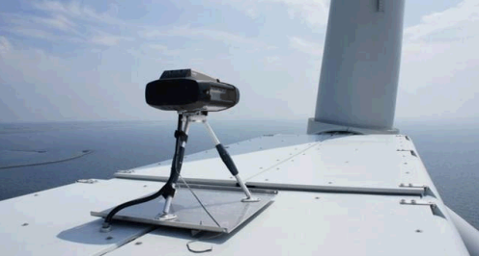
Contents
Project Overview
Power Curve Comparison overview
Uncertainty Discussion
Conclusions

Slide 3
Project Overview
Project comprises detailed analysis of existing LiDAR based power curve datasets submitted by OWA members and RES
Datasets represent most common approaches offshore:
Nacelle mounted LiDAR
Transition Piece (TP) mounted scanning LiDAR
Floating LiDAR
Dataset summary
Technology | Datasets
Nacelle | 5 datasets in total, 4 concurrent with masts
Scanning | 2 datasets, comparable with each other, but no concurrent mast data
Floating | 2 datasets: One dataset too far from turbine One dataset too short for quantitative analysis

Slide 4
Power Curve Comparisons
Sample

Slide 5
Analysis – Compare LiDAR and Mast
Rødsand 2 T73 Mast vs Nacelle LiDAR
Measurement Device | Measurement Distance | Hours of Valid Data
Mast | 3.7D | 950
Nacelle LiDAR | 2.6D | 964
Offshore
Mast analysis is IEC compliant
Mean power curves in close agreement
AEP agrees to 0.1%
Scatter is lower for the nacelle LiDAR measurement
Binned power curves
Rødsand setup
Power curve scatter plot
AEP Comparison

Slide 6
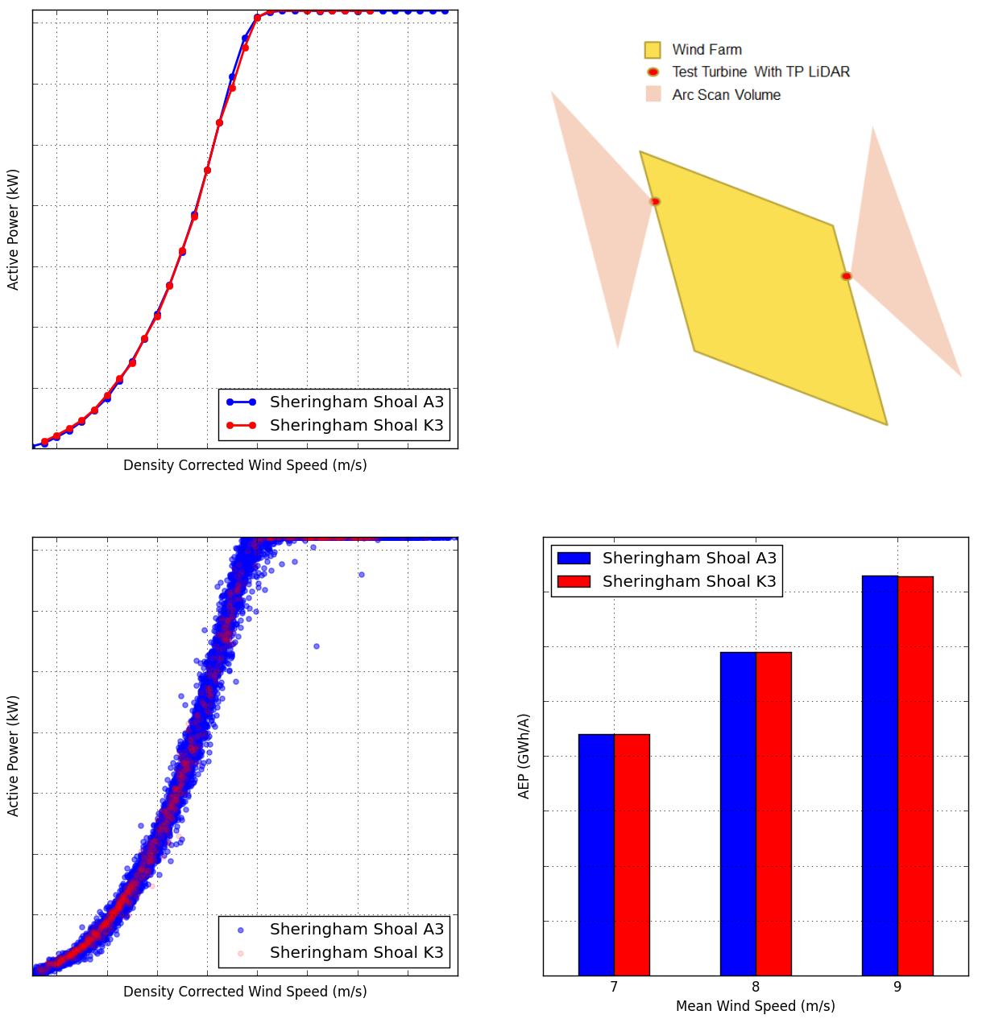
Analysis – LiDAR-LiDAR Comparisons
Sheringham Shoal A3 TP LiDAR vs K3 TP LiDAR
Turbine | Measurement Distance | Hours of Valid Data
A3 | 3.5D | 1416
K3 | 3.5D | 125
Offshore
Free stream sectors do not overlap
Mean power curves in close agreement
AEP agrees to within 0.2%
Binned power curves
Sheringham Shoal setup
Power curve scatter plot
AEP Comparison

Slide 7
Self-consistency
Do LiDAR power curves have comparable scatter to masts?

Slide 8
Analysis – Self-Consistency
Onshore
Offshore
More scatter
Less scatter
Category A Uncertainty quantifies scatter about the mean power curve
Category A Uncertainty decreases with data count – in the above plot all uncertainties have been corrected to 700 hours valid data for comparison

Slide 9
Analysis – Self-Consistency
Onshore
Offshore
More scatter
Less scatter
Highly precise power curve measurement for all nacelle LiDAR datasets
For each dataset where a comparison can be made, nacelle LiDAR power curve precision is superior to that achieved using masts

Slide 10
Analysis – Self-Consistency
Onshore
Offshore
More scatter
Less scatter
Promising results for SL mounted on the turbine transition piece
Note this is from one site and no comparisons to masts have been made

Slide 11
Uncertainty Discussion
Can LiDARs achieve lower uncertainty than masts?
Notes:
A BIT MORE BACKGROUND – WHY DO WE CARE ABOUT UNCERTAINTY?

Slide 12
Illustrative Uncertainties
Additional uncertainty due to pointing accuracy, horizontal vector reconstruction
Large uncertainty contribution from reference anemometer
LiDAR power curve uncertainties must always be higher than mast power curve uncertainty due to LiDAR wind speed calibration against an anemometer
Notes:
REDUCE TEXT

Slide 13
Illustrative Uncertainties
Improved calibration procedure?
Improve WS reference?
Improve WS reference?
Key potential for improvement: improve the wind speed reference used in LiDAR calibration
The relatively high uncertainty assigned to LiDAR measured power curves is strange given their precision and consistently close agreement with masts
Notes:
REDUCE TEXT

Slide 14
Uncertainty Discussion
Accurate: average of measurements is near the bullseye
Precise (Repeatable): measurements are consistent (low scatter)
Accurate
Precise
Precise and Accurate

Slide 15
Uncertainty Discussion
Accurate: average of measurements is near the bullseye
Precise (Repeatable): measurements are consistent (low scatter)
A mast measured power curve is accurate but less repeatable
LiDAR gives a precise power curve, but is it accurate?

Slide 16
Uncertainty Discussion
In the project, we have observed LiDARs measuring power curves with better precision and very similar accuracy to mast power curves (AEP agreement 0.1% to 0.6%)
LiDAR power curve measurements
Mast power curve measurements
However, the accuracy cannot be well defined (assigned uncertainty is large) because of the large uncertainty assigned to wind speed measurement
Can we define a better bullseye?

Slide 17
Uncertainty Discussion
Potential solutions to reducing LiDAR wind speed uncertainty may include:
Reduce the uncertainty of the reference anemometer (as presented by Mike Courtney*)
Use a different instrument to measure the reference wind speed (perhaps three orthogonal lidics?)
Define the reference speed using a spinning target?
*M. Courtney, “Why are lidars so uncertain?”, EWEA Resource Assessment Workshop, Helsinki, June 2015

Slide 18
Uncertainty Discussion
Potential solution to reduce contractual power curve uncertainty: the Golden Turbine concept
The golden turbine is a reference turbine which the manufacturer and the owner both have confidence in
Use owner’s test LiDAR to measure the AEP of the “golden turbine”
Move the test LiDAR to the test turbine and measure its performance relative to the golden turbine
Relative performance could conceivably be measured with very low uncertainty – very useful for a contractual test!
Step 1: Test LiDAR measures at Golden Turbine
Step 2: Test LiDAR deployed on Test Turbine

Slide 19
Conclusions

Slide 20
Conclusions
Both nacelle and TP scanning LiDARs can be used to perform precise measurements of power curves offshore
Insufficient data to properly evaluate application of floating LiDAR to power performance measurement
The uncertainty assigned to LiDAR measured power curves is undeservedly high; potential solutions have been suggested but more work is required

Slide 21
Future Work
Future work:
A public report will be released covering the contents of this presentation in more detail
Thank you to the Carbon Trust, OWA TWG and dataset providers!

Slide 23
Analysis – Correction Methods
Correction Methods

Slide 24
Analysis – Correction Methods
Turbulence Renormalisation
Using either LiDAR or mast sensitivity of the power curve to TI is reduced through the application of TI renormalisation for both Cyclops and Rødsand 2 T73
These results imply that TI renormalisation can be applied successfully using LiDAR measured TI signal as long as reference and measured TI are consistent

Slide 25
Analysis – Correction Methods
REWS Analysis for Cyclops nacelle LiDAR
For the Cyclops dataset, using REWS as opposed to HHWS does not reduce the scatter (NMAE is slightly higher when using REWS).
Power curve sensitivity to shear exponent is not reduced by using the REWS for Cyclops.

Slide 26
Analysis – Sensitivity
Power Curve Sensitivity Analysis

Slide 27
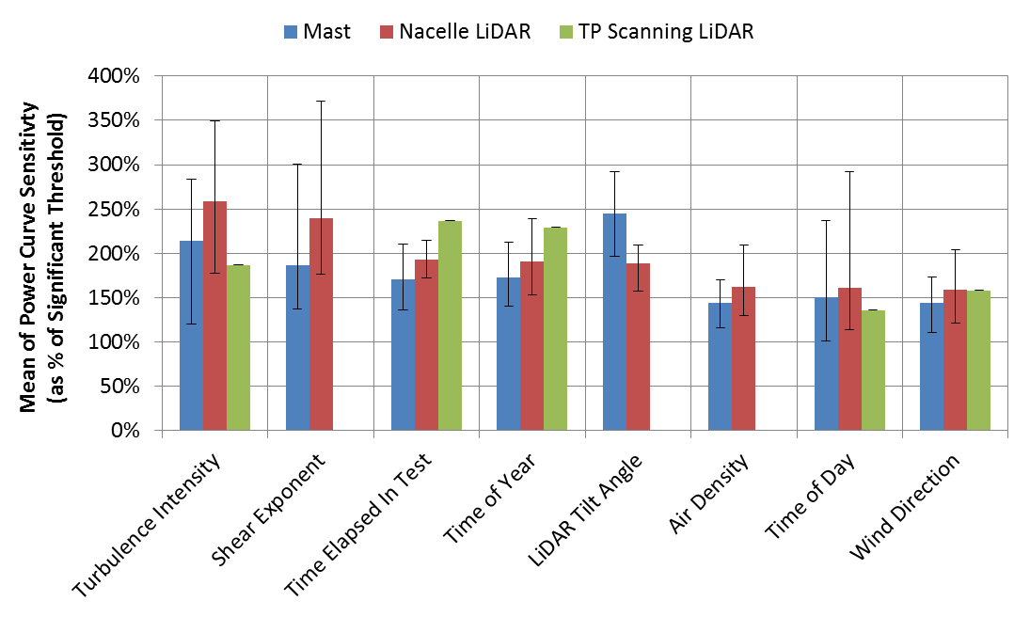
Analysis – Sensitivity
Nacelle LiDAR and masts show the same sensitivity pattern. Shear and Turbulence are the most significant factors for power curve variation.
LiDAR Tilt Angle is not associated with significant power curve variation
Mast and LiDAR analyses show comparable variation metric (mast slightly higher). The influence is therefore thought to be due to cross correlation with other variables.
TP scanning LiDAR shows a similar sensitivity pattern but the result is based on only one test

Slide 28
Analysis – Compare LiDAR and Mast
Gwynt y Môr Mast vs Floating LiDAR
Measurement Device | Measurement Distance | Hours of Valid Data
Mast | 2.3D | 47
Nacelle LiDAR | 3.9D | 65
Offshore
Many incomplete bins in power curves due to sparse datasets
Not suitable for AEP calculations
Scatter is lower for the mast measurement
Notes:
Re-do mean power curve graph so that no line is drawn for empty bins

