Slide 2
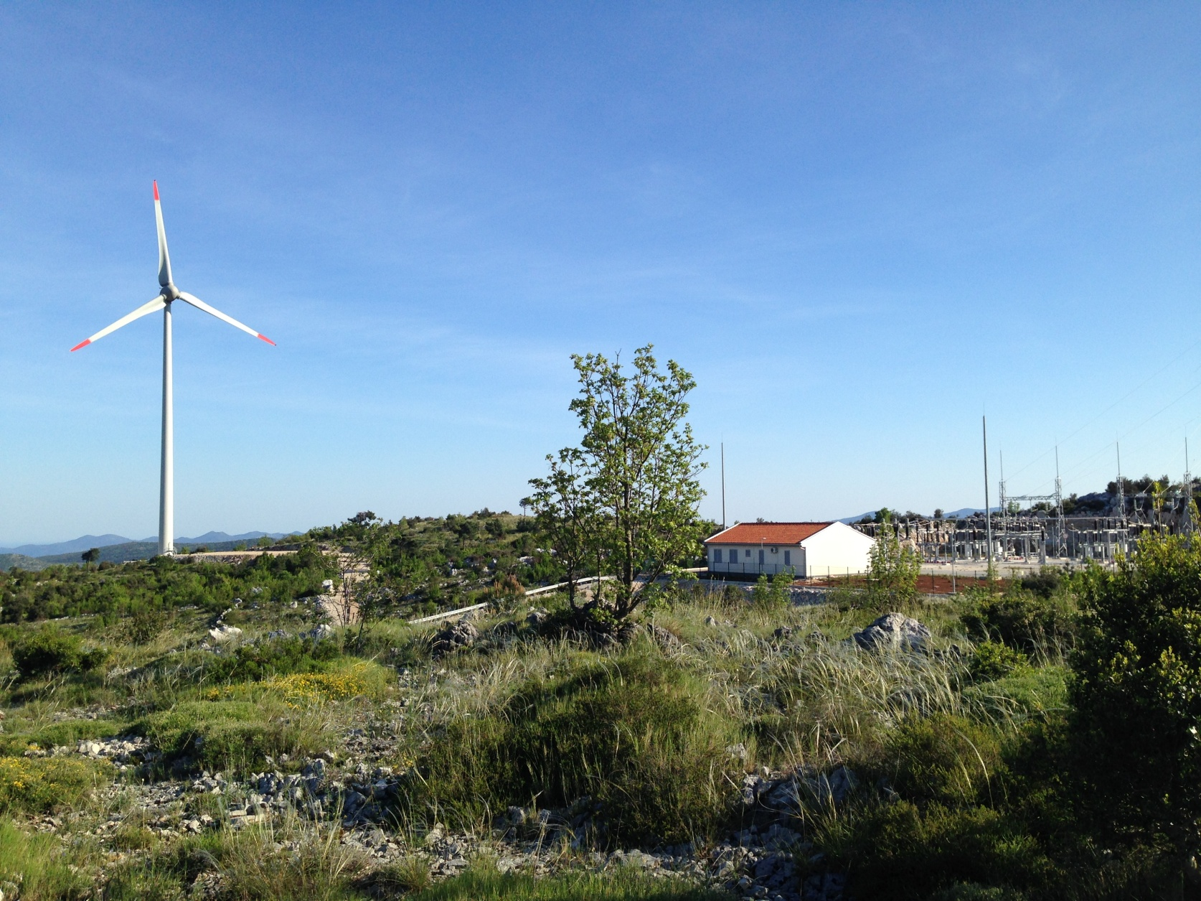
Introduction
In general: European citizens support wind energy (Eurobarometer 2007 & 2011).
On local level: criticism and opposition by public
→ around 20 % of wind energy projects delayed resp. seriously threatened due to appeals (Windbarriers 2010).
Necessity for social acceptance measures of wind energy infrastructure for all stakeholders involved in wind energy projects.
Notes:
Social acceptance of wind energy:
Promising strategies to foster social acceptance: Implementing public participation and engagement strategies into project management for onshore wind energy farms

Slide 3
Research questions of the study
Which measures of public participation are employed by project developers across the EU?
Have the measures led to positive effects regarding the social acceptance of wind energy projects?

Slide 4
Data and methods
Implementation of written survey in winter 2014/15
Sample description
207 participants (response rate 44%)
Experts with different backgrounds involved in wind energy projects.
Respondents from 13 countries (BE, DE, DK, EL, ES, FI, FR, HR, IE, IT, PL, RO, UK).
Notes:
On average, 15 questionnaires per country
countries from three stages of market development: developed, growth and emerging markets

Slide 5
Social acceptance as a challenge in wind project development
Experience of delays and stops of wind farms due to lack of social acceptance
Project developers
&
Cooperatives with experience with public participation (n=75)

Slide 6
Social acceptance as a challenge in wind project development
Main positive public reactions experienced in past 3 years
Positive reactions by political or other societal stakeholders
Positive reactions by local citizens
Main negative public reactions experienced in past 3 years
Negative reactions by local citizens
Formation of local opponent groups
Positive local media coverage
Negative reactions by political or other societal stakeholders
1
1
2
2
3
3
(n=207, multi responses possible)
Notes:
In sum, more negative than positive reactions were reported.
Local citizens are the most important originators of negative reactions, while positive reactions are expressed more often by political stakeholders.
In contrast to this: more positive reactions from political stakeholders reported on a local level.
Overall negative reactions predominate; though the fact that positive reactions do not get to be reported as often remains underliying this statement (negative reaction bias).
There is a significant positive correlation between these index variables (.51). Thus, the more positive reactions are reported the more negative ones are reported and vice versa.

Slide 7
Which measures of public participation are employed by project developers?
Three types of public participation acitivities:
Informational measures (e.g. distributing leaflets/brochures)
Consultation and dialogue with the public (public is able to give feedback on the project which is then considered)
Empowerment of the public (sharing the decision making process, e.g. via citizen vote)
Almost 70% of the project developers and cooperatives with experience with public participation (n=75): Public participation and engagement are elements as part of usual procedure:
Notes:
Informational measures: Include activities such as distributing brochures/leaflets which provide information about the project or provide possibilities where citizens may ask questions, e.g. information centre, special event, telephone hotline, open houses.
Consultation and dialogue with the public: Means that the public has the possibility to give feedback on the project and its specifications, e.g. at special events or through the collection of written feedback. The collected feedback is then considered by the project team and / or relevant administration.
Empowerment of the public = decision making: The public has the opportunity to make final decisions after having been thoroughly engaged regarding the project, e.g. via a citizen vote.
75 project developers and representatives from cooperatives with experience with public participation activities
24 state, they don’t apply any public participation measures in the phase of project preparation – but only 10 respondents indicate that measures are not relevant in this phase from their point of view. In later phases the share stating these measures are not relevant is higher.

Slide 8
Which measures of public participation are employed by project developers?
How many different public participation measures are applied in which project phase on average (project developers and cooperatives with experience with public participation activities (n=75))?
Notes:
Thus, the most measures of public participation are applied in the spatial and technical planning and in the permitting process (1.5 measures on average in each case), whereas in the project preparation only 1 measure on average is applied. Furthermore fewer measures are applied in the operation phase
Interpretation: It seems as if the project developers and cooperatives only apply measures of public participation when the project officially started and when there is maybe already some public opposition.

Slide 9
Have the measures led to positive effects regarding the social acceptance of wind energy projects?
Carrying out more public participation measures is associated with more positive reactions by residents.
Applying public participation measures in early project stages is associated with less negative reactions of local residents.
Correlations between no. of measures carried out in different project stages and public reactions
Spat. + tech. planning
Permitting
Construction
Project preparation
Operation
Positive reactions by local citizens
.288* | .237* | .473** | .411** | .363*
-.234* | - | - | - | -
Negative reactions by local citizens

Slide 10
Have the measures led to positive effects regarding the social acceptance of wind energy projects?
Carrying out more public participation measures is associated with more positive reactions by political stakeholders.
Applying public participation measures is not associated with negative reactions of political stakeholders.
Correlations between no. of measures carried out in different project stages and public reactions
Spat. + tech. planning
Permitting
Construction
Project preparation
Operation
Positive reactions by political stakeholders
.166* | .249* | .231* | .227* | .245*
- | - | - | - | -
Negative reactions by political stakeholders

Slide 11
Conclusions
Negative reactions by local residents and political stakeholders are an important issue for wind projects: Majority of project developers reported delays or stops of wind farms due to social acceptance issues.
Developers are aware of social acceptance issues: Elements of public participation often form part of usual procedure. However, they often start too late with public participation activities, even if they evaluate carrying out measures in early stages as necessary.
Carrying out many public participation measures in all project stages is associated with more positive reactions by residents and political stakeholders. These measures, however, can not prevent negative reactions of stakeholders or the public, only those applied very early.
Notes:
The public is often responsible for negative reaction in relation to wind farms and also political stakeholders.
Start too late: One possible explanation for this could be the fact that the project developers and cooperatives only apply measures of public participation when there is already some opposition. A reason might be too few resources (staff, time, money) to apply public participation measures in early project stages.
to avoid negative reactions public participation measures have to start very early, but to trigger positive reactions measures in all project phases are important

Slide 12
Uta Schneider, Dr. Elisabeth Dütschke, Julius P. Wesche Fraunhofer Institute for System and Innovation Research ISI
Breslauer Straße 48 | D-76139 Karlsruhe
Telephone +49 721 6809-433
Uta.schneider@isi.fraunhofer.de
http://www.isi.fraunhofer.de
wisepower@isi.fraunhofer.de
12
Notes:
For further information please come and see me.

Slide 13
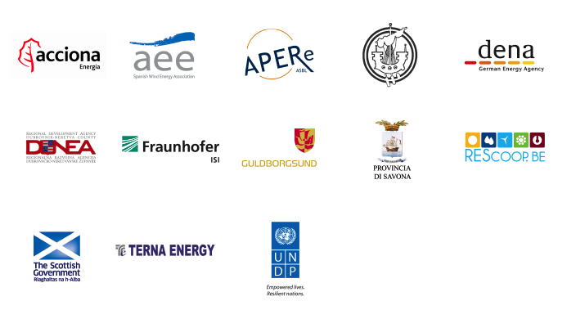
COORDINATOR
PARTNERS

Slide 14
Annex

Slide 15
Social acceptance as a challenge in wind project development
Main positive issues in relation to wind power projects (past 3 years)
Main negative issues in relation to wind power projects (past 3 years)
Notes:
In sum, more negative than positive reactions were reported.
Local citizens are the most important originators of negative reactions, while positive reactions are expressed more often by political stakeholders.
In contrast to this: more positive reactions from political stakeholders reported on a local level.
Media coverage was perceived equally often as negative and positive.
About 30% of the respondents have experienced lawsuits, which is quite a high number, as they can have significant impact on delaying wind farm projects.
17% of the respondents did not report any reaction.
Overall negative reactions predominate; though the fact that positive reactions do not get to be reported as often remains underliying this statement (negative reaction bias).

Slide 16
Last year’s presentation

Slide 17
Results: Activities regarding public participation
Public participation elements obligatory during phases of wind farm development:
48% of the participants*
→ Public participation often goes beyond what is envisaged by legislation.
Public participation elements as part of usual procedure:
66% of the participants*
(independent of whether public participation is obligatory)
* Only respondents who have been directly involved in activities for public participation, N=121
Notes:
Public participation obligatory?
48% stated that elements of public participation obligatory during any phase of wind farm development.
33% said this is sometimes the case.
15 % no
4% don’t know
Public participation as part of usual procedure:
66% yes, always or in most cases
27% sometimes
3% no
3% don’t know
→ Public participation of some kind usually part of the project development for wind farms

Slide 18
Results: Resource allocation
Systematical resource allocation to participation and communication activities in only about 40% of referenced organisations *
* Only respondents who have been directly involved in activities for public participation, N=121
Notes:
Knowledge of advice giving documents:
Only 12 % of the respondents ever applied the practices on social acceptance of wind energy projects from the International Energy Agency (IEA);
GPWind project and “Best Practices for Community Engagement and Public Consultation” from the Canadian Wind Energy Association applied by only 6 %.
two reports from the Centre for Sustainable Energy (2007, 2009) and the ESTEEM toolkit (2007) used to an even lesser extent.
Barriers for using standard guidelines and toolkits:
reason stated most often is a lack of resources (22%)
Furthermore, guidelines are considered as not helpful for actual project development processes (15%).
12% do not see the need to use them.
Further barriers (open question): difficulties applying the existing knowledge.
Standard guidelines, toolkits and best practices often do not fit the local realities,
Material is perceived as abstract and difficult to transfer to the concrete project,
Approaches are needed, that can be individually adjusted.

Slide 19
Results: Utilisation of standard procedures
Regularly utilisation of standard procedures or guidelines for public participation activities is confirmed by 34% of participants*
* Only respondents who have been directly involved in activities for public participation, N=121 multiple responses were possible)
Notes:
Knowledge of advice giving documents:
Only 12 % of the respondents ever applied the practices on social acceptance of wind energy projects from the International Energy Agency (IEA);
GPWind project and “Best Practices for Community Engagement and Public Consultation” from the Canadian Wind Energy Association applied by only 6 %.
two reports from the Centre for Sustainable Energy (2007, 2009) and the ESTEEM toolkit (2007) used to an even lesser extent.
Barriers for using standard guidelines and toolkits:
reason stated most often is a lack of resources (22%)
Furthermore, guidelines are considered as not helpful for actual project development processes (15%).
12% do not see the need to use them.
Further barriers (open question): difficulties applying the existing knowledge.
Standard guidelines, toolkits and best practices often do not fit the local realities,
Material is perceived as abstract and difficult to transfer to the concrete project,
Approaches are needed, that can be individually adjusted.

Slide 20
Results: Reasons for not using advice giving documents
Reasons (quantitative) for not using advice giving documents already available (guidelines and toolkits)*
* Only respondents who have been directly involved in activities for public participation, N=121 multiple responses were possible)
Notes:
Further reasons (qualitatively collected)
Standard guidelines, toolkits and best practices often do not fit the local realities,
Material is perceived as abstract and difficult to transfer to the concrete project,
Approaches are needed, that can be individually adjusted.

Slide 21
Results: Evaluation of different levels of public involvement
Informa-tional
measures
Considered as fundamental requirement, but not sufficient as such
Consul-tation + dialogue with public
Considered next step after informational measures
Empower-ment of public
Not been implemented very often, not many experiences
On the other hand: negative experiences with dialogues with the public or poor levels of interest.
Several challenges
Processes could be too time-consuming to be in line with investor interests.
By many respondents also considered as basic requirement.
Notes:
Informational measures: Include activities such as distributing brochures/leaflets which provide information about the project or provide possibilities where citizens may ask questions, e.g. information centre, special event, telephone hotline, open houses.
Consultation and dialogue with the public: Means that the public has the possibility to give feedback on the project and its specifications, e.g. at special events or through the collection of written feedback. The collected feedback is then considered by the project team and / or relevant administration.
Empowerment of the public = decision making: The public has the opportunity to make final decisions after having been thoroughly engaged regarding the project, e.g. via a citizen vote.
Experiences on average positive.
Experiences: If the answers are analysed according to market development similar results emerge for all three market types.
This shows that consultation and dialogue does not necessarily lead to success.
Em-power-ment of public. Challenges
find right point in time, right format and making sure that all representatives of community including the opponents of wind power come to such meetings.

Slide 22
Synopsis: Status quo of wind acceptance and utilisation of a strategies and practices
Wind usually evaluated positively, though for specific projects social acceptance remains a challenge.
Public participation measures seem to frequently exceed legal requirements.
There are resources allocated to social engagement activities but only to a limited extend
A considerable quantity of advice giving documents are already available but they do not seem to be used regularly due to difficulties applying the existing knowledge.
While informational measures are considered as fundamental, they should be supplemented by consultation and dialogue

Slide 23
Experience of delays and stops of wind farms due to lack of social acceptance
* Only respondents who have been directly involved in activities for public participation, N=121 multiple responses were possible)

Slide 24
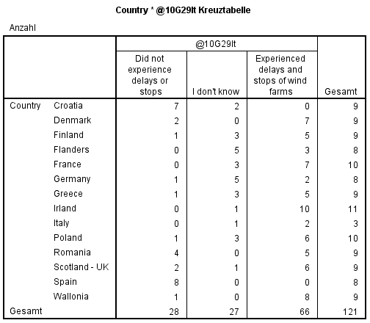
Experience of delays and stops of wind farms due to lack of social acceptance
Experience of delays and stops of wind farms due to lack of social acceptance (N=121)

Slide 25
Experienced reactions towards wind farms
Green = positive reactions; red = negative reactions; orange = other categories

Slide 26
Utilisation of standard procedures (e.g. guidelines, best practices and toolkits)
Knowledge and utilisation of selected English social acceptance guidelines and toolkits
A considerable quantity of advice giving documents are already available but they do not seem to be used regularly due to difficulties applying the existing knowledge.

