Slide 1
Creation and management of a compensatory scheme wind farms and wolf habitat conservation in Portugal Gonçalo Brotas, José Miguel Oliveira & Cindy Loureiro
Hamburg, 29th September 2016

Slide 2
Compensatory Measures
Project
Construction
Operation
Impacts
Impact 2
Impact 1
Measures
Minimization 2
Minimization 1
Impacts
Impact 2
Measures
Minimization 2
Minimization 1
Unpredicted impact
Impact 1
Impacts
Impact 2
Measures
Minimization 2
Minimization 1
Compensatory
Unpredicted impact
Impact 1
Creation and management of a compensatory scheme
wind farms and wolf habitat conservation in Portugal
Hamburg, 29th September 2016

Slide 3
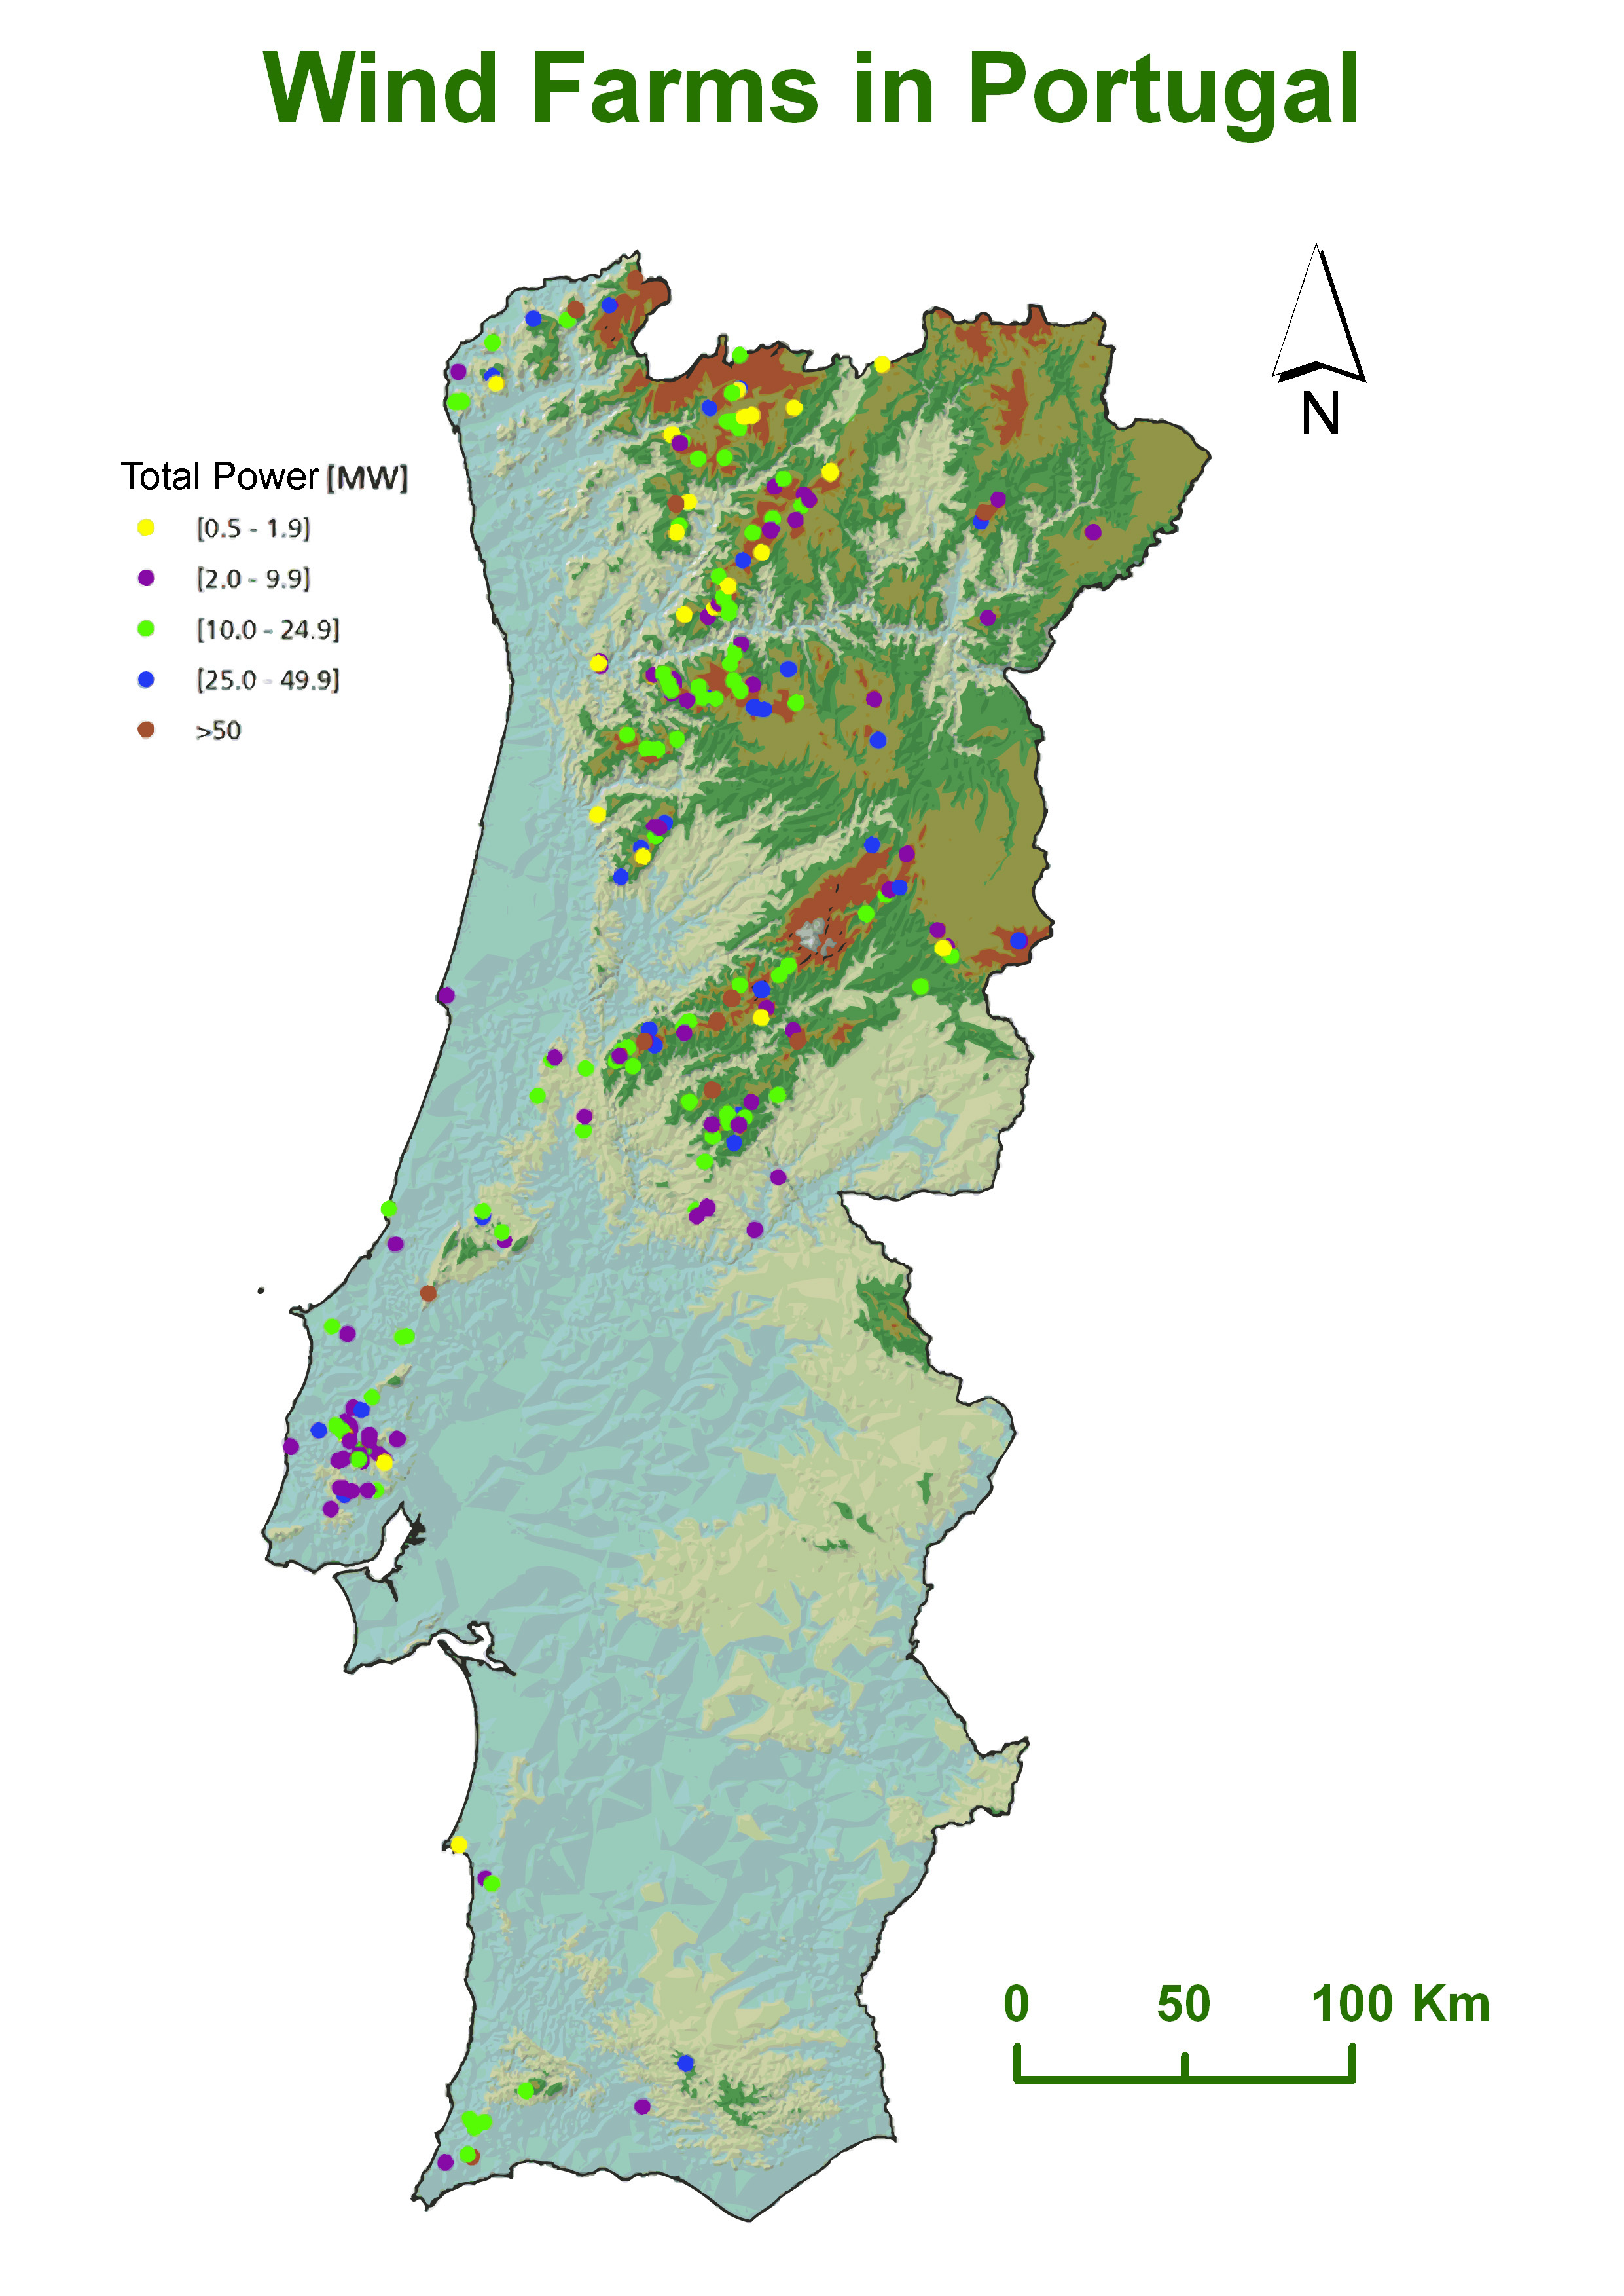
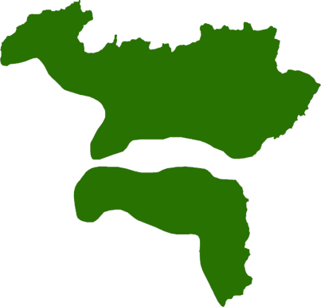
Wind farms and Wolf
5000 MW installed
Majority of wind farms located in remote mountain areas
Iberian Wolf is a protected species
Northern and central (interior) regions
Creation and management of a compensatory scheme
wind farms and wolf habitat conservation in Portugal
Hamburg, 29th September 2016

Slide 4
The Compensatory Scheme
Wind Farms
Habitat disturbance
ACHLI and Wolf Fund
Habitat Management
Improved Habitat
Refuge
Food
Tranquility
Human/Wolf relationship
Financed by Wolf Fund
Promoted by ACHLI
Creation and management of a compensatory scheme
wind farms and wolf habitat conservation in Portugal
Hamburg, 29th September 2016

Slide 5
The Compensatory Scheme
Creation of ACHLI in 2006
16 members – Wind farm companies
Annual contributions to the Wolf Fund and ACHLI according to the installed capacity
ACHLI (a NPO) manages the Wolf Fund
Creation and management of a compensatory scheme
wind farms and wolf habitat conservation in Portugal
Hamburg, 29th September 2016

Slide 6
Wolf Fund and ACHLI
Creation and management of a compensatory scheme
wind farms and wolf habitat conservation in Portugal
Hamburg, 29th September 2016

Slide 7
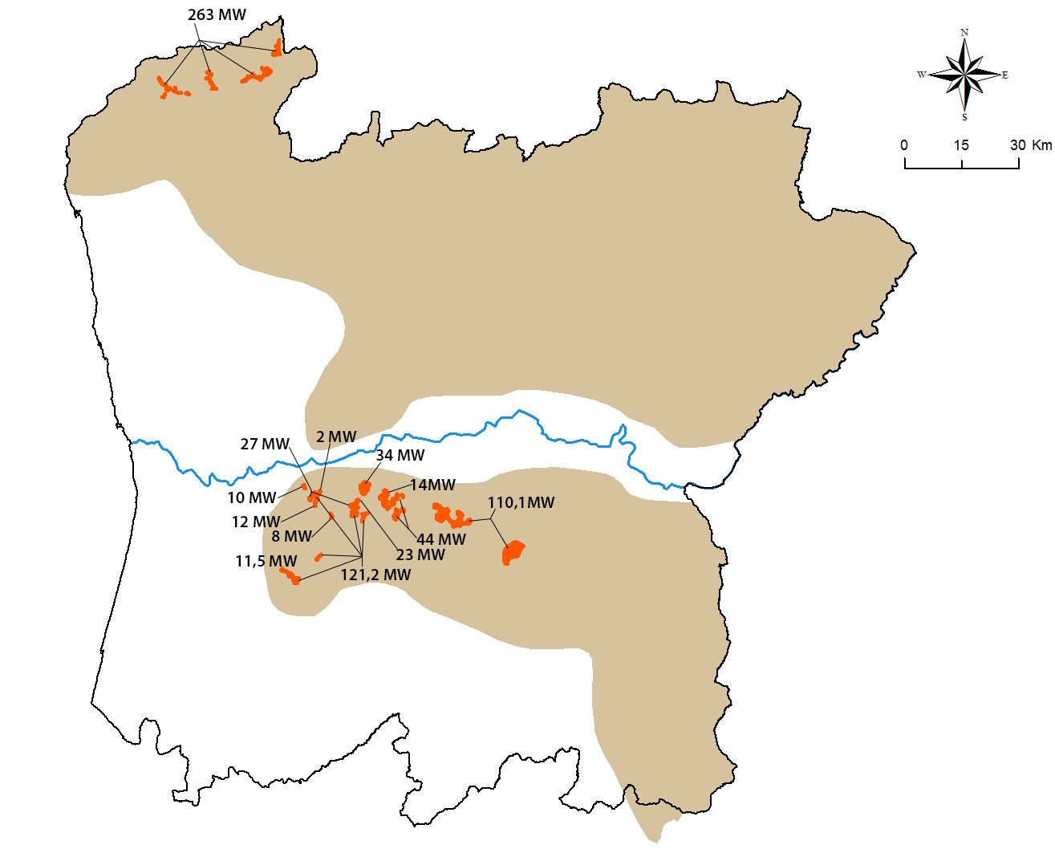
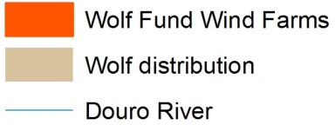
Wolf Fund Wind Farms
12 wind farms from 2 MW to 263 MW
Total of 668 MW
Average contribution of 574€/MW/year
Creation and management of a compensatory scheme
wind farms and wolf habitat conservation in Portugal
Hamburg, 29th September 2016

Slide 8
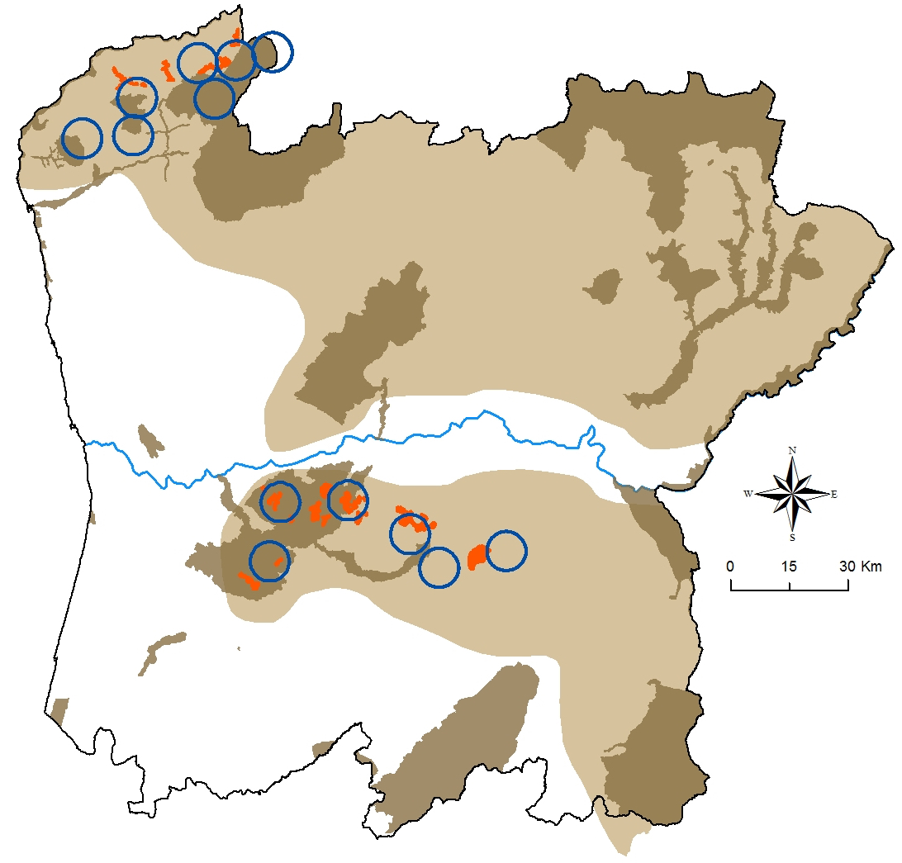
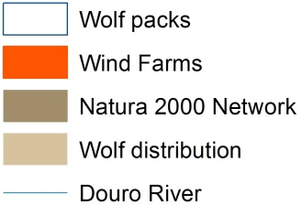
Wolf Fund Wolf Packs
Creation and management of a compensatory scheme
wind farms and wolf habitat conservation in Portugal
Hamburg, 29th September 2016

Slide 9
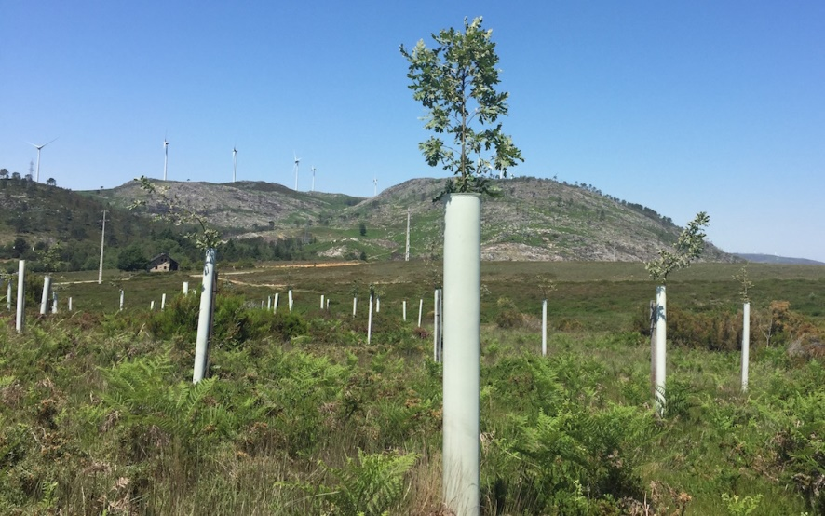
Projects - Forestry
Forestry for conservation
Total area of 341 ha
71 000 trees planted
1 Tree nursery
Creation and management of a compensatory scheme
wind farms and wolf habitat conservation in Portugal
Hamburg, 29th September 2016
Notes:
Several hectares of forestations with authoctonous trees an fire preventing actions.

Slide 10
Projects - Forestry
Creation and management of a compensatory scheme
wind farms and wolf habitat conservation in Portugal
Hamburg, 29th September 2016
Notes:
Several hectares of forestations with authoctonous trees an fire preventing actions.

Slide 11
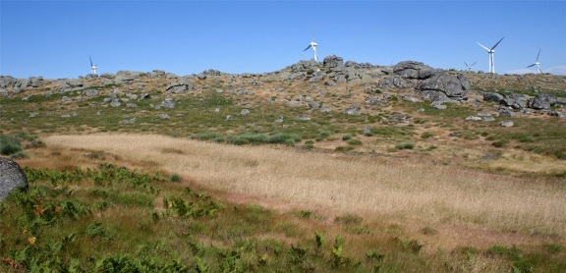
Projects – Game Management
Creation of no hunting areas
Developed in collaboration with hunters associations
Total of 2300 ha of no hunting areas
Creation and management of a compensatory scheme
wind farms and wolf habitat conservation in Portugal
Hamburg, 29th September 2016
Notes:
Several hectares of forestations with authoctonous trees an fire preventing actions.

Slide 12
Projects – Game Management
Creation and management of a compensatory scheme
wind farms and wolf habitat conservation in Portugal
Hamburg, 29th September 2016

Slide 13
Projects - Wild Prey Reintroduction
Increase food availability
Increase wild prey diversity
Reduce livestock damages
Roe deer reintroduction
58 roe deer in 3 years
Creation and management of a compensatory scheme
wind farms and wolf habitat conservation in Portugal
Hamburg, 29th September 2016
Notes:
This project partners are: forestry national authority, universities, local government institutions and local hunters associations;

Slide 14
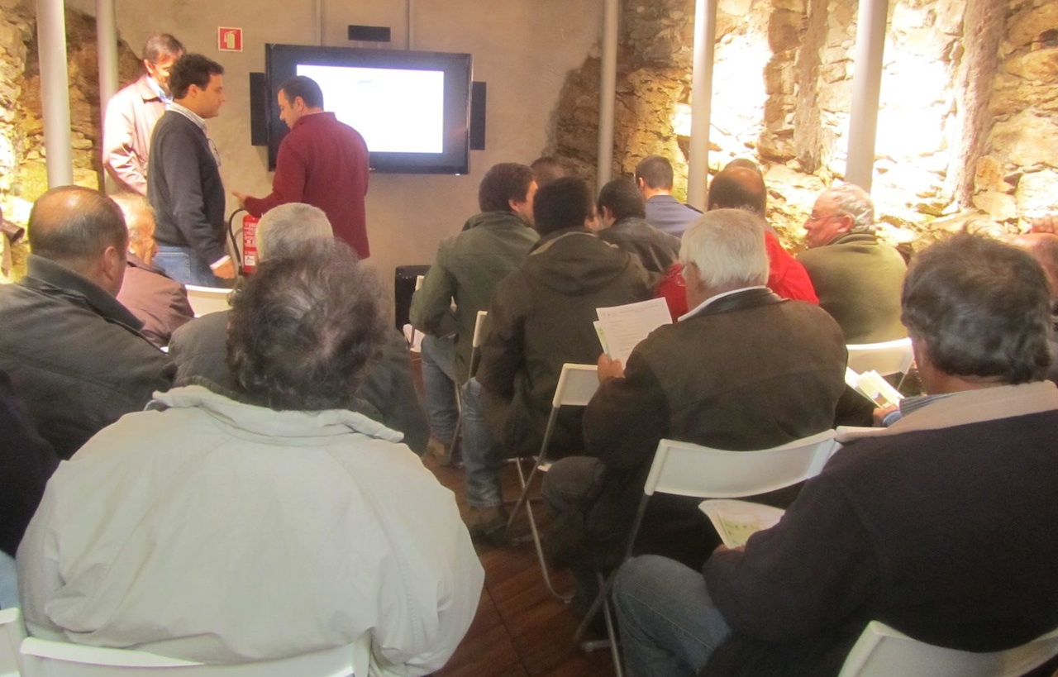
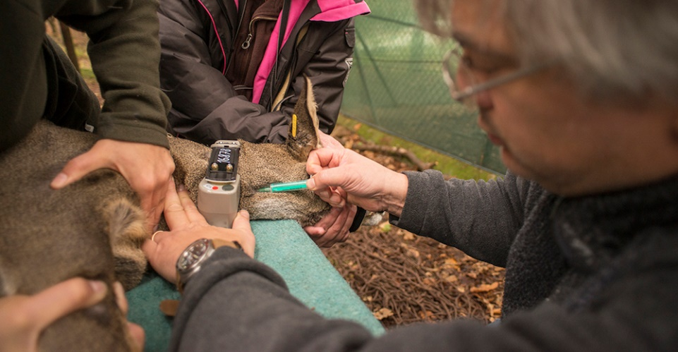
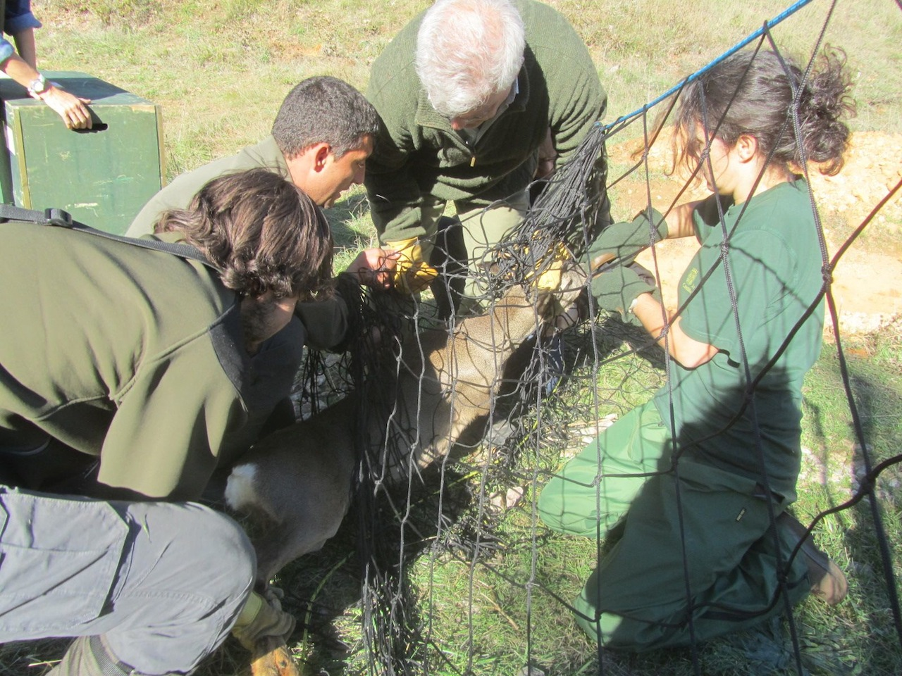
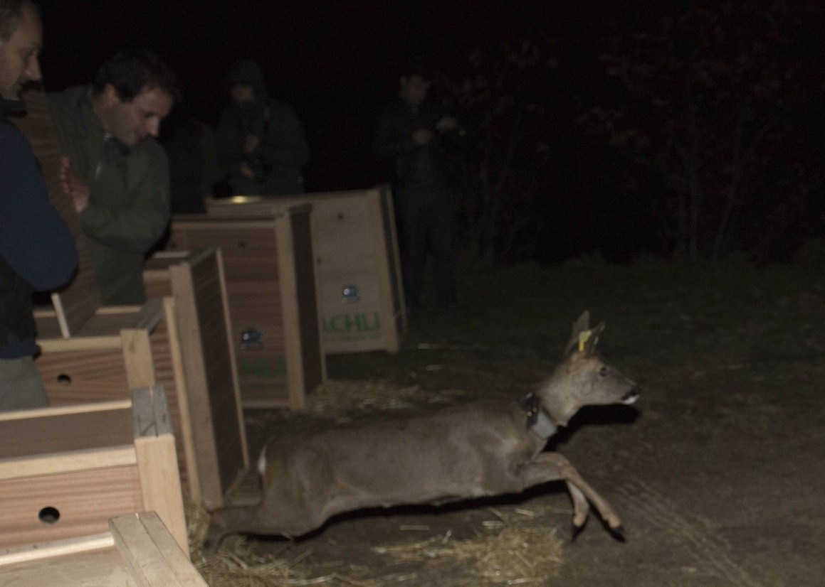
Projects - Wild Prey Reintroduction
Fonte: Torres R.T., et al (2012)
Creation and management of a compensatory scheme
wind farms and wolf habitat conservation in Portugal
Hamburg, 29th September 2016

Slide 15
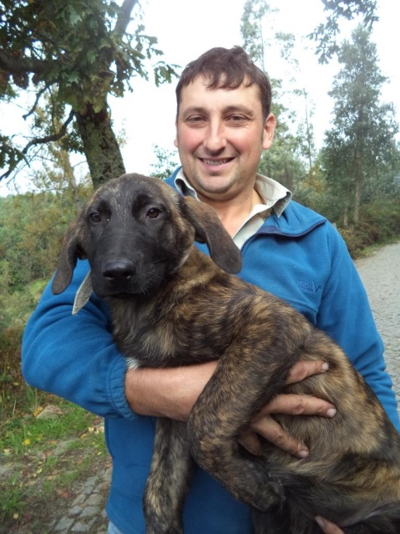
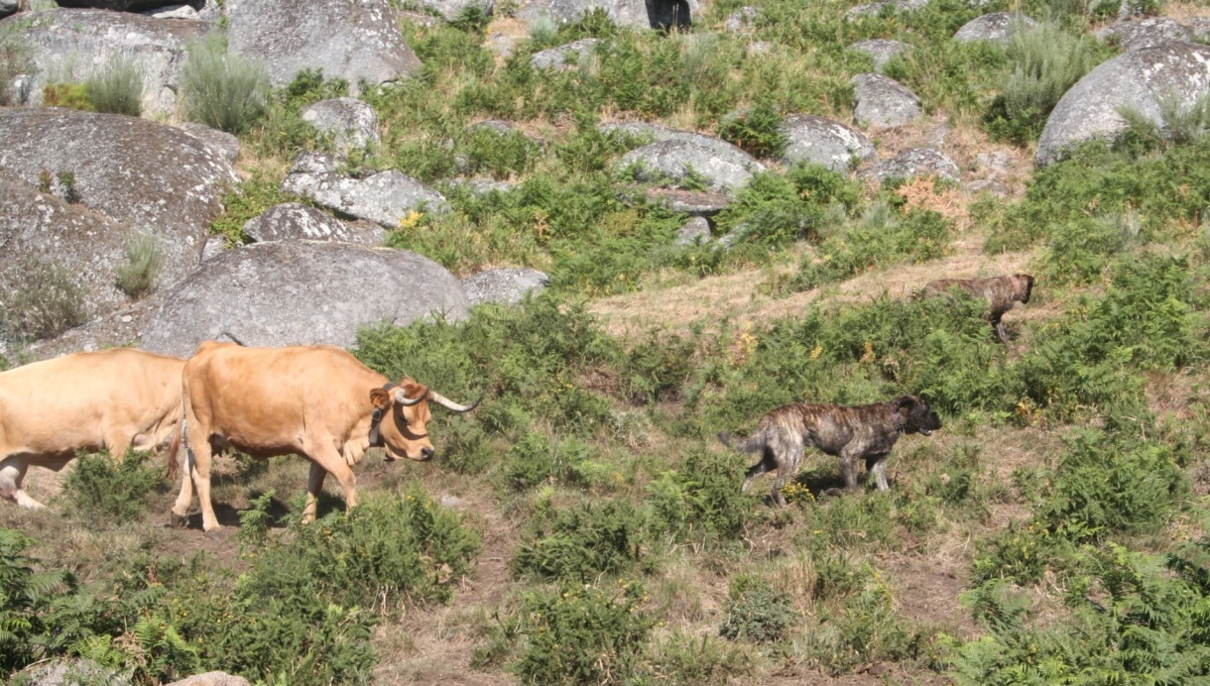
Projects - Livestock Guarding Dogs
Distribution of livestock guarding dogs to local farmers
28 dogs in 2,5 years
Creation and management of a compensatory scheme
wind farms and wolf habitat conservation in Portugal
Hamburg, 29th September 2016

Slide 16
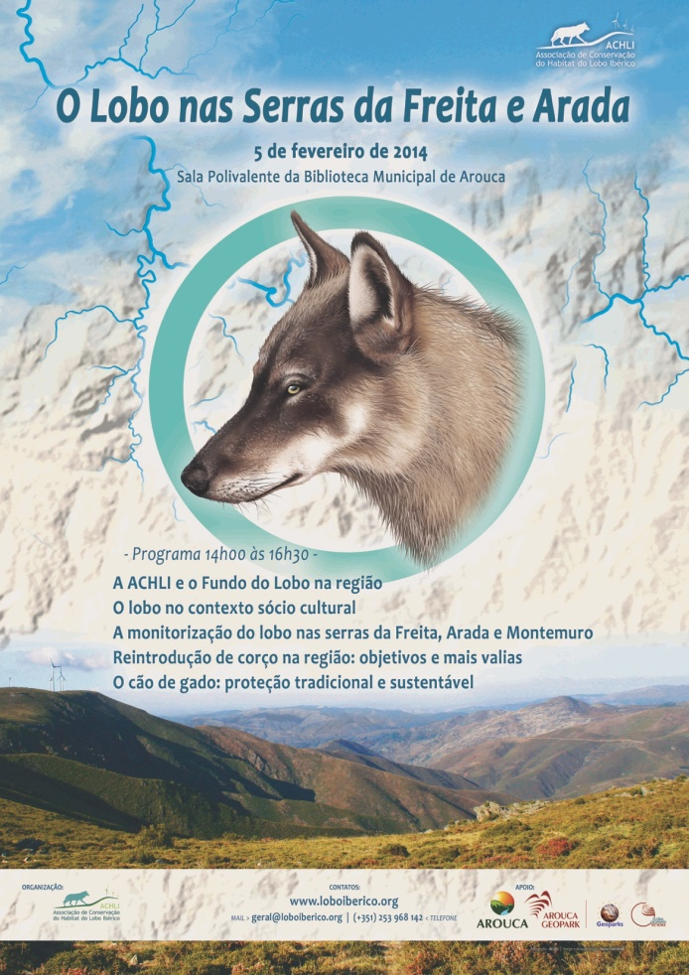
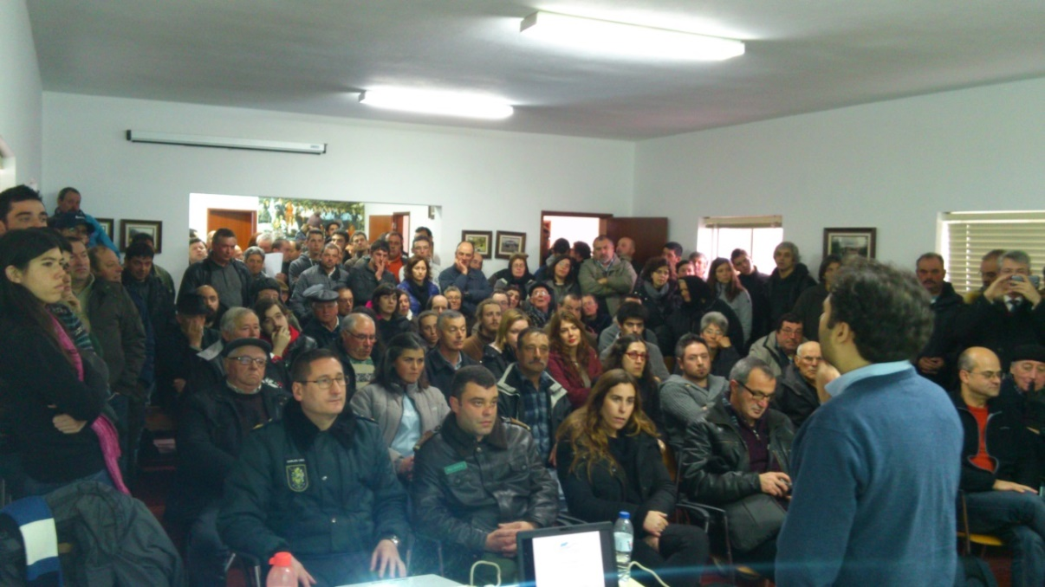
Projects - Awareness
Awareness sessions
Target audience: local populations
Talking and listening
Creation and management of a compensatory scheme
wind farms and wolf habitat conservation in Portugal
Hamburg, 29th September 2016

Slide 17
Discussion
Pros of the compensatory scheme:
Long term planning
Financial sustainability
Complementary between projects
Better articulation between national authorities, wind farms owners, local populations and, R&D and conservation organizations
Cons of the compensatory scheme:
Difficult to assess short term results
Creation and management of a compensatory scheme
wind farms and wolf habitat conservation in Portugal
Hamburg, 29th September 2016

Slide 18
Relevant aspects
Adaptive management of projects
Scheme replicability
Coordination with National Authorities
Local population contact
Scale effect
Financial sustainability
Creation and management of a compensatory scheme
wind farms and wolf habitat conservation in Portugal
Hamburg, 29th September 2016
Notes:
Conjuntura económica

Slide 19
Acknowledgments
THANK YOU!
Creation and management of a compensatory scheme
wind farms and wolf habitat conservation in Portugal
Hamburg, 29th September 2016

