Slide 1
--- The repowering challenge in Germany ---

Slide 2
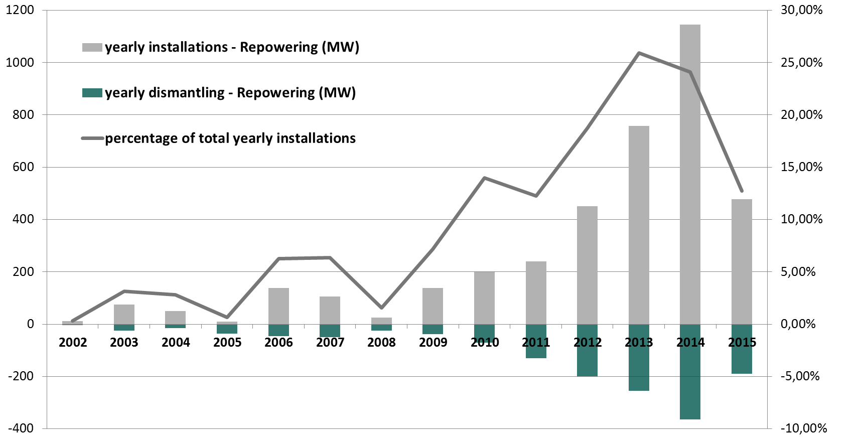
Development of Repowering-Projects in Germany
➔ Repowering is of increasing importance to achieve future development goals.
source: Deutsche Windguard – Status des Windenergieausbaus an Land - 2015

Slide 3
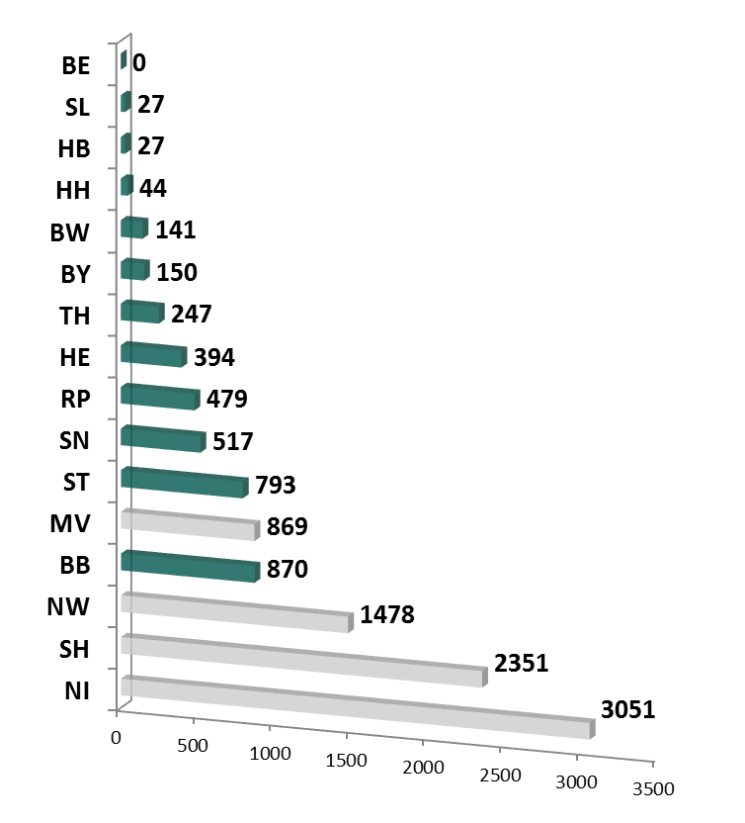
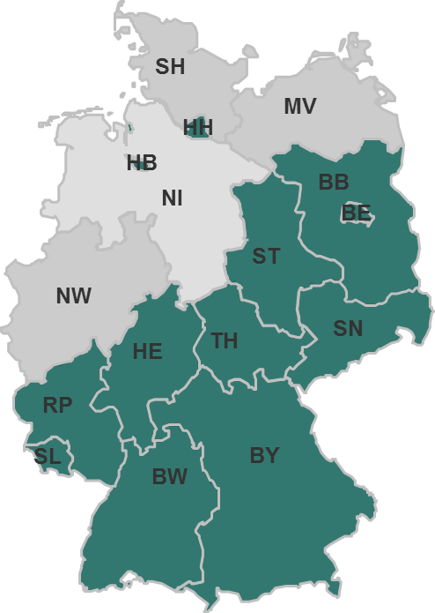
Allocation of repowering potential in Germany
Number of WECs installed until 2001
Nearly 70% of approximately 11.500 WECs with an installation date prior to 2001are installed in the northwestern federal states
➔ The main repowering potential for the next years can be found especially in the northwest of Germany.
source: DEWI Magazin Nr. 20, February 2002

Slide 4
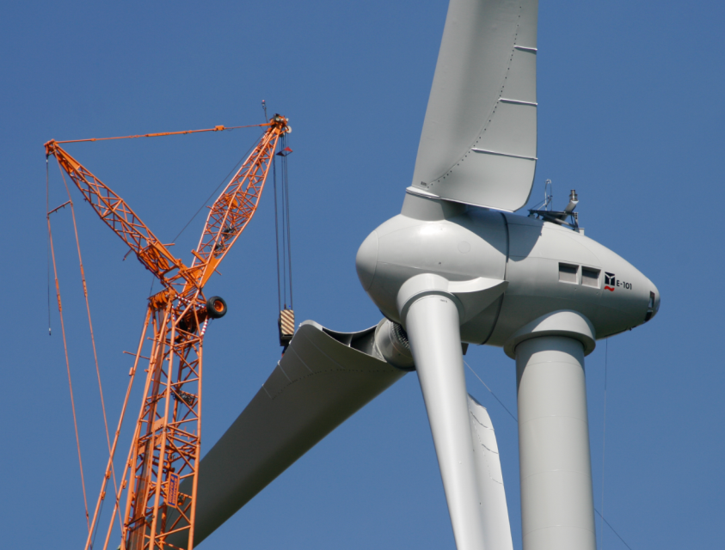
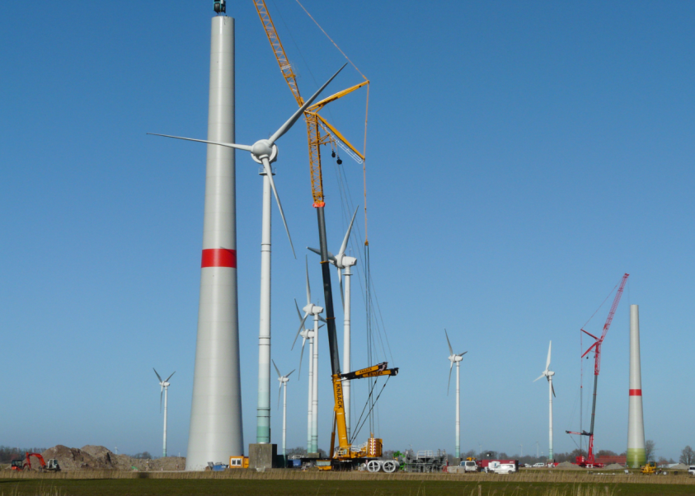
Repowering example from Lower Saxony
Old windfarm:
→ 25x E-44 5.40 in Lower Saxony
→ installation date: 1999; feed-in tariff till 2020
→ yearly energy yield: 1.030 MWh/WTG; 25.761 MWh/windpark
New project:
→ 13x E-101 135m hubheight
→ installation date: 2015
→ yearly energy yield: 9.949 MWh/WTG; 129.349 MWh/windpark
+ 502% energy yield

Slide 5
Thank you for your attention!
ENERCON GmbH | Dreekamp 5 | D-26605 Aurich
phone: +49 4941 927-0 | fax: +49 4941 927-109

Slide 6
Legal notice
Publisher | ENERCON GmbH ▪ Dreekamp 5 ▪ 26605 Aurich ▪ Germany Phone: +49 4941 927-0 ▪ Fax: +49 4941 927-109 ▪ E-mail: info@enercon.de ▪ Internet: http://www.enercon.de Managing Directors: Hans-Dieter Kettwig, Nicole Fritsch-Nehring Local court: Aurich ▪ Company registration number: HRB 411 ▪ VAT ID no.: DE 181 977 360
Copyright notice | The entire content of this document is protected by the German Copyright Act (UrhG) and international agreements. All copyrights concerning the content of this document are held by ENERCON GmbH, unless another copyright holder is expressly indicated or identified. Any content made available does not grant the user any industrial property rights, rights of use or any other rights. The user is not allowed to register any intellectual property rights or rights for parts thereof. Any transmission, surrender and distribution of the contents of this document to third parties, any reproduction or copying, and any application and use - also in part - require the express and written permission of the copyright holder, unless any of the above are permitted by mandatory legal regulations. Any infringement of the copyright is contrary to law, may be prosecuted according to §§ 106 et seq. of the German Copyright Act (UrhG), and grants the copyright holder the right to file for injunctive relief and to claim for punitive damages.
Registered trademarks | Any trademarks mentioned in this document are intellectual property of the respective registered trademark holders; the stipulations of the applicable trademark law are valid without restriction.
Reservation of right of modification | ENERCON GmbH reserves the right to change, improve and expand this document and the subject matter described herein at any time without prior notice, unless contractual agreements or legal requirements provide otherwise.
Dokumentinformation
Document ID
Note | Translation
Date | Language | DCC | Plant / Department
yyyy-mm-dd | <iso-code> | <DCC> or -- | <plant / department>
Revisions
Rev. | Date | Change
0 | 2016-09-26 | Creation of the document

