Slide 1
System integration costs and the UK: the good, the bad and the ugly
by Alex Coulton
Senior Policy Analyst, Western Europe
e alex.coulton@res-ltd.com
t +44 (0)7469 859 958

Slide 2
Challenge our traditional view of the trilemma
Price
Wholesale price
Network costs
Levies
VAT
Volume
Energy Efficiency
Demand Side Response
Secure decarbonised power sector at least cost
Cost
Environmental & social
Security
Poyry / Baringa market projections
Rapid cost reduction of renewables
Risk perception
Goals (policy imperatives)
Attractors (market dynamics)
Energy security (access to resource)
Security of supply (balancing)
System Adequacy (capacity)
System Stability (operation)
Decarbonisation
Regulation
Health
Notes:
Goal is secure decarbonisation at lower cost
But security and decarbonisation at imperatives
We can have a debate around where the red lines reside – for instance LOLE or carbon intensity
But there are red lines here – system needs to be kept with a certain frequency because of the laws of physics / we cannot compromise on nuclear waste disposal
Importantly and not very well understood by stakeholders and especially government is that the red lines are reinforced by market dynamics
Security and environmental/social agenda are market attractors
This is because risk perception & market projections influence investment decisions
Even if this government where to renegade on the decarbonisation agenda investors cannot ignore that the next is likely to change its mind
Additionally, there is a technological revolution taking place, cost reduction of renewables is stimulated by global supply chains and this is a serious risk to any investment made today
Trafford CCGT – only successful CM bid but will not deliver. Financiers told the developers they needed £72/MWh, a significantly higher price than commodity price projections, I price which clearly indicates that the decarbonisation agenda and limits on fossil fuel emission where clearly being considered as red lines by the market

Slide 3
Delivering affordability is about market design
Technology options
A secure decarbonised power sector at least cost
Traditional market
Capacity, Dispatch & Balancing
Wholesale & balancing market
System stability
Ancillary market
Decarbonisation add ons
RO / FiT – but not a market
Electricity Market arrangements
Post-EMR market
Dispatch & Balancing
Wholesale & balancing market
Decarbonisation
CfD (& LCF)
Capacity
Capacity Market
Ancillary market
System stability
NECESSARY– wholesale market cannot deliver capacity of any kind, let alone the right type of new-build
AND
DESIRABLE – efficiently allocated CfDs are a lower cost investment vehicle & provide deployment control
Notes:
If security and Environment are red lines how do you deliver affordability?
Through the electricity market arrangements
This is why we mover from traditional market structure in which new-build generation was supposed to be delivered with the wholesale market to a new reformed market
The EMR seeks to deliver on our policy objectives
It was necessary – no new build let alone the right type
CfD is desirable – lowest cost vehicle for high capex generation + control on deployment
It’s lowest cost because CfD is a revenue stabilisation mechanism that reduces the cost of capital
We estimate that a 2% reduction in the cost of capital on one of our typical onshore wind farm represents ~£9/MWh reduction in costs.
And let me highlight how important this is now…

Slide 4
Government puts SIC on the agenda
Is competition in the CfD on a level playing field?
What should be done to address this?
Source: Nuclear power in the UK, National Audit Office, 2016

Slide 5
Imperial college report
Sponsors:
Innogy
Statoil
Scottish Power
RES group
Imperial team:
Prof Goran Strbac
Dr Marko Aunedi
Aim:
Develop evidence base that will help advance the policy debate
Key outputs:
Identification of the Total Cost of the System
Further develop understanding of System Integration Costs
Provide policy recommendations on how to take this forward

Slide 6
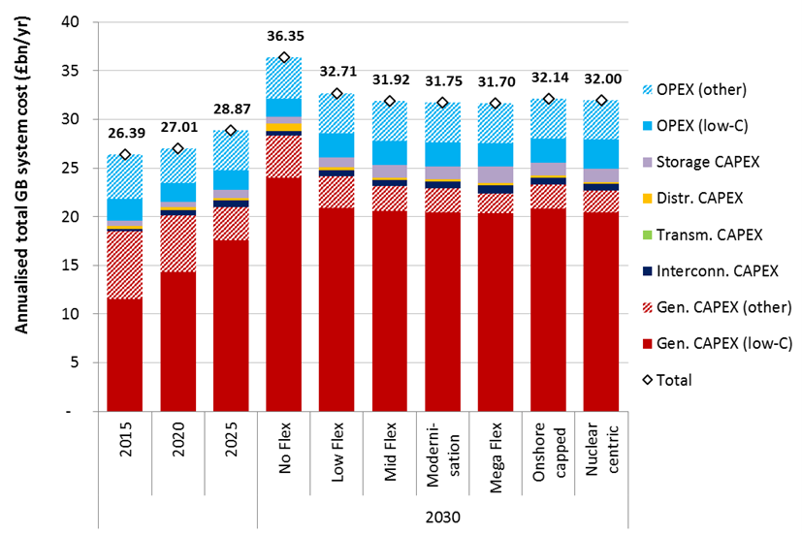
The Good: Total System Costs in 2030 – wind is competitive
- 100gr CO2/KWh
- 3hr LOLE
Wind: 40-42GW
Nukes: 16.4GW
Onshore: 8GW

Slide 7
The Bad: System Integration costs and going beyond 100gr CO2/KWh
Sensitivity
Elements that contribute to the System Integration Costs of Variable RES
Network reinforcements (already accounted for in the cost of generation)
Balancing the system
Backup capacity
Cost of maintaining system carbon emissions

Slide 8
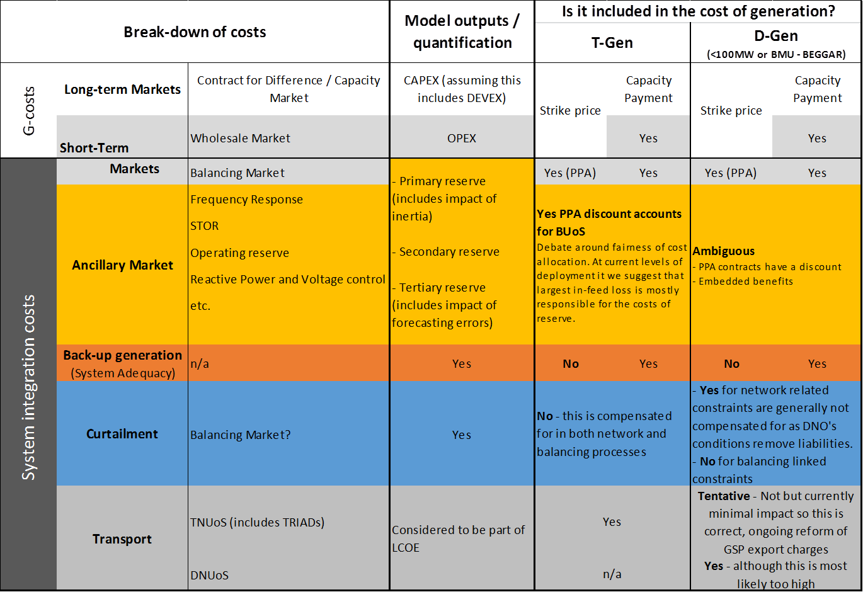
The ugly: model to reality…

Slide 9
Further market reform is needed…
There is a need for further market reform…
Network charging arrangements
Ancillary services
Back-up generation?
Deliver a secure and decarbonised power sector at least cost:
In the UK, SIC does not undermine the least cost nature of mature RES
Accelerating flexibility is a no-regret option
E3G front-end report will lay out policy recommendations in more detail:
Sponsors: Innogy, RES group and Scottish Power
Launch date: Late October

