Slide 1
A study of the variation in offshore turbulence intensity around the British Isles
WindEurope Summit 2016
Przemek Marek, Thomas Grey, Andrew Hay

Slide 2
Background
Offshore Wind Accelerator is a joint industry programme to drive down costs
Joint industry project involving 9 developers + Carbon Trust
The largest and most established innovation programme
New lower-cost technologies, ready to use
Simple governance model
Over €100m total programme spend to date
Industry has funded >60%
Two types of project
Common R&D – concept development and knowledge building
Discretionary Projects – demonstrations
Value to government and industry partners
Great leverage for industry partners (>13x)
Efficient vehicle for government to accelerate innovation and attract international interest
CarbonTrust.com/OffshoreWind

Slide 3
Motivation
Turbulence intensity is one of key wind metrics
Increasing use of LiDAR devices
Publicly available data available
Can off-site turbulence intensity measurements be used for offshore assessments?
Notes:
Positive spin on LiDARs. Costs can be reduced using LiDARs, however TI from RS not comparable to cup anemometry.
Assessments – energy assessments, site conditions

Slide 4
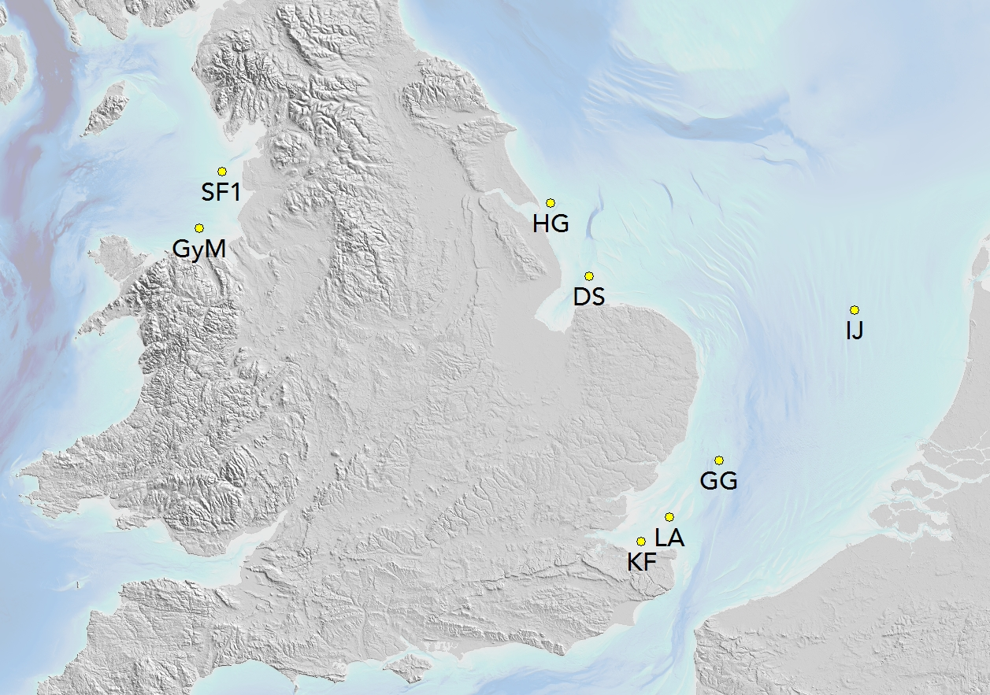
Datasets
The study was based on publicly available datasets from 8 masts:
Docking Shoal
Greater Gabbard
Gwynt y Môr
Humber Gateway
IJmuiden
Kentish Flats
London Array
Shell Flats
Notes:
Sourced from The Crown Estate MDE and ECN
Standard FG data processing
Datasets not FG - data coverage, mounting arrangements, missing info – but suitable for the purposes of this study
Wind speed data at 87 m amsl derived from each dataset
Seasonal balancing – cut to integer years (to be explained later on)
Largely Round 2 UK sites. SF and KF – Round 1. IJ – ECN.

Slide 5
All directional turbulence intensity
Max 6.5%
Min 5.8%
All turbulence intensity values derived for a hub height of 87 m
Notes:
- Using means from all wind speed bins yields a slightly higher overall TI values, however the trends and spread remains very similar

Slide 6
Turbulence intensity vs season
Turbulence frequency distributions for 8 – 10 m/s wind bins and southwest sectors only shown
Notes:
SW sectors only shown.
Strong seasonal trends. Convective TI
water / air temp diff hypothesis
also likely to cause a slight dip in the S sectors in the previous graphs.
SEASONALLY BALANCED DATASETS!

Slide 7
Turbulence intensity vs wind speed and sea-air temperature difference
 |  | Wind speed [m/s]
Air – water temp [ºC] |  | 3 | 4 | 5 | 6 | 7 | 8 | 9 | 10 | 11 | 12 | 13 | 14 | 15 | 16
(air colder than water) | -8 |  |  |  |  | 8.8 | 8.4 | 8.1
 | -7 |  | 13.6 |  | 10.7 | 9.5 | 7.9 | 6.8
 | -6 |  | 14.0 | 11.0 | 10.6 | 9.3 | 8.2 | 7.4 | 7.4 | 7.3 | 6.9 | 7.1 | 7.1
 | -5 |  |  | 11.0 | 10.3 | 8.6 | 7.8 | 7.0 | 7.7 | 7.1 | 6.8 | 6.5 | 6.8 | 6.8 | 6.4
 | -4 | 13.0 | 11.7 | 10.1 | 8.7 | 8.1 | 7.2 | 6.8 | 6.7 | 6.6 | 6.0 | 6.3 | 6.1 | 6.3 | 6.3
 | -3 | 12.1 | 10.8 | 8.1 | 7.3 | 6.6 | 6.1 | 5.9 | 5.8 | 5.8 | 5.9 | 5.7 | 6.3 | 6.2 | 6.2
 | -2 | 8.3 | 7.4 | 6.6 | 6.1 | 5.6 | 5.3 | 5.2 | 5.4 | 5.7 | 5.5 | 5.9 | 6.1 | 6.2 | 6.1
 | -1 | 6.9 | 5.7 | 5.2 | 5.2 | 5.0 | 5.2 | 5.1 | 5.3 | 5.3 | 5.6 | 5.9 | 6.0 | 6.2 | 6.2
 | 0 | 6.0 | 5.5 | 4.8 | 4.2 | 4.3 | 4.3 | 4.3 | 4.6 | 4.6 | 4.7 | 5.3 | 5.8 | 5.6 | 5.8
(air warmer than water) | 1 | 5.5 | 5.7 | 4.2 | 4.6 | 3.8 | 3.7 | 3.3 | 3.5 | 3.5 | 3.6 | 4.0 | 4.2 | 4.4 | 4.7
 | 2 | 6.8 | 4.1 | 4.9 | 4.8 | 3.6 | 3.8 | 2.9 | 2.9 | 2.5 | 2.9 | 2.8 | 3.2 | 3.8 | 4.4
 | 3 |  |  |  | 4.3 | 4.8 | 3.1 | 3.1 | 2.6 | 2.8 |  | 2.6
 | 4 |  |  |  |  |  | 2.8
Turbulence intensity values as a function of wind speed and sea-air temperature difference (data from IJmuiden mast only)
Notes:
- clear trend, agreement in with the hypothesis on sea/air temp & stability
only one dataset used – need more data to confirm the hypothesis.

Slide 8
Turbulence intensity vs wind speed and sea-air temperature difference
 |  | Wind speed [m/s]
Air – water temp [ºC] |  | 3 | 4 | 5 | 6 | 7 | 8 | 9 | 10 | 11 | 12 | 13 | 14 | 15 | 16
(air colder than water) | -8 |  |  |  |  | 8.8 | 8.4 | 8.1
 | -7 |  | 13.6 |  | 10.7 | 9.5 | 7.9 | 6.8
 | -6 |  | 14.0 | 11.0 | 10.6 | 9.3 | 8.2 | 7.4 | 7.4 | 7.3 | 6.9 | 7.1 | 7.1
 | -5 |  |  | 11.0 | 10.3 | 8.6 | 7.8 | 7.0 | 7.7 | 7.1 | 6.8 | 6.5 | 6.8 | 6.8 | 6.4
 | -4 | 13.0 | 11.7 | 10.1 | 8.7 | 8.1 | 7.2 | 6.8 | 6.7 | 6.6 | 6.0 | 6.3 | 6.1 | 6.3 | 6.3
 | -3 | 12.1 | 10.8 | 8.1 | 7.3 | 6.6 | 6.1 | 5.9 | 5.8 | 5.8 | 5.9 | 5.7 | 6.3 | 6.2 | 6.2
 | -2 | 8.3 | 7.4 | 6.6 | 6.1 | 5.6 | 5.3 | 5.2 | 5.4 | 5.7 | 5.5 | 5.9 | 6.1 | 6.2 | 6.1
 | -1 | 6.9 | 5.7 | 5.2 | 5.2 | 5.0 | 5.2 | 5.1 | 5.3 | 5.3 | 5.6 | 5.9 | 6.0 | 6.2 | 6.2
 | 0 | 6.0 | 5.5 | 4.8 | 4.2 | 4.3 | 4.3 | 4.3 | 4.6 | 4.6 | 4.7 | 5.3 | 5.8 | 5.6 | 5.8
(air warmer than water) | 1 | 5.5 | 5.7 | 4.2 | 4.6 | 3.8 | 3.7 | 3.3 | 3.5 | 3.5 | 3.6 | 4.0 | 4.2 | 4.4 | 4.7
 | 2 | 6.8 | 4.1 | 4.9 | 4.8 | 3.6 | 3.8 | 2.9 | 2.9 | 2.5 | 2.9 | 2.8 | 3.2 | 3.8 | 4.4
 | 3 |  |  |  | 4.3 | 4.8 | 3.1 | 3.1 | 2.6 | 2.8 |  | 2.6
 | 4 |  |  |  |  |  | 2.8
Q4 – warmer sea and cooler air
Q2 – cooler sea and warmer air
Turbulence intensity values as a function of wind speed and sea-air temperature difference (data from IJmuiden mast only)
Notes:
- clear trend, agreement in with the hypothesis on sea/air temp & stability
only one dataset used – need more data to confirm the hypothesis.

Slide 9
Mean turbulence intensity vs wind direction
Docking Shoal mast example
Notes:
Explain the graph only

Slide 10
Directional turbulence intensity variation
DS
IJ
GG
KF
GyM
LA
HG
SF
Notes:
No clear directional / coastal exposure trends - fetch does not seem to be a major factor
Mountains upwind (Snowdonia, GyM) appear to increase the TI
Very weak dip in TI in almost datasets

Slide 11
Mean turbulence intensity vs speed
Notes:
this shows better agreement than the all-dir means (ws bias removed)
Some variation is real conditions, some is bias in data
comment on amount/agreement of scatter in the plots
marked difference in shape from the IEC standard TI curve

Slide 12
Impact of turbulence intensity on wake loss
Impact of applying the maximum or minimum TI curves results in a 0.3% change in wake loss
Notes:
Take curves created from min (or max) for each wind bin from all 8 datasets
Some variation is real conditions, some is bias in data
Gives and idea of the magnitude of the effect. Unc associated with using offsite TI data for this much lower than unc in the wake model itself (0.2-0.3 of wake mag typically)

Slide 13
Conclusions
Use of off-site mast turbulence intensity data offshore is appropriate:
- within a given region
seasonally balanced
upwind complex terrain
Notes:
Therefore LiDARs are a viable way of reducing the costs of an offshore measurement campaign

Slide 14
Q&A

