Slide 1
Introduction
Offshore wind farm lifecycle and supply chain
Assessing local effects
Jimmy Murphy
University College Cork, Ireland

Slide 2
Offshore Wind Impacts
Offshore wind is a proven contributor to the;
Achievement of national renewable policies
Reduction of carbon footprint
‘Clean’ electricity supply
Job Creation
Industry ahead of schedule regarding cost reduction targets so likelihood that it will continue rapid growth
Future - Bigger windfarms, larger turbines, deeper water, bigger vessels etc.

Slide 3
Windfarm Impacts
The pace and scale of development is critical for the industry sustainability
However it cannot be a case of progress development at any cost
Would we introduce innovations/new procedures solely to reduce cost and neglect assessing broader non technical impact
National Regulatory Agencies apply stringent controls but industry must also be proactive
Must be conscious that the status of an industry can be fragile in relation to public opinion and national policy

Slide 4
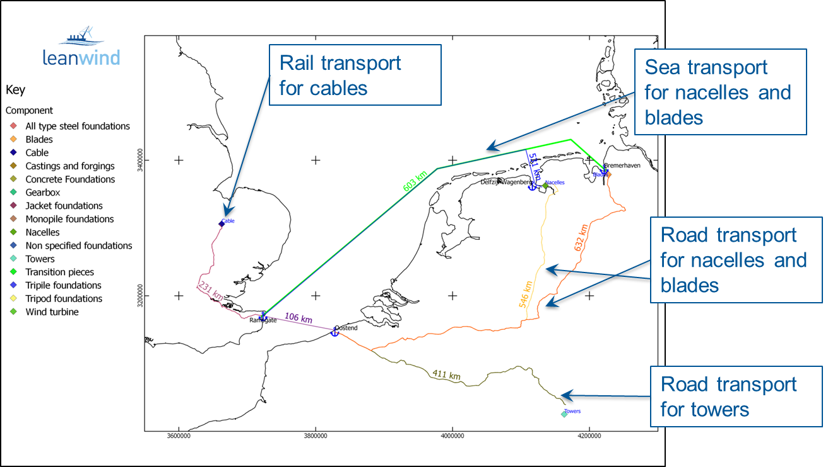
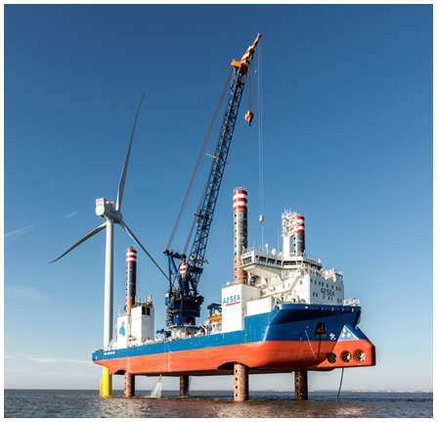
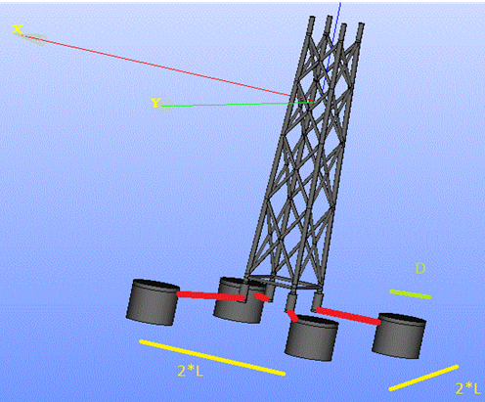
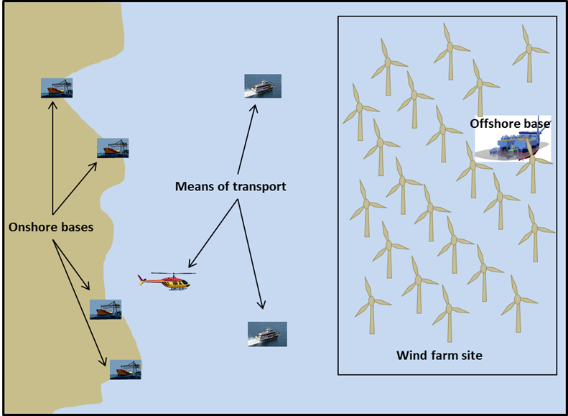
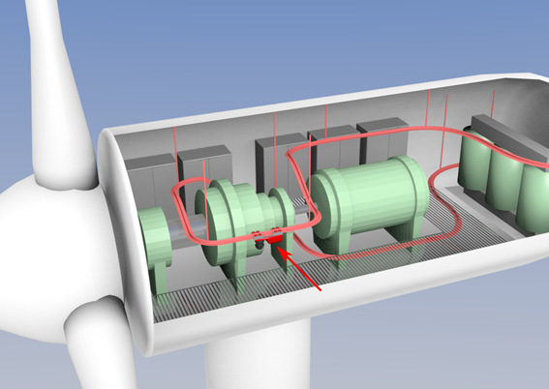
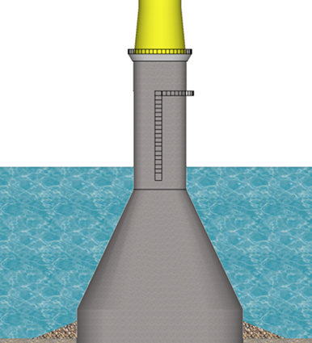
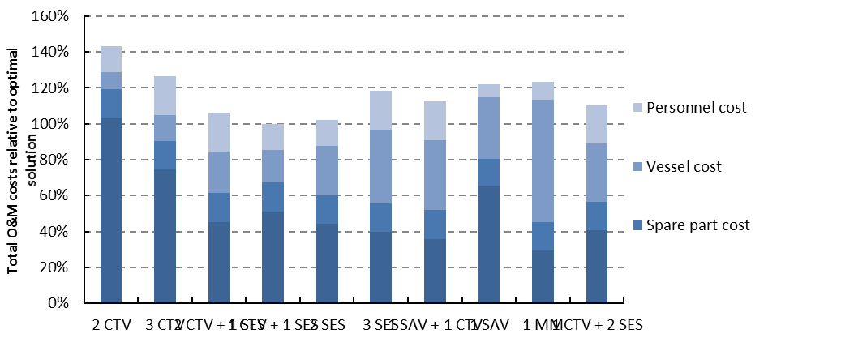
LEANWIND Innovations
FP7 Leanwind project committed to delivering innovations in foundation design, vessel development, O&M and logistical optimisations and more ….

Slide 5
LEANWIND Innovations
Innovations tested and validated from financial, technical and non technical perspectives.
This session focuses on Life Cycle Analysis (cradle to grave) and local impacts
Potential Environmental and socio economic impacts
LCA to assess environmental effects of different foundation types
Port of Oostende study
Financial models

Slide 6
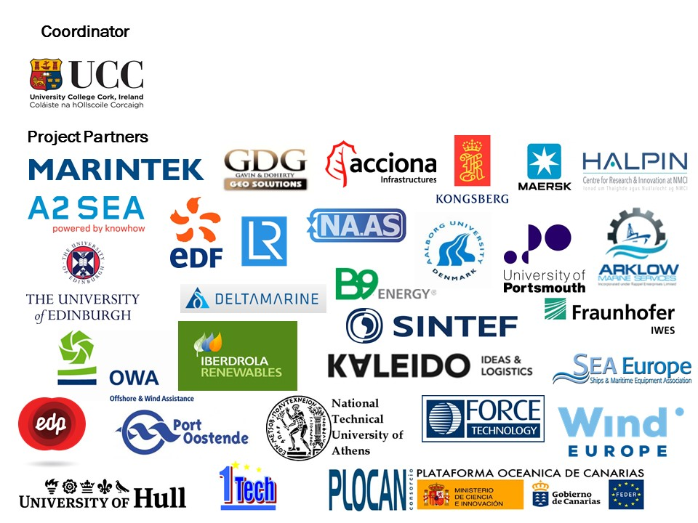
LEANWIND Consortium
52% Industry Partners
Aims to be industry relevant and not simply an academic project

