Slide 1
Onshore Manufacturing Surveillance
DNVGL Global Innovation Portfolio Project 77842004
Dr. Karl Steingroever

Slide 2
Contents
Introduction
Necessary manufac-turing surveillance
Example
Summary

Slide 3
Contents
Introduction
Necessary manufac-turing surveillance
Example
Summary

Slide 4
Introduction
Up to now Project Certification (PC) is done for offshore wind farms only.
For onshore wind farms PC is viewed as not favourable because of costs.
One key element of PC is manufacturing surveillance of wind turbine components.
A manufacturing surveillance concentrating on critical components can be beneficial for onshore wind farm projects.

Slide 5
GIP “Onshore manufacturing surveillance”
Global Innovation Portfolio Project (GIP) “Onshore manufacturing surveillance”
Market survey
Detection of critical components
Rating of site conditions
Rating of component manufacturers

Slide 6
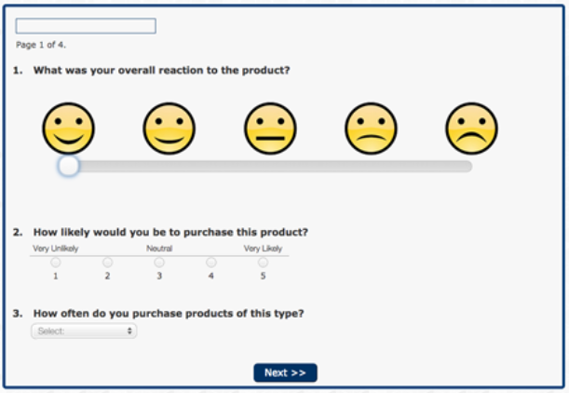
Market survey
A market survey was done with 35 companies in Europe (wind farm developers, wind farm operators and wind turbine manufacturers)
The wind turbine manufacturers in general have no
interest in manufacturing surveillance.
39 % of the wind farm developers and operators
showed their interest in a cost effective, intelligent manufacturing surveillance.
The market survey showed that for onshore wind farms there is a market for a cost effective, intelligent manufacturing surveillance although the market volume is unclear and cannot be specified in detail.

Slide 7
Contents
Introduction
Necessary manufac-turing surveillance
Example
Summary

Slide 8
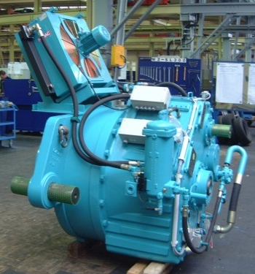
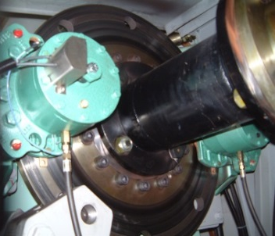
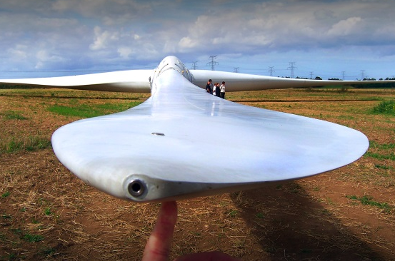
Detection of critical components
Detection of critical components:
Rating of the design calculations
Rating of recorded failures
Rating of the importance of a component for the structural integrity
Rating of the type of design
Rating of other information
Criticality of a component C_{r}:
C_{r} = (a ∙ A + b ∙ B + c ∙ C + … + n ∙ N + …) / (2 ∙ (A + B + C + … + N +…)) – 0,5
with n: status factor for a criterion
N: balancing factor

Slide 9
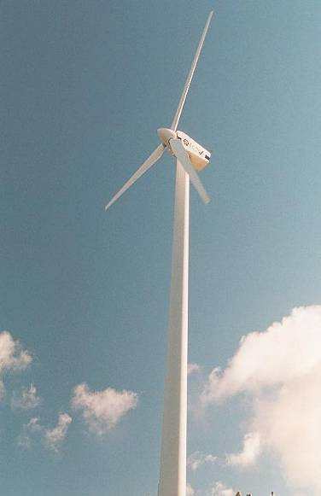
Rating of site conditions
Values for characterization of the site specific load increase / decrease:
Turbulence intensity TI
Weighing factor for wind speed
distribution W
Equivalent fatigue load potential L:
L = (Σ W_{i} · TI_{i}^{m})^{1/m}
Criticality of site conditions C_{s}:
C_{s} = L_{s} / L_{d} – 0,925
with L_{s} : equivalent fatigue load potential for site conditions
L_{d} : equivalent fatigue load potential for design conditions
???

Slide 10
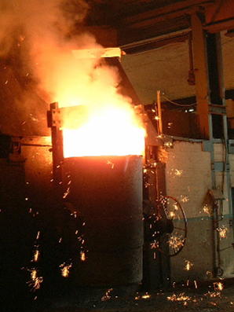
Rating of component manufacturers
Characteristics for rating the component manufacturer:
shop approval available
use of sub-supplied parts
reputation / experience with similar parts
size of shop / output
series production of part
qualification of staff
manufacturing equipment
experience from previous projects
Criticality of component manufacturer C_{m}:
C_{m} = (a ∙ A + b ∙ B + c ∙ C + … + h ∙ H) / (A + B + C + … + H) – 1,5
with n: status factor for a criterion
N: balancing factor

Slide 11
Contents
Introduction
Necessary manufac-turing surveillance
Example
Summary

Slide 12
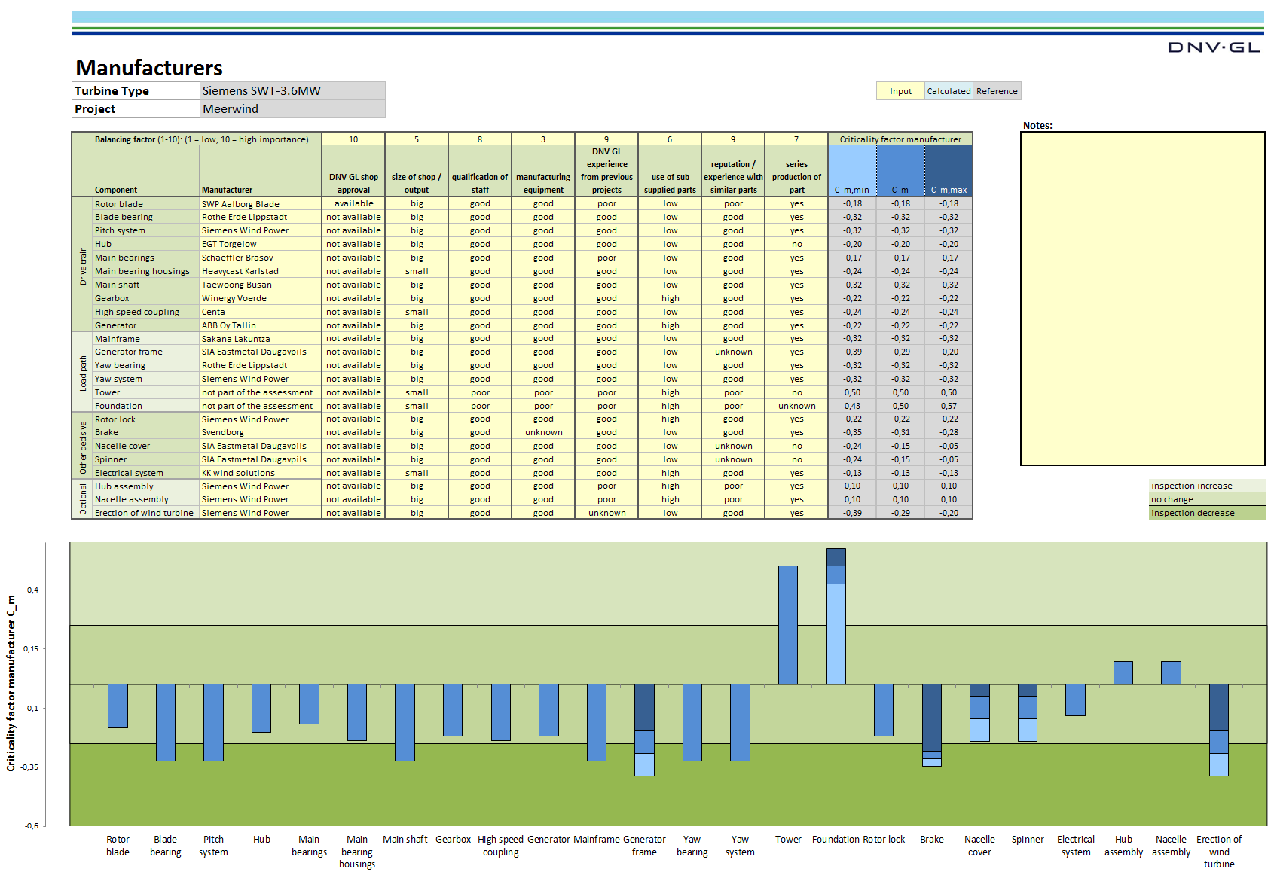
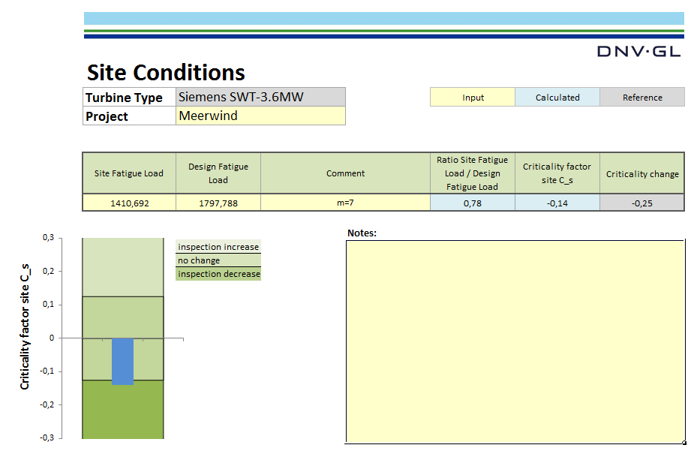
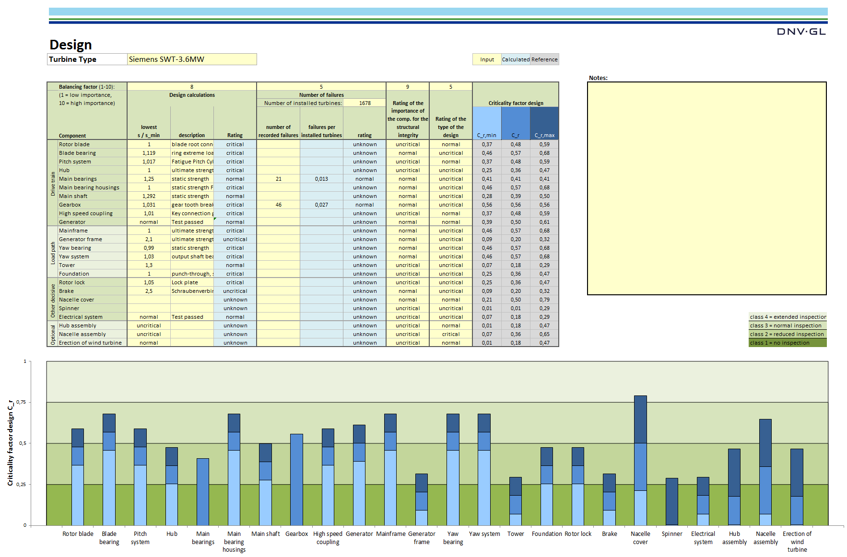
Practical example - intermediate results

Slide 13
Practical example - final results

Slide 14
Contents
Introduction
Necessary manufac-turing surveillance
Example
Summary

Slide 15
Summary
Up to now Project Certification (PC) is done for offshore wind farms only.
For onshore wind farms PC is viewed as not favourable because of costs.
One key element of PC is manufacturing surveillance of wind turbine components.
An intelligent approach was developed by which the amount of necessary manufacturing surveillance can be calculated (based on rating of critical components, site conditions and component manufacturers).
In many cases this approach leads to lower percentages of manufacturing surveillance compared to fixed values according to applicable guidelines and therefore to reduced costs. This was shown by an practical example.

Slide 16
Thank you for your attention
Dr. Karl Steingroever
karl.steingroever@dnvgl.com
+49 40 36149 7440

