Slide 1
Targeting a second to none EHS Performance through Ownership
Wind Europe Summit 2016 Hamburg 27th- 29th September

Slide 2
Why are we here?

Slide 3
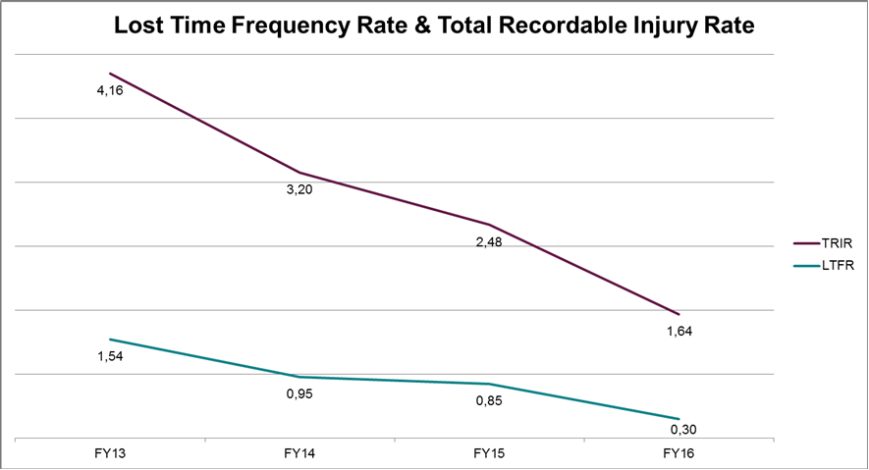
Safety Performance – Offshore FY13 to 16

Slide 4
“Ownership Transfer” in a project driven organization

Slide 5
Using a Marine Org Structure as Case Study
Captain
Chief Officer
Chief Engineer
2nd Engineer
2nd Officer

Slide 6
Examples from “everyday life”
EHS Inspections and Internal Audits
Preparing/revising Operational Documentation and Work Packs
On-scene Risk Assessing (“Pre-Task Planning” of unforeseen jobs)
Incident Investigation
Actively selecting or de-selecting EHS Advice and Support

Slide 7
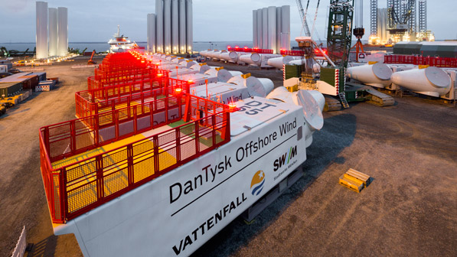
Neptune Site as pilot project
Complex operational landscape incl. multiple activities related to pre-assembly, retrofit and load-out
Clients very attentive to this part of the project LC due to first step in value chain after production
Weekly Safety Inspections conducted on site covering between 1 and 5 projects simultaneously
Inspections originally 100% scope of EHS – changed to a joint effort involving all key ops roles in site management

Slide 8
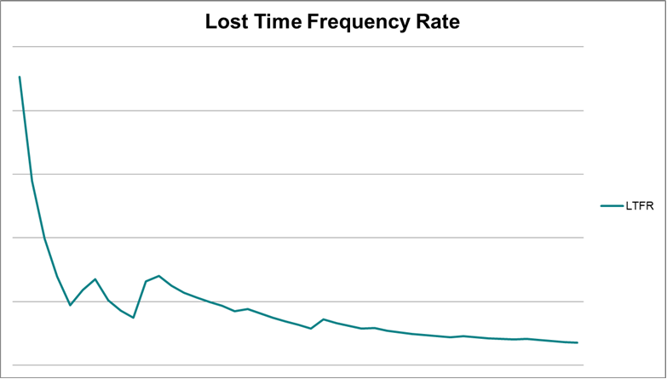
Safety performance for Neptune (FY13-16) – documented improvement as sign of success!

Slide 9
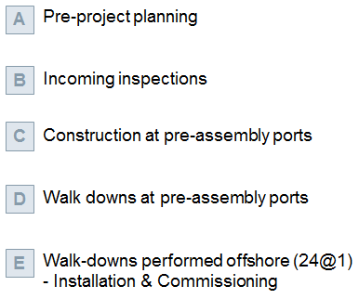
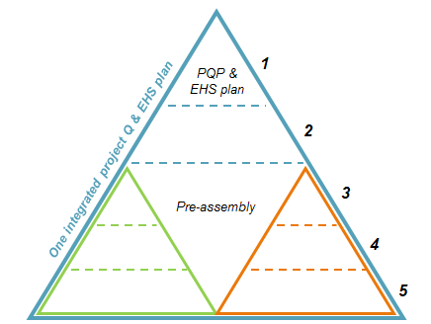
Additional measures optimizing the project execution from an EHS perspective
Implementation of the “Site Inspector”
as combined QEHS site management concept

Slide 10
A final Success Criteria?
Second to None
Safety Performance
Ownership Transfer
(Dual perspective)
Empowerment to Act in Projects
(Accountability culture)
Coaching by the Line Organization
(No managing or directing)

Slide 11
Hasse A. Andreasen Head of EHS Wind Power Offshore Princess Road, Princess Parkway Manchester M20 2UR, United Kingdom Phone: +44 (0) 7921 244 292 E-mail: hasse.andreasen@siemens.com
Q & A

