Slide 1
Wake effects at FINO 1 new observations since the construction of Trianel Borkum & Borkum Riffgrund I wind farms
R. Frühmann, T. Neumann,

Slide 2
Wind farm developments near FINO1
Trianel Windpark Borkum (completed 2015)
Alpha Ventus (completed 2010)
Borkum Riffgrund 1 (completed 2015)
Notes:
Progress is an unstoppable, transformative force that is building upon itself and accelerating.
New technologies, product innovations and materials are developing one on top of another at a dizzying pace and are rapidly changing the world, impacting the way we live and work.
And while Innovation makes us more efficient, more productive and more connected, there is a cost, and that cost is risk.
Because in the rush to make what is new and better available to all, people, companies and the environment can be exposed to potentially unintended, yet potentially harmful effects.
At UL, we use a rigorous, science-based approach, to stay ahead of emerging risks, including the environment, supply transparency, transaction security and even worker treatment.
Our scientists and engineers safeguard innovation by consistently inventing new ways to identify problems and help companies solve them

Slide 3
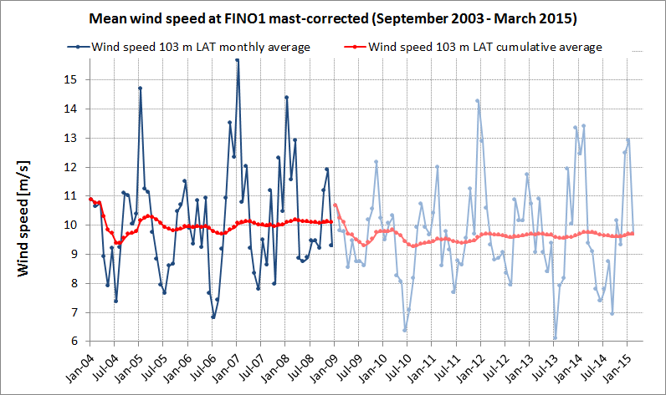
Outline
Changes in turbulence intensity over time
Influence on wind profile via Lidar
Structure of turbulence via spectral analysis
Notes:
With a track record spanning more than a century, UL has been redefining safety, from the public adoption of electricity to new breakthroughs in sustainability, renewable energy and nanotechnology.
The UL mark appears on 22 billion products worldwide, signaling peace of mind to consumers, customers, businesses and governments.
Last year, UL evaluated over 20,000 different types of products and conducted more than 92,000 individual product evaluations.

Slide 4
Changes in turbulence intensity

Slide 5
Changes in turbulence intensity
Alpha Ventus
Borkum Riffgrund 1
Trianel Windpark Borkum

Slide 6
Changes in wind profile
Lidar located at both FINO 1 and AV-Converter Station. Difference wind profiles (FINO1 – AV) show the trend more clearly.

Slide 7
Relative Lidar wind profiles
Lidar located at both FINO 1 and AV-Converter Station. Difference wind profiles (FINO1 – AV) show the trend more clearly.
Case 1:
Northerly winds,both
Lidars undisturbed
Case 2:
Easterly winds, F1 in
direct wake of AV04-06
AV undisturbed

Slide 8
Relative Lidar wind profiles
Lidar located at both FINO 1 and AV-Converter Station. Difference wind profiles (FINO1 – AV) plotted against wind direction

Slide 9
Spectral evaluation of sonic wind speed data

Slide 10
Spectral evaluation of wind speed
Sector width is 10°.
Spectra calculated using „pwelch“ function in MatLab for a 10 min period.
Data recorded at 20 Hz.
U-component of wind speed at 80 m.

Slide 11
Spectral evaluation of wind speed

Slide 12
Conclusions
An increase in turbulence intensity is clearly present, noticeable several km distant in the wake of medium sized wind farms.
Turbulence intensity indicates significant broadening of the wake.
Wind speed reductions well above the blade tip height are observed in Lidar measurements in the wake.
Turbulence spectra show very different behaviour depending on atmospheric conditions (e.g.: stability).
Explainable structure in the turbulence has only been identified in the near-field wake (< 1 km) under stable conditions.
The importance of multiple measurement locations to facilitate the interpretation of observed phenomena.

Slide 13
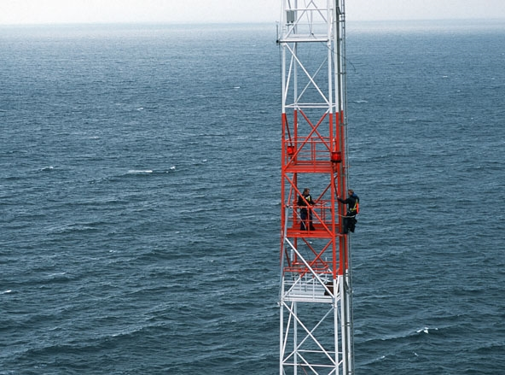
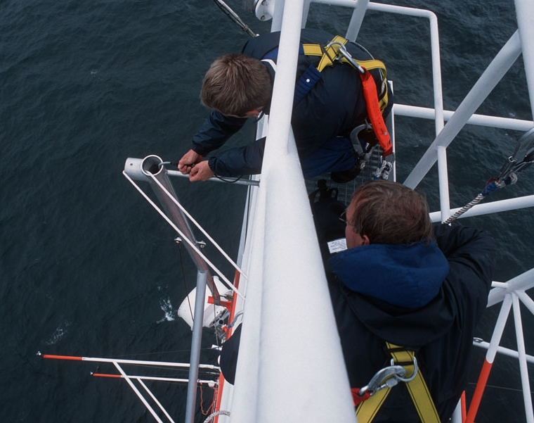
Thank you.
Photo: Jan Oelker

