Slide 1
Energy Storage
Key Note

Slide 2
DNV GL 2016 Market Pulse Survey Technology Driver
Which technology development will have the most significant impact on the trajectory of the energy industry’s evolution in the next 2-5 years?
36%
62%
of all respondents from across the energy value chain predicted that the evolution of energy storage technologies & applications will have the most significant impact

Slide 3
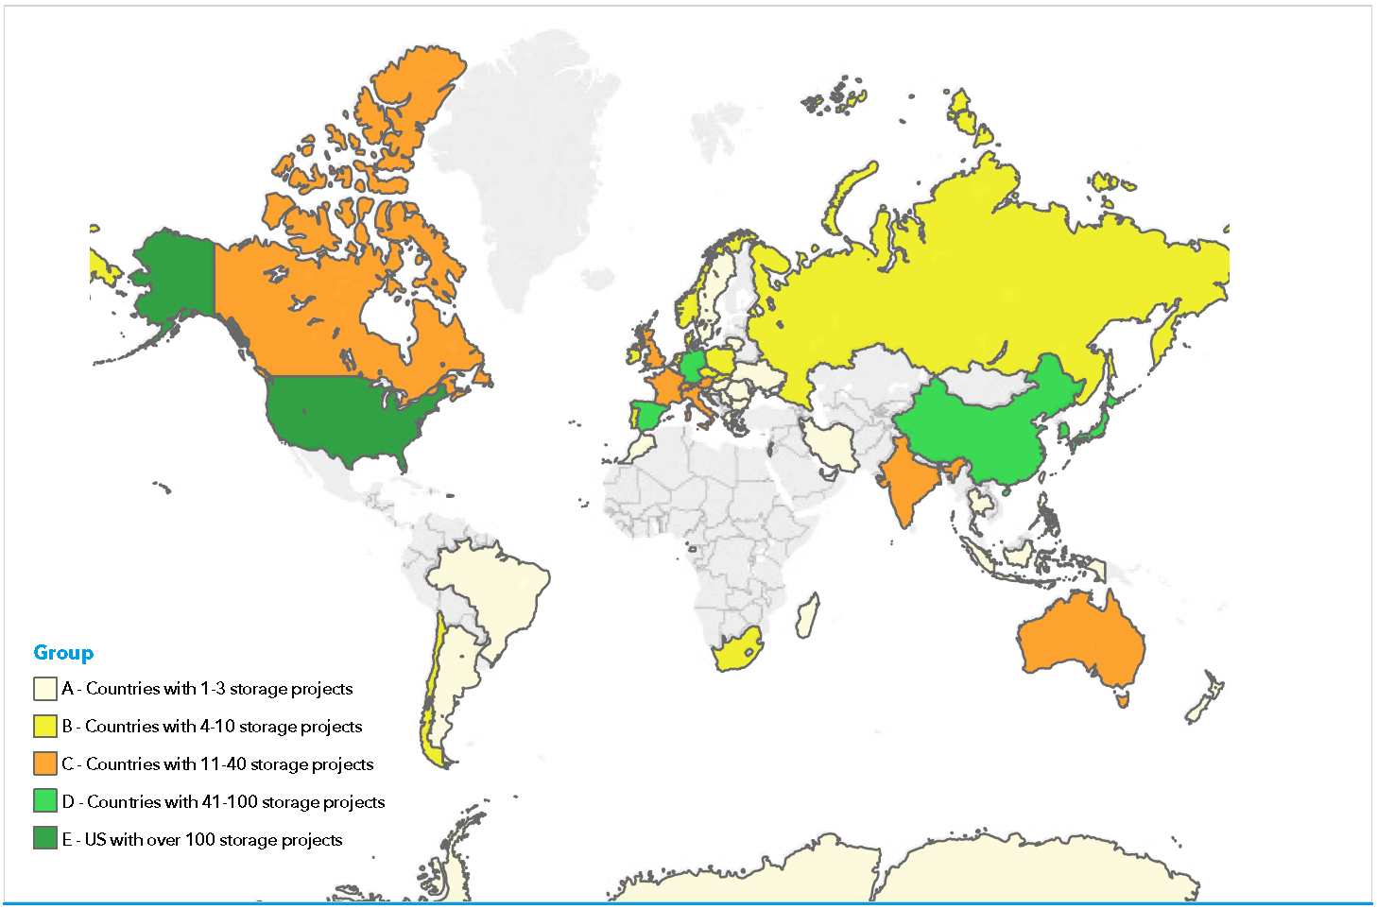
Global Map of Energy Storage Installations by April 2016
Notes:
Main countries today: United States, China, Spain and Germany
Every market has it´s specific market conditions – technology what might be good for one country might fail in an other (as of today)
The database excludes very small-scale installations such as domistic battery storage (e.g. Germany) and domestic hot-water storage. It also doesn´t treat conventional hydro reservoirs or Electrical Vehicles batteries as “storage”

Slide 4
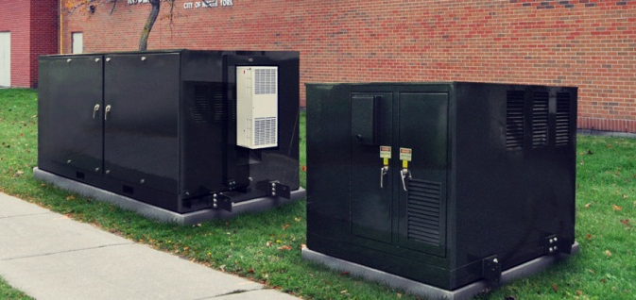
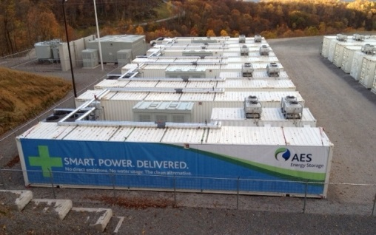
Types and roles of energy storage
Arbitrage – Using storage to trade for financial gain on the electricity markets
Synthetic Inertia – Required as more renewables penetrate the network
Load Shifting
Network Support – Voltage, thermal constraints, phase balancing…
Smoothing and controlling the output of renewable generation and plants
Ancillary Services (Frequency and Reserve products from the TSO)
Notes:
Arbitrage is driven by market prices, whereas load-shifting is driven by other factors. Also, it’s also clearly possible to include synthetic inertia, voltage control, managing thermal constraints etc in ‘Ancillary Services’.
It is worth mentioning that the roles of energy storage have different names and different definitions in different markets, depending on how those markets and the regulatory systems have developed. Over time, we expect these markets to converge, but it may take a long time.

Slide 5
Technology Overview
Electrical Energy Storage Systems
Mechanical
Thermal
Chemical
Pumped-storage Hydropower
Transport-Sector
Heat-Sector
Electro-chemical
Lithium-Ion Battery
Electrical
Lead Acid Battery
NaS Battery
Redox Flow Battery
Super Capacitors
Hydrogen Storage
SNG
CAES
LAES
Flywheels
Thermo-chemical
Sensible Thermal
Latent Thermal
…and many more
Notes:
If we look at technologies, there are lots of different options, not only in the electrical Energy Sector, but also in the Heat-Sector or the Transport-Sector. Most used today (besides Pumped Hydropower) are Lithium-Ion Batteries, lately responsible for a major part of installed capacity.
Of course different types of storage purpose may end up in the use of different technologies – this needs to be evaluated in each and every case.
LAES: Liquid Air Energy Storage
SNG: Synthetic Natural Gas

Slide 6
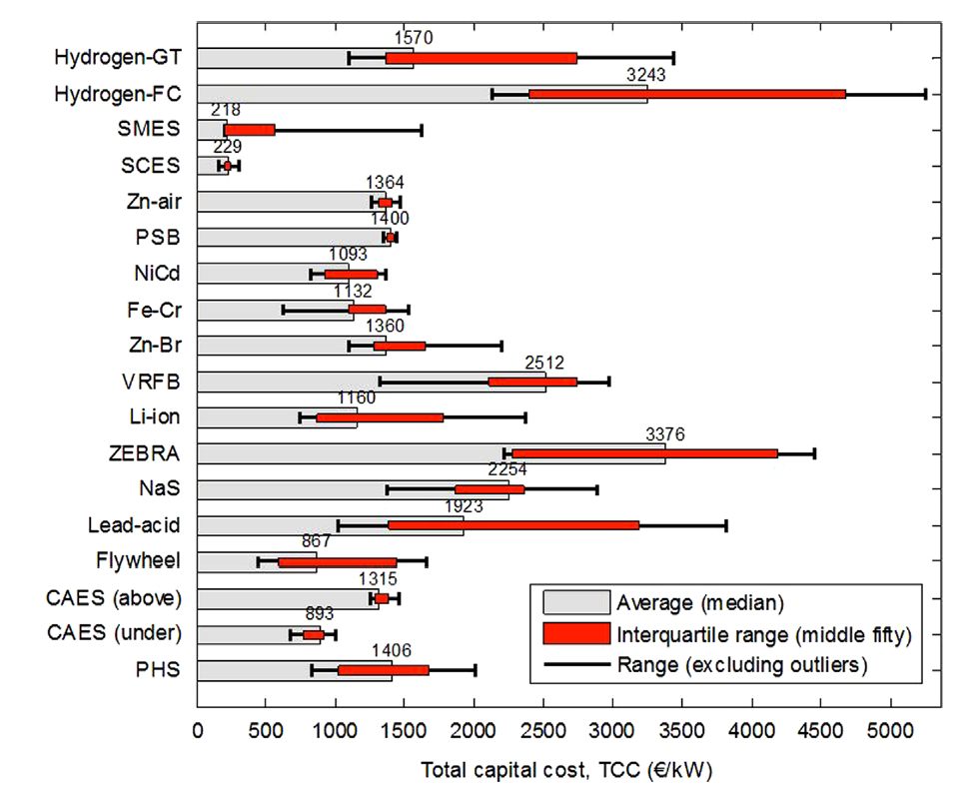
Costs - Battery Costs are dropping rapidly
Limited consensus in price forecasts other than they will continue to decline – for storage, much more rapidly than anticipated even two years ago!
Ref: Zakeri et al, Electrical energy storage systems: A comparative life cycle cost analysis, 2015
Source: Rocky Mountain Institute
Notes:
If we look at the costs, the different graphs show the dilemma we find: should we look at €/installed capacity? Capacity in kW or in kWh? How many load cycles do we take into account? So for different storage cases different technologies might be the cheapest. Is there an acceptable approach to something equal to “LCOE” we know for wind (Levelized Cost of Energy) – a Levelized Cost of Storage, which of course needs to be calculated for the different use cases – as it is proposed for example by the colleagues of Lazard.
At least for single technologies we can see that costs are declining – opening opportunities which will boost the use cases for storage in the future.
The LH graph is per kW, and the RH graph is per kWh. ‘Per kWh’ means per unit of storage capacity, NOT per kWh of energy exported.
The RH graph is for the battery only: the rest of the system (inverters, control, balance of plant etc) is also significant.
The application radically affects the cost of storage: for example, the costs for a storage device used for frequency response (i.e. most of the time doing nothing) will be very different from the same device used for load-shifting, or balancing renewables.
Hydrogen-GT: Gas Turbine?
Hydrogen-FC: Fuel Cell
SMES: Supraconducting magnetic energy storage
SCES: Super Capacitor Energy Storage
Zn-air: Zinc-Air-Battery
PSB: Polysulphide Bromide (Fuel Cell technology)
NiCd: Nickel-Cadmium batteries
Zn-Br: Zinc Bromine batteries
VRFB: Vanadium Redox-Flow Batteries
Li-Ion: Lithium-Ion Battery
ZEBRA: Zero Emissions Batteries Research Activity: Sodium Nickel Chloride Battery
NaS: Sodium-Sulfur battery
Lead-Acid: Bleiakku
Flywheel: “Schwungrad”
CAES (above): Compressed Air Energy Storage
CAES (under): Compressed Air Energy Storage
PHS: Pumped Hydroelectrc Storage

Slide 7
Overview of Global Storage Applications
Storage Services | USA | Germany | UK | Spain | Netherlands | France | Italy | Japan | Korea | China | Australia | South East Asia
Frequency Regulation & Spinning Reserve |  |  |  |  |  |  |  |  |  | 
PV + Storage System |  |  |  |  |  |  |  |  |  |  |  | 
Wind + Storage System |  |  |  |  |  |  |  |  |  |  |  | 
Community Energy Storage |  |  |  |  |  |  |  |  |  |  |  | 
C&I Customer Backup |  |  |  |  |  |  |  |  |  |  |  | 
Substation Support |  |  |  |  |  |  |  |  |  |  |  | 
Residential Storage |  |  |  |  |  |  |  |  |  |  | 
Source: DNV GL
 Very Active  somewhat active
Distributed PV and storage is the most widespread and expanding application
7
Notes:
Different markets require different storage services, driven by different market conditions.

Slide 8
Looking ahead
Energy Storage already makes economic sense for certain applications.
There is no decision on the technology of the future in storage yet.
Sector coupling with Heat and Transport will play an important role in the future.
There are lots of different barriers in different countries that makes it difficult for storage technology to participate in the energy markets.
Prices are falling – Storage solutions will become more attractive.
Substantial Convergence and Standardisation will happen (e.g. Gridstor – Project https://www.dnvgl.com/energy/brochures/download/gridstor.html)
Distributed PV combines with small Storage devices may become the driver for the storage industry.
Notes:
A note of caution at the end:
Typically losses are around 10-20% of the input energy. That is a big economic penalty to overcome.
For some battery storage technologies, the energy used to manufacture the devices is about 1/10 of the energy imported and exported over the device’s entire useful life. That also is a big penalty to overcome. In comparison, for pumped hydro storage the ratio is over 200:1.

Slide 9
The future is electric and using Storage will be part of the solution!
Volker Köhne
volker.koehne@dnvgl.com
+49 4856 901 22

