Slide 2
We are looking forward to meeting you at the Bella Center in Copenhagen this April! Pass by our stand to book your spot for Annual 2026 in Madrid!
Find us at Stand D-B10, Hall D

Slide 3
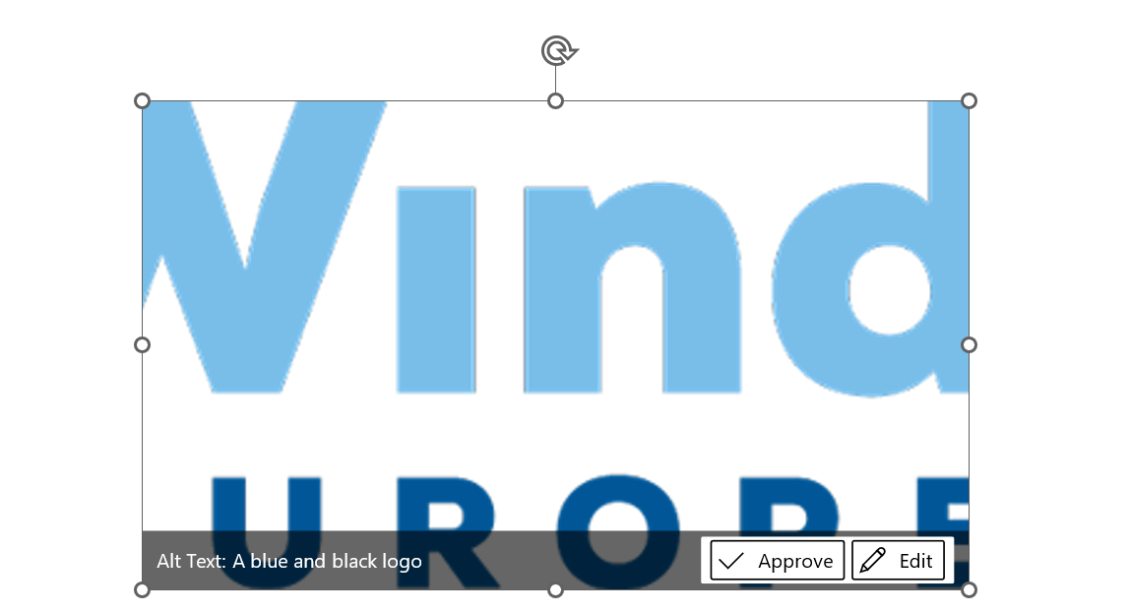
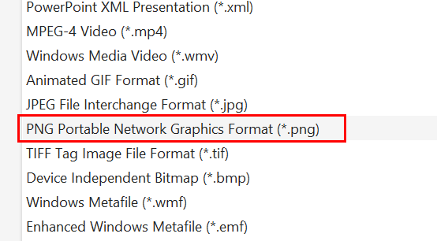
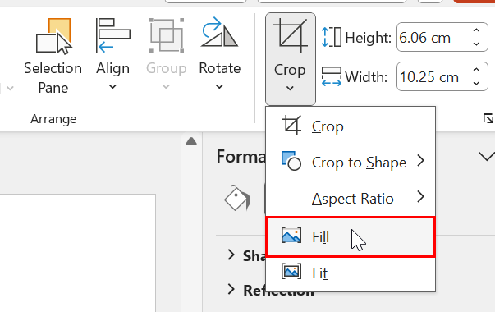
HOW TO EXPORT YOUR BANNER
TROUBLESHOOTING
When you are finished editing, select “File > Save as”
And select “PNG format” from the dropdown:
If your logo is cut:
Double-click on the logo, go to “Crop” and select “Fill”:
Select “Desktop” as the destination and export the image there.
Your banner is now ready to post to social media!

